Slide 1
Interactive Dashboard:
Air Quality Trends and Socio-Economic Parameters
Sarah Sinclair
8/4/2022

Slide 2
Abstract
This project aimed to create an interactive dashboard to visualize the hourly ambient concentrations of criteria air pollutants in recent years nationwide.
This data was combined with supporting data from the census to better characterize the areas and populations affected by these pollutants.
The completed dashboard can be examined for information of interest- such as patterns, clusters, or outliers in the distribution of the air pollution around surrounding populations.

Slide 3
Tasks
Data Collection
Data Processing
Dashboard Creation
Analysis
Literature Review
Results

Slide 4
Data
Hourly Air Quality Readings
Included Useful Fields for Site Number, Latitude, Longitude, Date, Time, Pollutant, and Concentration
Census Fields Including Median Income, Population Measures, and Population Counts for Various Races

Slide 5
Dashboard Components
Map of Average Pollutant Concentrations by Air Quality Site
Graph of Average Concentration by Month of the Year
Chart of Average Concentrations by Day of the Week
Chart of Average Concentrations by Time of Day
Plot of Pollutant Concentration by Demographic Variable
Filterable to Specific Pollutant, Time Range, and Demographic Variable

Slide 6
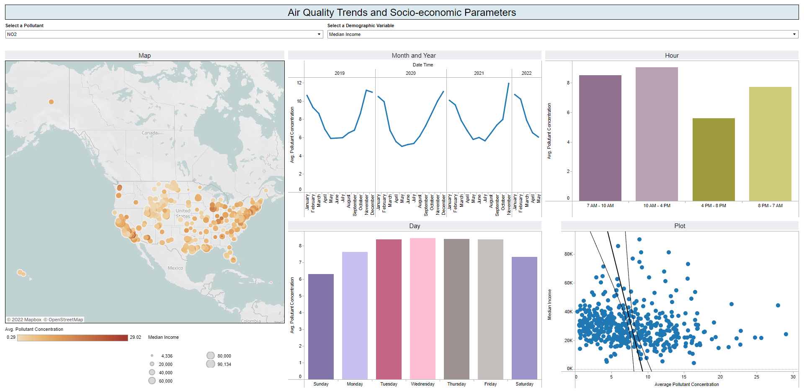
Demo Workbook: Air Quality and Demographics (tamu.edu)

Slide 7
Analysis
Map Showcases the Lack of Measurement Sites in the Majority of the Nation
PM10 Highest Average Concentrations
Similar Temporal Patterns in NO2 and PM10 Measurements
PM2.5 Most Spatially Dispersed
Evidence of Environmental Injustice Especially Considering Income

Slide 8
Further Uses
Potentially Updatable for Future Years of Data, Additional Air Pollutants, or Census Fields
Analysis of Variance Over the Course of the COVID Pandemic or Other Time Periods
Regional Analysis

Slide 9
Thank You.
Questions?

