Slide 1
Transportation and Health: The Mediating Role of Sociodemographic Factors
Maya Ghosh
2022 Summer Intern
August 4, 2022
Notes:
Hi, my name is Maya Ghosh. I’m a student at Johns Hopkins University, and this summer I was a CARTEEH intern under Dr. Tara Ramani. I would like to thank her for her guidance throughout this project, her advice and expertise was crucial to this project. Today I am going to be talking to you about transportation and health, and the mediating role of sociodemographic factors

Slide 2
Introduction
Prevalence of health disparities based on sociodemographic factors
Transportation and its externalities are associated with health impacts
How can we understand the relationship between transportation, sociodemographic factors and health?
Notes:
Because I am currently studying public health, I wanted to keep my project closely focused on health. One aspect of public health I’m interested in learning more about, and particularly concered with, is the issue of health disparities.
A health outcome is considered a health disparity when the health outcome is seen to a greater or lesser extent between populations, there is disparity
There isn’t one solid definition for the term of sociodemographic variables, but generally speaking sociodemographic factors refer to different social and physical characteristics and variables captured through demographic information – such as race/ethnicity, age, income, sex and education level.
While much more familiar with the health side of things, from my studies I knew that transportation and its externalities are associated with health impacts.

Slide 3
The Process
How did I want to conceptualize the relationships between transportation, sociodemographic factors and health?
Notes:
So, while I initially thought that a consideration of these relationships would be sufficient to serve as the basis of my research project, it became evident that these factors are complex and interrelated, and therefore I had to figure out how I wanted to conceptualize these relationships between the three variables I had outlined earlier.

Slide 4
Transportation-Related Factors
Sociodemographic Factors
Health Impact
Sociodemographic Factors
Transportation-Related Factors
Health Impact
Notes:
The first is that we have transportation, which has associated health impacts -- but exposure to these factors and thus the ultimate health impact can be dictated by sociodemographic factors. For example, residential proximity to roadways is associated with increased air pollution exposure, which is associated with certain health impacts -- and sociodemographic factors such as income could modify this relationship to either having greater or less residential proximity
The second relationship is that sociodemographic factors are associated with certain health impacts, and transportation factors can modify this relationship. For example, age may lead to certain health impacts, and lack of transportation to healthcare services can exacerbate an adverse health impact.

Slide 5
Transportation-Related Factors
Sociodemographic Factors
Health Impact
Sociodemographic Factors
Transportation-Related Factors
Health Impact
Notes:
While the second conceptualization is important, the research would be more broad and therefore in order to keep the focus on transportation specifically, I picked the first conceptualization of this relationship to serve as the foundation of my research project.

Slide 6
The Process
How did I want to conceptualize the relationships between transportation, sociodemographic factors and health?
Research Question: How might an individual’s economic status or race/ethnicity modify the pathway between transportation and health?
Literature review
Finding literature on the relationship between transportation-related factors and health
Finding evidence of disparities in exposures to transportation-related factors associated with sociodemographic factors of interest
Synthesis
Notes:
Ultimately, my research question ended up being: How might an individual’s economic status and race/ethnicity modify the pathway between transportation and health?
- Choose specific variables because I wanted to focus in the scope of my paper
With a clear understanding of how I was going to be analyzing these relationships, I then went about conducting a literature review.
At first looked more broadly for a general overview of transportation-related factors which have a relationship with health outcomes, then looked specifically into disparities in exposure to these factors based on sociodemographic factors of interest
Final step: synthesizing the relationship between transportation-related factors and health with the relationship between transportation-related factors and sociodemographic factors

Slide 7
Results
Four transportation-related factors of interest:
Residential proximity to high-traffic roadways
Mode of transportation
Access to transportation
Community Severance
Wide range of health impacts
Encompass mental and physical effects
Notes:
Ultimately came up with 4 factors of interest. These factors are closely related – for example, some modes of transportation are more accessible than others. Despite this, the pathways which lead to particular health outcomes
Residential proximity: Low-income individuals, and those who are racial/ethnic minorities are more likely to live in close proximity to high-volume roadways
Mode of transportation: Low-income and minority populations are more likely to rely on alternative modes of transportation compared to automobile usefrs , and communities of color make up the majority of transit users.
Access to transportation:. Transportation may be inaccessible to low-income individuals due financial barriers, and disadvantaged communities more frequently do not have well-connected, reliable public transit options.
Community severance occurs “when transport infrastructure or motorised traffic acts as a physical or psychological barrier to the movement of pedestrians”
- Low-income and minority communities have been found to be less walkable, and have historically been where transportation infrastructure is developed– leading to increased severance.
Associated Health impacts include cardiovascular disease, stress and sleep disturbance, respiratory illnesses and reproductive health effects
While there is an association between health and these transportation-related factors, there is often an intermediate varible which is associated with the health impact. For example, it is not just simply living near a high-traffic roadway which can impact health, but it is the fact that residential proximity leads to greater exposure to air pollution and noise pollution, and these factors are associated with adverse health impacts.

Slide 8
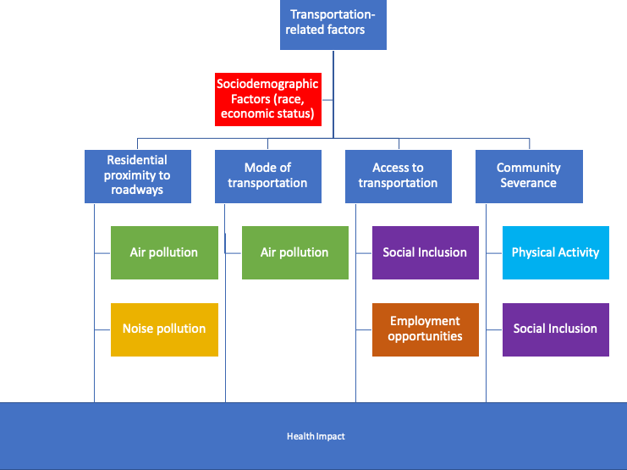
Notes:
Here is an overview of the relationships between transportation-related factors, sociodemographic factors and related outcomes which lead to health impacts.

Slide 9
Conclusion
Found associations between sociodemographic factors of race/ethnicity and income and transportation-related factors, which are associated with health impacts
Unequal distribution of the burdens and benefits of transportation
Transportation as an environmental justice concern
Notes:
I also want to acknowledge that while these associations can be drawn, it is not fair to say that transportation is the definitive cause of these health outcomes – as noted earlier, there is a wide variety of health disparities which are related to sociodemographic factors, and transportation is just one of these factors. Regardless, it is important to think about transportation and health impacts, because being able to pinpoint where health may be detrimentally affected means it’s possible to potentially mitigate these concerns, therefore hopefully reducing the incidence of associated health impacts.
Environmental justice: “the fair treatment and meaningful involvement of all people regardless of race, color, national origin, or income with respect to the development, implementation and enforcement of environmental laws, regulations and policies”
- Due to the fact that the burdens of transportation has fallen disproportionately on certain communities, it is important that these groups are involved in future transportation decision-making and planning processes to prevent the perpetuation of this undue amount of burden on these communities

