Slide 1
TTI Summer Research
Caroline Cordova

Slide 2
Table of Contents
01
02
03
04
What is the research?
Goal of Research
My Tasks
Independent Research
Here you can describe the topic of the section
Here you can describe the topic of the section

Slide 3
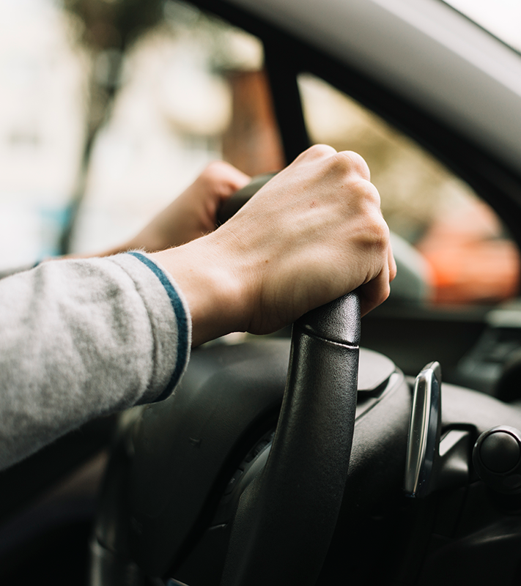
01
What is the Research?

Slide 4

Purpose
Transportation = key to everyone's day to day lives
Has positive as well as negative impacts on health
Extremely relevant in densely populated cities
  Ex: shanghai, new york, Ahvaz
Climate change increasing
Important to start implementing lifestyle changes in citizens

Slide 5
SMART Objectives
8 pathways
Vehicle Emissions, Connectivity, Health Destinations, Active Transport, Green Space, Runoff, Safety, Traffic Noise
  Many strategies within
  Ex: promoting bicycle culture in the workplace
  Implementing speed reduction strategies

Slide 6
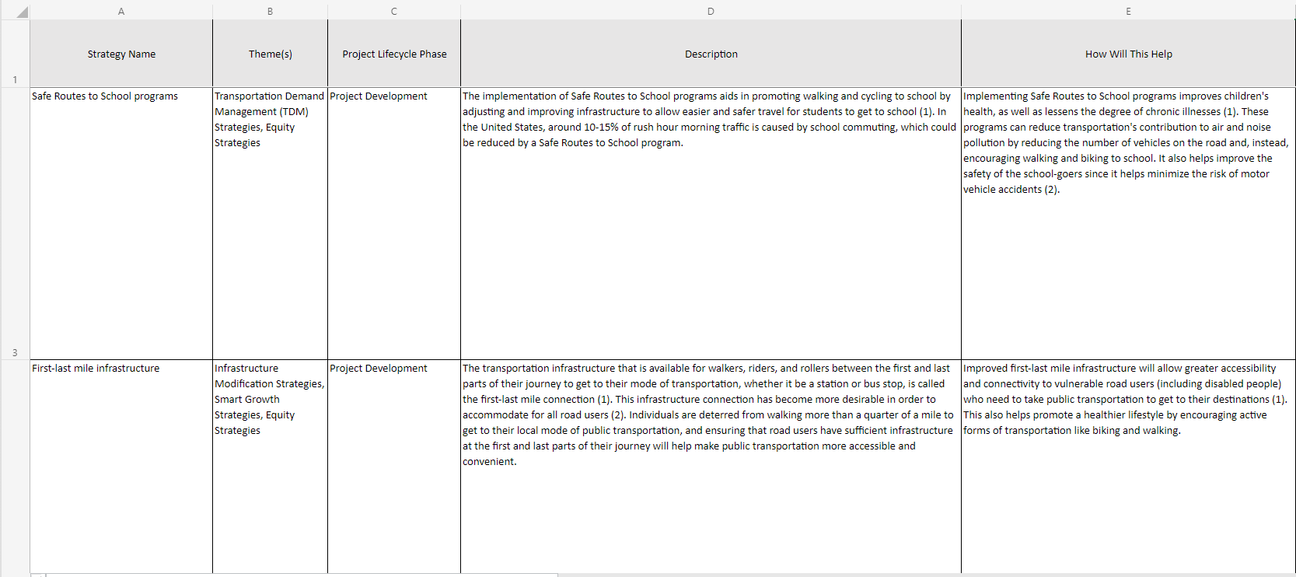

Slide 7
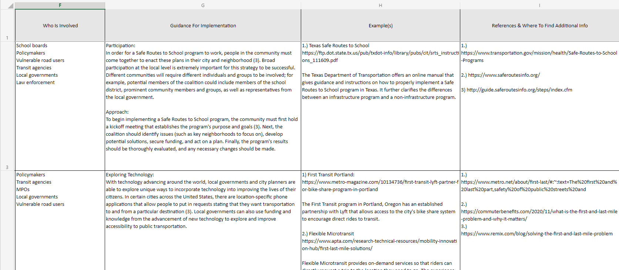

Slide 8
02
Goal of Research

Slide 9

SMART Goals
Develop a comprehensive conceptual model of 8 pathways that link transportation to numerous health outcomes
Develop applicable ideas people as well as government entities can implement
Emphasis on Urban Areas
Formulate into a web-based tool
Basic language

Slide 10
03
My Tasks

Slide 11
My Tasks
Background Reading
Literature Evaluation
Gather information
Put on Spreadsheet

Slide 12

Task
Given objective active transport
30 strategies
create/find….
  Description
  How this will help?
  Who is involved?
  Guidance for Implementation
  Examples
  References & Where to find additional information

Slide 13
04
Independent Research

Slide 14
Proposed Question
Does mom’s exposure to pollution/car emissions result in low birth weight/birth defects in baby?

Slide 15
Why conduct this Research?
Background
Purpose
Benefits

Slide 16
My Tasks
Formulate Thesis ?
Select Literature
Literature Review
Research Paper

Slide 17
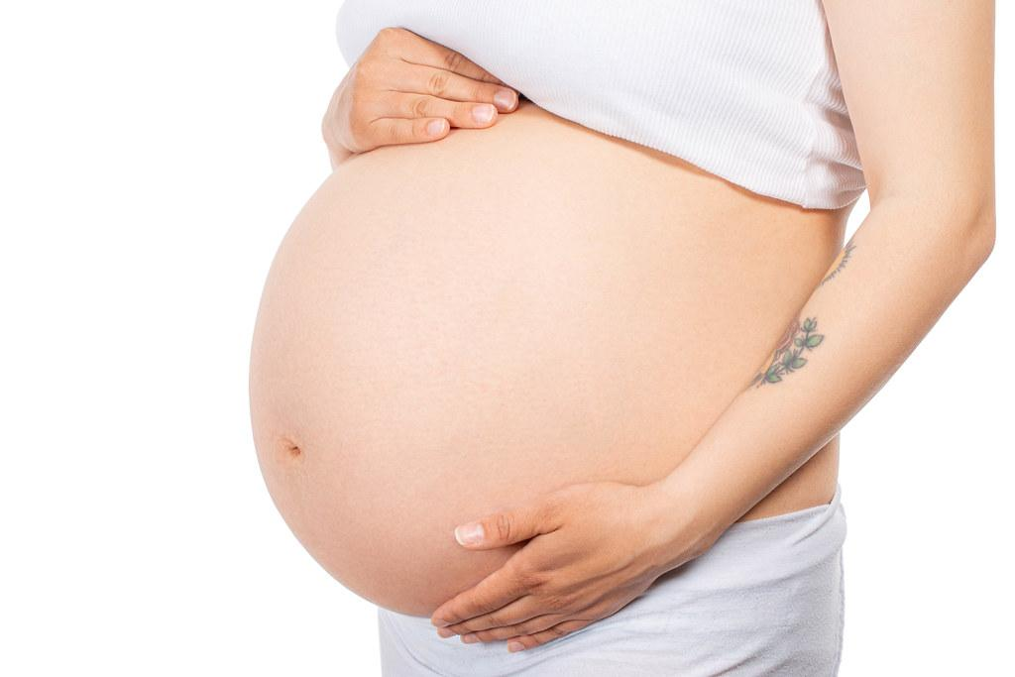
Findings
Pollution has a strong correlation with causing low birth weight
Important to consider other factors
Also can cause things such as asthma in children post birth
Different pollutants can have different effects on the baby
Continuous studies should be done to clear up any discrepancies

Slide 18
Questions?

