Slide 1
www.carteeh.org

Slide 2
Lecture #27: Observational Analytical Epidemiological Studies
Raed Khalid Alotaibi
Imam Abdulrahman Bin Faisal University
rkalotaibi@iau.edu.sa +966508284310
Declaration of any conflicts of interest
Lecture Track(s): HT
Notes:
Health Track (HT)—mainly targeted at urban planners, transportation planners, and engineers with limited knowledge of public health-related concepts;
Transportation Track (TT)—mainly targeted at environmental epidemiologists and public health professionals with limited knowledge of transportation-related concepts; and;
Planning and Policy Track (PPT)—mainly targeted at planners, civil servants, and policy and decision makers with particular interest in the science-policy link.

Slide 3
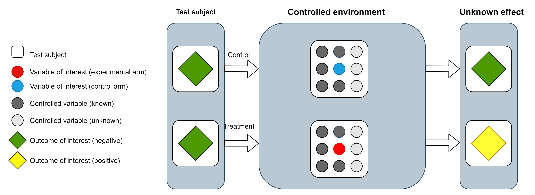
Experimental Design and Causal Inference
A procedure conducted by changing the level of the variable of interest in a controlled environment to examine the effect on an outcome.
Notes:
What is an experiment?
A procedure conducted by changing the level of the variable of interest in a controlled environment to examine the effect on an outcome.
Let's look at this diagram → This is a procedure for an experiment, we have two test subjects that are identical (comparable) → we a controlled environment (meaning all variables for both subjects are similar, this includes internal, external, known and hidden variables) + the only difference between the two subjects is the variable of interest (represented in blue and red) → we then see the effect of changing only the variable of interest on our previously identical subjects (we say previously because now they are different in terms of the variable of interest) → if there is a difference in the outcome of interest then we may say that that change is attributable to the change in the variable of interest, or in other words the change in the variable of interest caused a change in the outcome of interest.
I would like to point out that a necessary condition for this claim is temporality (or time) in that the change in the variable of interest happened before the outcome of interest.

Slide 4
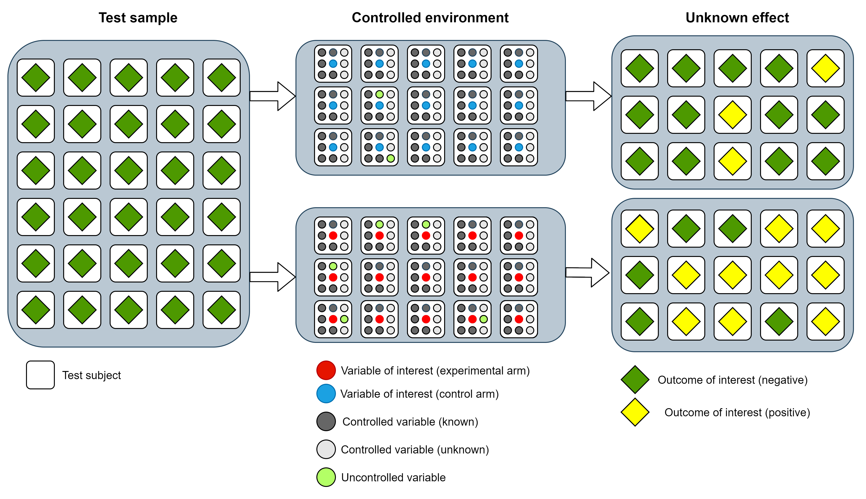
Experimental Design and Causal Inference
Notes:
However, in experiments involving biological species the variables to control for are many and complex with many unknown or hidden variables that may confound the results.
The image represents a experiment in biological species.
As we can see we have a test sample → we assign the samples into control arm or a test arm → the objective is to make them comparable as possible, however, because the complex nature of biological system we can see this it is very difficult to have a fully controlled environment.
----------------- Challenges facing environmental epidemiological studies
Studies investigating whether certain exposures are harmful to an individual are unethical to conduct. Researchers studying environmental exposures for their harmful effects rely on observational studies to investigate whether a certain exposure is causally associated with an outcome or disease. However observational studies have several limitations including the following:
-Prone to ecological bias
-Measuring the degree of exposure on an individual is difficult (e.g. how much air pollution has the individual been exposed to during the past year?)
-Cannot rule out confounding
-Measuring the outcome in some cases is difficult (e.g. measuring stress or depression)

Slide 5
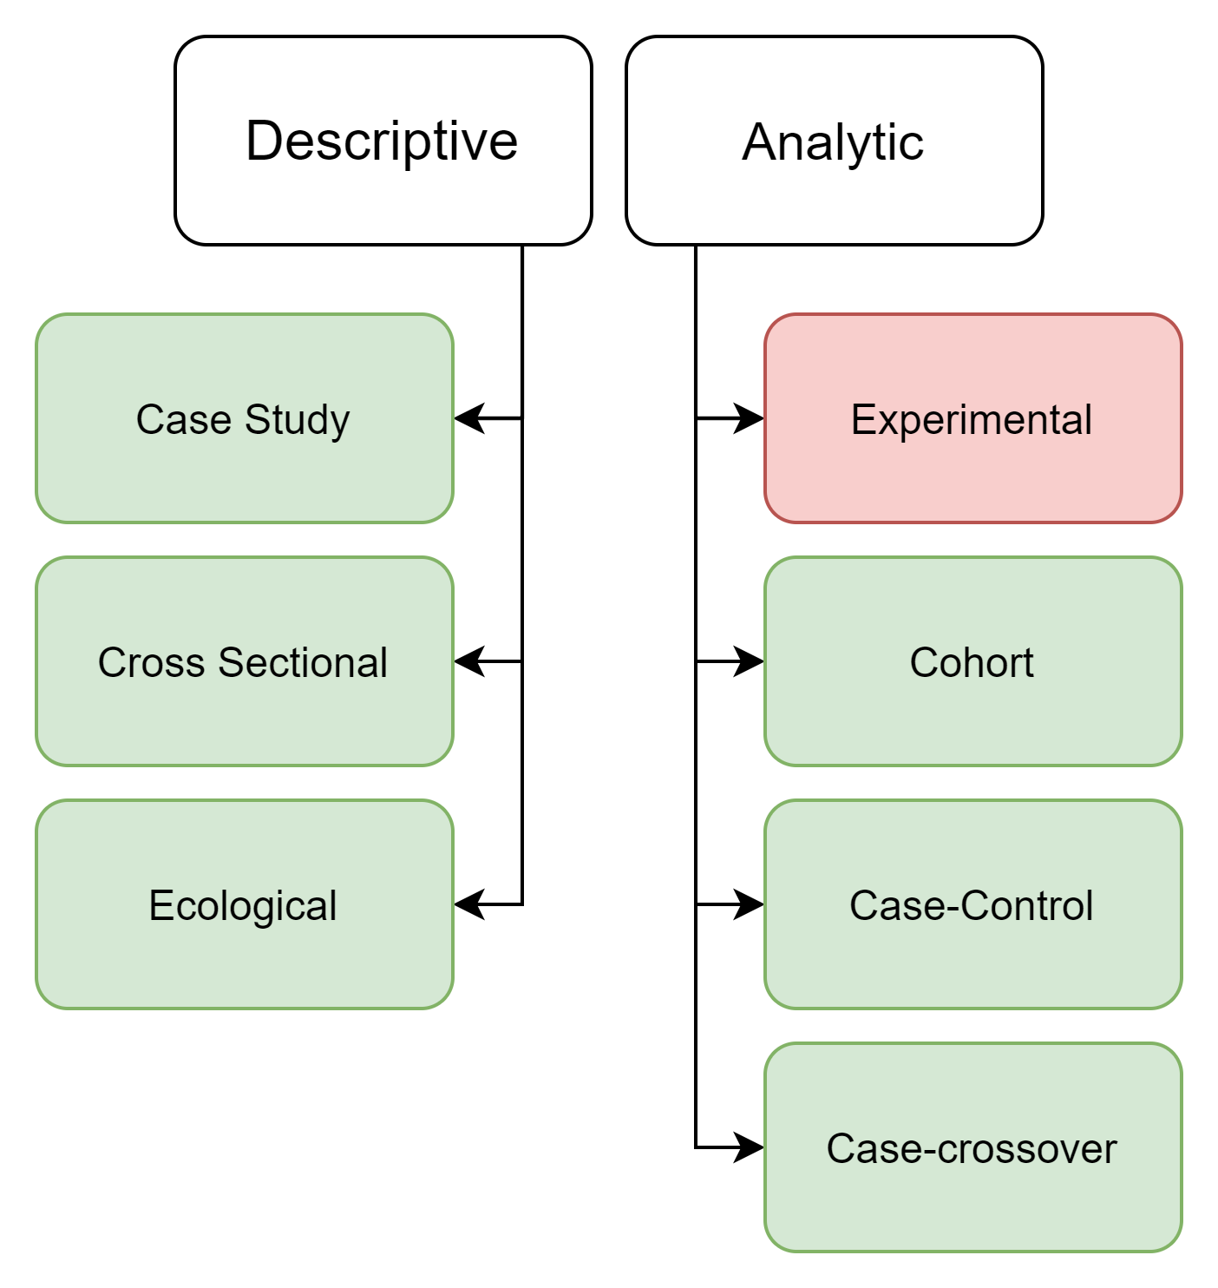
Study Designs and Types
Notes:
Epidemiological studies may be divided into descriptive or analytic.
In descriptive studies there is no comparison group while analytic studies have a comparison group.
Furthermore, analytic studies are divided into experimental or non-experimental (also known as observational).

Slide 6
Study Designs and Types
 | Descriptive | Analytic
Comparison group | No | Yes
Nature | Observational | Observational or Experimental
Answers the … | What, who, where and when | Why and how
Describes the … | Place, person and time | Strengths of association between X and Y
Hypothesis | Generates hypothesis | Test hypothesis
Examples | Case studies, cross-sectional, and ecological | Experimental, cohort, case-control and case-crossover
Notes:
The tables compare Descriptive with Analytic study designs.
Epidemiological study designs may be categorized into either descriptive or analytic designs.
Analytics studies utilize a comparison group that has been explicitly collected while descriptive studies don’t.
Descriptive studies answer the who, where, or when in relation to what (outcome).
Analytic studies answer the why and how
Descriptive studies also describe the person, place and time.
Person→ Age, sex, race, occupation, comorbidities …etc.
Place → Where the events occurred
Time → When the events occurred
Analytic studies describe strength of association between X and Y
Descriptive studies assist us in the following manner
Generate hypothesis for future research
Provide information about the event (disease, conditions, risk factor …etc.)
Provide clues to identify a new disease, adverse health effect, or a risk factor
Describe the extent or distribution of the event
Identify the population at increased risk of the events
Assist in policy making and resource allocation
Analytic studies are used to test a hypothesis (is X associated with Y?)
Examples of Descriptive study types:
Case Studies
Ecological Studies
Cross-sectional studies
Examples of Analytic study types:
Experimental studies
Cohort
Case control
Case-cross over

Slide 7
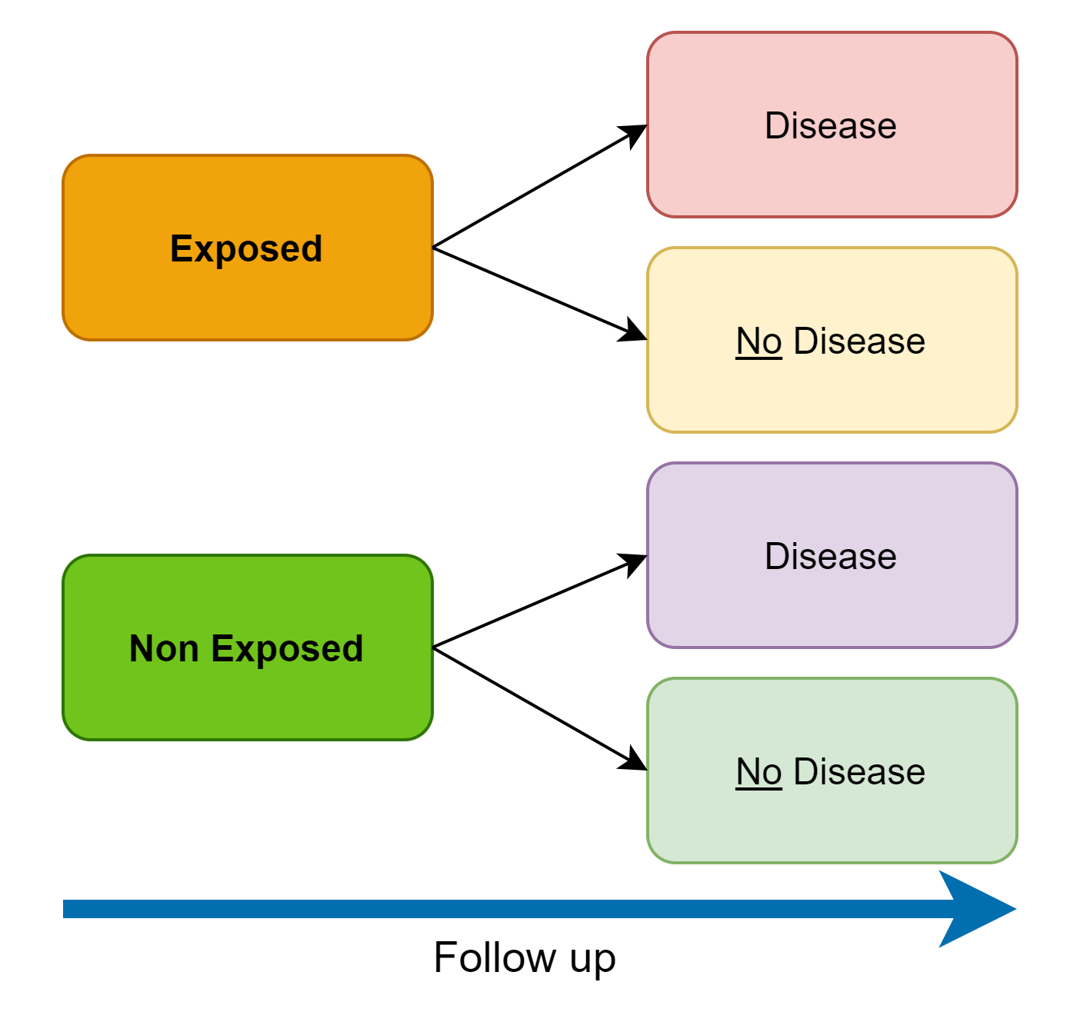
Cohort Studies
 | Disease | No Disease | Total | Incidence Rates of Disease
Exposed | A | B | A+B | A / (A+B)
Non-Exposed | C | D | C+D | C / (C+D)
Notes:
Cohort Studies:
Aim
To investigate the causal relationship between an exposure and an outcome
Design
Ινϖεστιγατορσ σελεχτ α γρουπ οφ εξποσεδ ινδιϖιδυαλσ ανδ α γρουπ οφ νονεξποσεδ ινδιϖιδυαλσ
Τηεψ φολλοω υπ ωιτη τηε γρουπσ οϖερ τιμε.
Τηε ουτχομε οφ ιντερεστ ισ ρεχορδεδ φορ εαχη γρουπ.
Τηε ρατε οφ ουτχομε (ε.γ., ινχιδενχε οφ δεατη ορ δισεασε) ισ χομπαρεδ ιν τηε τωο γρουπσ.
Interpretation
Ιφ α ποσιτιϖε ασσοχιατιον εξιστσ βετωεεν τηε εξποσυρε ανδ τηε ουτχομε, τηε ρατε οφ ουτχομε ιν τηε εξποσεδ γρουπ (ινχιδενχε ιν τηε εξποσεδ γρουπ) ωιλλ βε γρεατερ τηαν τηε ρατε οφ ουτχομε ιν τηε νονεξποσεδ γρουπ (ινχιδενχε ιν τηε νονεξποσεδ γρουπ).
Characteristics, strengths, and limitations
Cohort studies may be in the form of prospective or retrospective designs.
In prospective studies, the study begins by measuring the exposure level at baseline then following the cohort over time and recording the outcomes as they occur based on exposure status. Retrospective studies use historical records. For example, researchers will investigate historical records and classify individuals based on their exposure status from these historical records, they then see what outcomes occurred as time passed from the historical records.
The prospective design has a couple of strengths:
exposure and outcome levels can be collected more accurately compared to historical data in a retrospective design.
However, prospective studies have several drawbacks :
Τηεψ ρεθυιρε λονγ περιοδσ οφ φολλοω υπ εσπεχιαλλψ ιφ τηε τιμε βετωεεν εξποσυρε ανδ ουτχομε τακεσ α λονγ τιμε το αππεαρ. Ιν σομε χασεσ, τηε στυδψ περιοδ ουτλιϖεσ τηε ινιτιαλ ινϖεστιγατορσ.
Βεχαυσε οφ τηε λονγ περιοδ οφ φολλοω−υπ, τηερε ισ α γρεατερ χηανχε οφ παρτιχιπαντσ βεινγ λοστ το φολλοω υπ.
Ιφ τηε στυδψ περιοδ ισ ϖερψ λονγ τηερε ισ α χηανχε τηατ βψ τηε ενδ οφ τηε στυδψ περιοδ, τηε στυδψ οβϕεχτιϖε βεχομεσ ιρρελεϖαντ.
Τηεψ αρε εξπενσιϖε το χονδυχτ.
Examples of cohort studies
Framingham study
(Kannel, W.B. and McGee, D.L., 1979. Diabetes and cardiovascular disease: the Framingham study. Jama, 241(19), pp.2035-2038.)
Nurses' Health Study
(Belanger, C.F., Hennekens, C.H., Rosner, B. and Speizer, F.E., 1978. The nurses’ health study. Am J Nurs, 78(6), pp.1039-1040.)

Slide 8
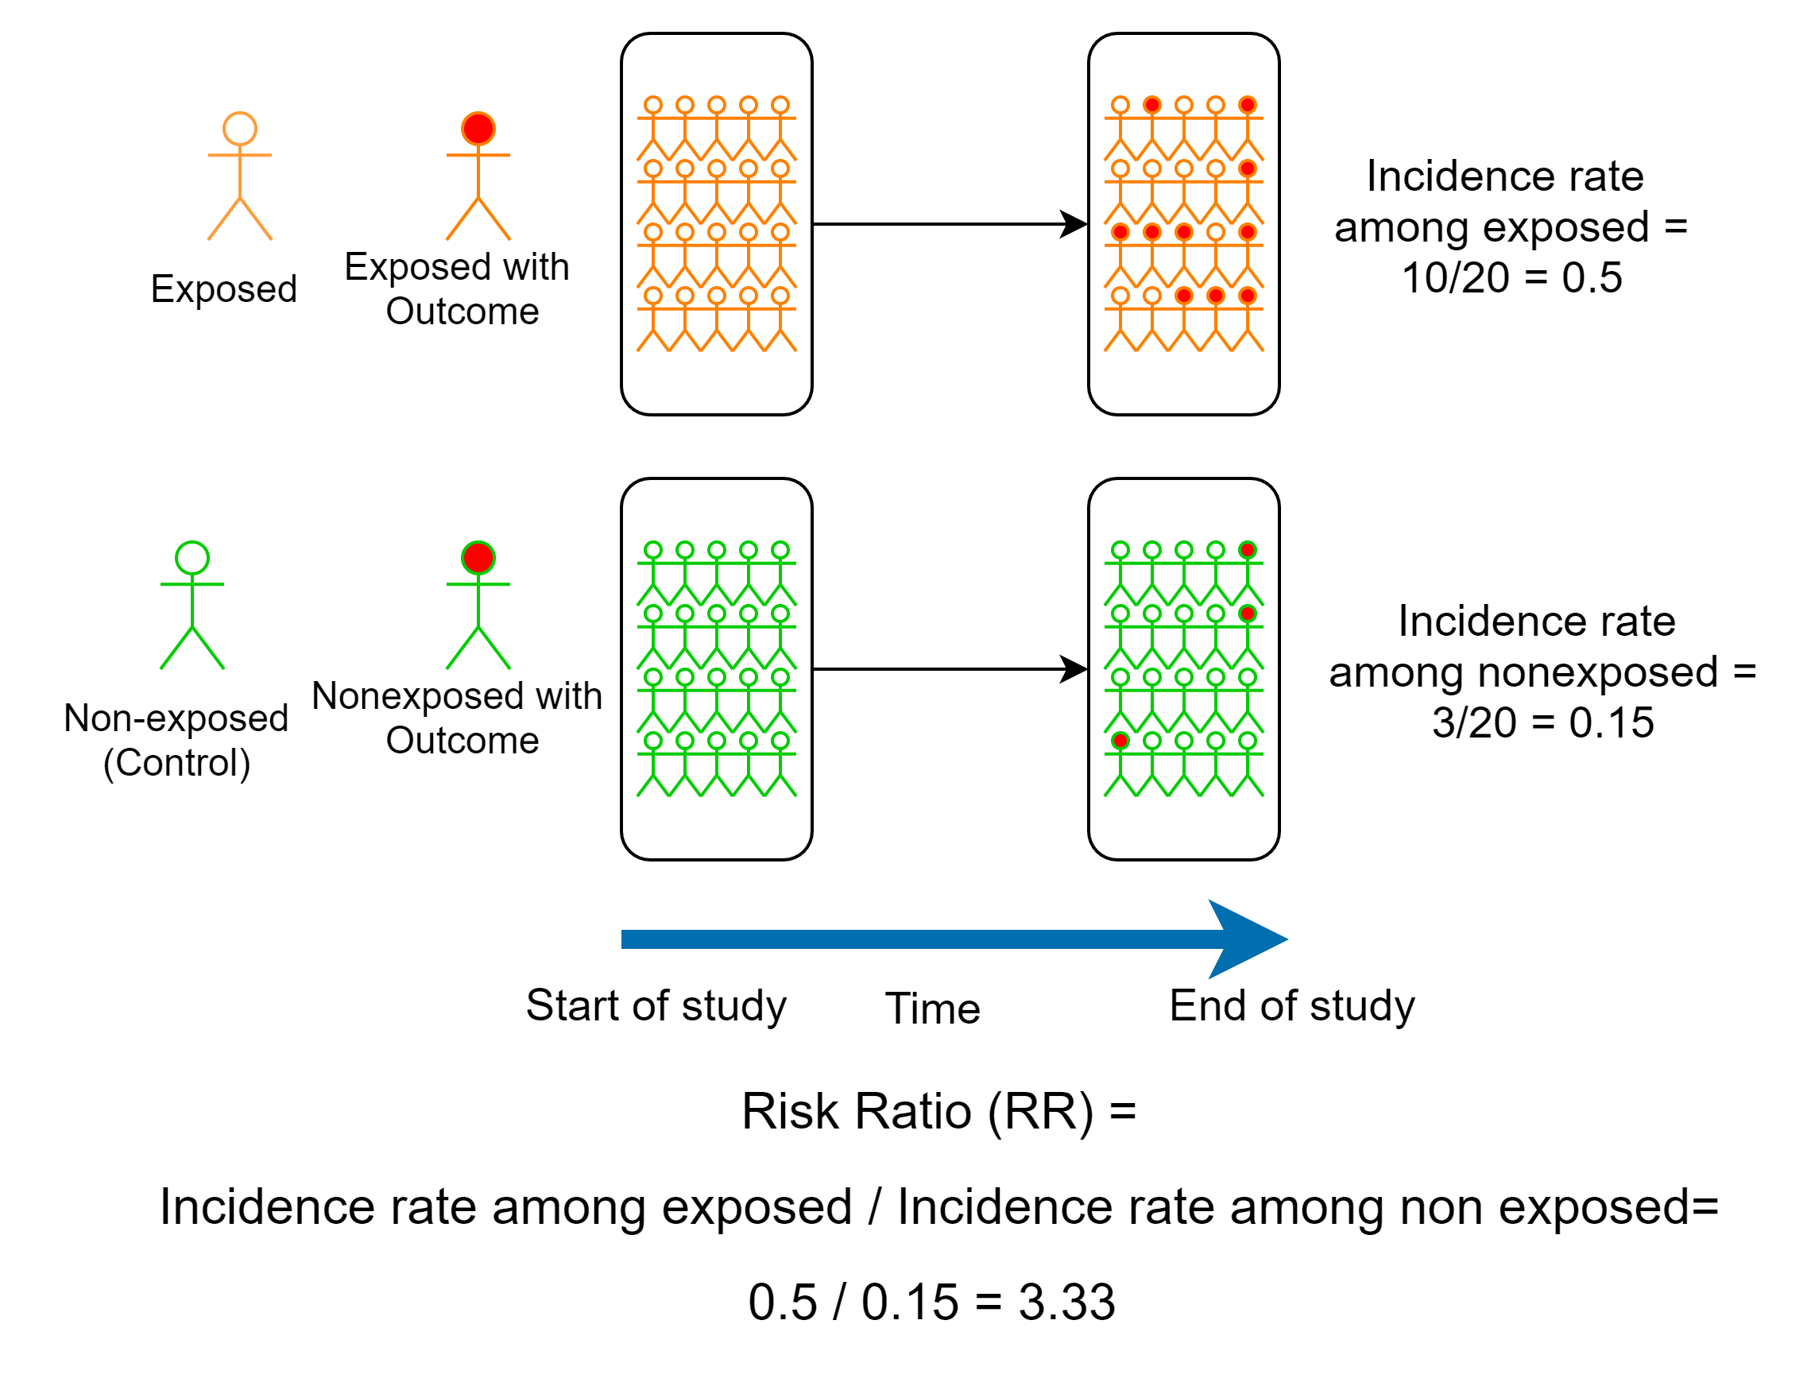
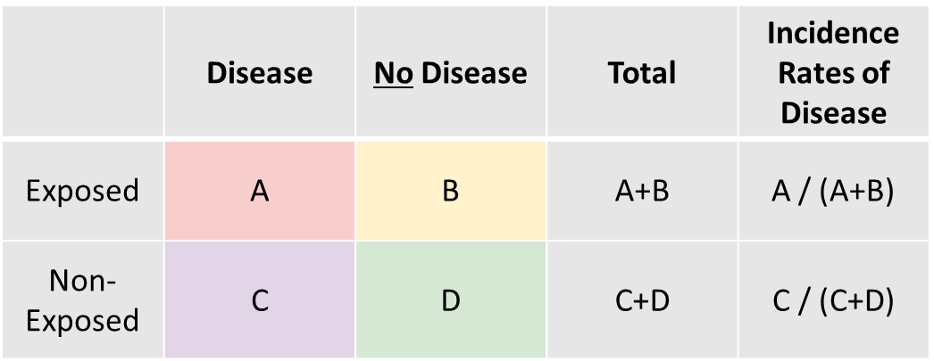
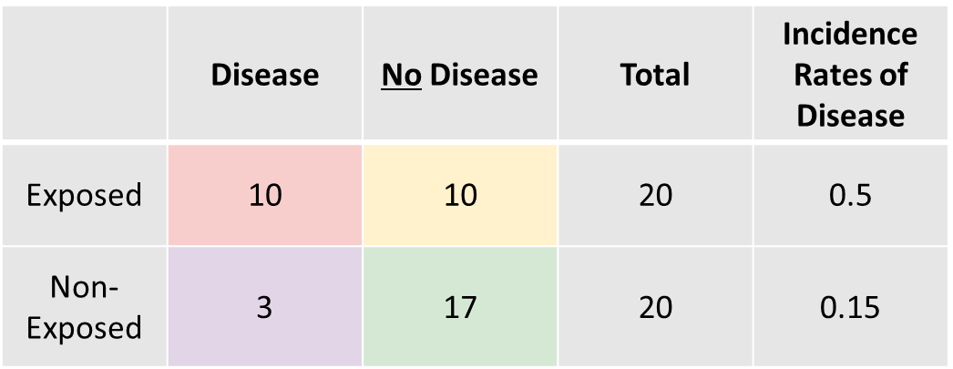
Cohort Studies
Notes:
Example - Figure (cohort study)
The figure illustrates a cohort study design.
In this study, there are two groups, a group of exposed individuals (20 orange individuals) and a group of nonexposed individuals (20 green individuals). The two groups are followed through time (blue arrow) and the outcome of interest (red filled circle) is recorded in each group.
Τηε ινχιδενχε ιν τηε εξποσεδ ισ τηε νυμβερ οφ εξποσεδ ινδιϖιδυαλσ ωιτη τηε ουτχομε διϖιδεδ βψ τηε τοταλ νυμβερ οφ εξποσεδ ινδιϖιδυαλσ:
(10 εξποσεδ ινδιϖιδυαλσ δεϖελοπεδ τηε ουτχομε) / (20 εξποσεδ ινδιϖιδυαλσ)
Ινχιδενχε ρατε οφ εξποσεδ = 10/20 = 0.5.
Τηε ινχιδενχε ιν τηε νονεξποσεδ ισ τηε νυμβερ οφ νονεξποσεδ ινδιϖιδυαλσ ωιτη τηε ουτχομε διϖιδεδ βψ τηε τοταλ νυμβερ οφ νονεξποσεδ ινδιϖιδυαλσ :
(3 νονεξποσεδ ινδιϖιδυαλσ δεϖελοπεδ τηε ουτχομε) / (20 νονεξποσεδ ινδιϖιδυαλσ)
Ινχιδενχε ρατε οφ νονεξποσεδ = 3/20 = 0.15.
Ιφ τηερε ισ α ποσιτιϖε ασσοχιατιον βετωεεν τηε εξποσυρε ανδ ουτχομε, ωε ωουλδ εξπεχτ τηατ τηε ινχιδενχε ρατε οφ δισεασε αμονγ εξποσεδ ωουλδ βε γρεατερ τηαν τηε ινχιδενχε ρατε οφ δισεασε αμονγ νον−εξποσεδ (αλσο κνοων ασ Ινχιδενχε ρατε ρατιο)
Ωε τηεν χομπαρε τηε ινχιδενχε ρατε οφ τηε τωο γρουπσ:
(ινχιδενχε ρατε ρατιο = 0.5 / 0.15 = 3.33)
Τηε Ινχιδενχε ρατε ρατιον ισ (> 1) τηισ ινδιχατεσ α ποσιτιϖε ασσοχιατιον βετωεεν τηε εξποσυρε ανδ ουτχομε.
-----------------------------
The table summarizes the results of the study. The rows represent the exposure status (i.e. exposed and non-exposed) while the columns represent the outcome status (i.e. disease and non-disease). For example cell A is the number of exposed individuals with the outcome (10 individuals) while cell D is the number of nonexposed individuals without the outcome (17 individuals). The incidence rate is also shown in the right-sided columns:
Τηε Ινχιδενχε ρατε οφ εξποσεδ = Α/(Α+Β)=10/(10+10) = 0.5
Τηε Ινχιδενχε ρατε οφ νονεξποσεδ = Χ/(Χ+Δ)=2/(3+17) = 0.15

Slide 9
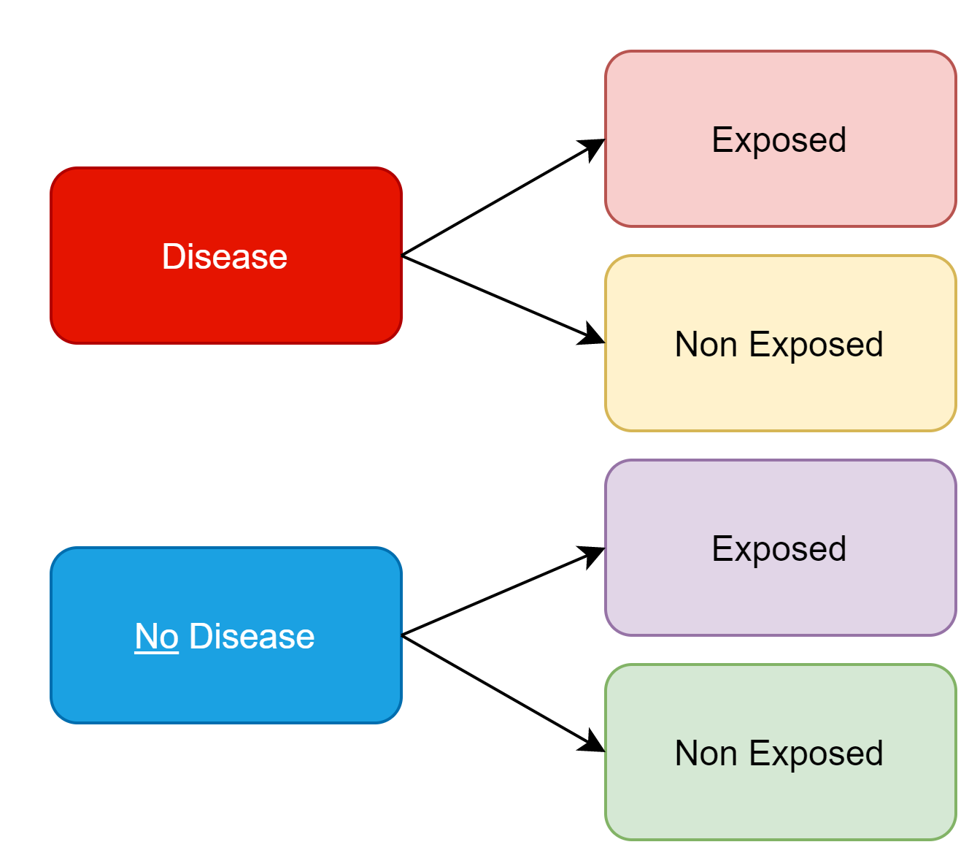
Case-Control Studies
 | Disease | No Disease
Exposed | A | B
Non-Exposed | C | D
Total | A+C | B+D
Odds of exposure | A / C | B / D
Odds Ratio | (A/C) / (B/D)
Notes:
Case-Control Studies
Aim
To determine potential risk factors for a certain outcome
Design
Ινϖεστιγατορσ ιδεντιφψ χασεσ (ινδιϖιδυαλσ ωιτη τηε ουτχομε οφ ιντερεστ) ανδ χοντρολσ (ινδιϖιδυαλσ ωιτη σιμιλαρ χηαραχτεριστιχσ το τηε χασεσ βυτ ωιτηουτ τηε ουτχομε οφ ιντερεστ).
Δετερμινε τηε εξποσυρε ηιστορψ φορ εαχη γρουπ
Ιφ εξποσυρε ισ ασσοχιατεδ ωιτη τηε ουτχομε, ωε εξπεχτ το φινδ τηατ τηε λικελιηοοδ οφ εξποσυρε αμονγ χασεσ γρεατερ τηαν τηε λικελιηοοδ οφ εξποσυρε αμονγ χοντρολσ
Interpretation
If exposure is associated with an outcome, the likelihood of exposure among cases will be greater than the likelihood of exposure among controls.
Characteristics, strengths, and limitations
Case control studies investigate potential risk factors among individuals with the outcome.
The study starts off by selecting or recruiting two groups, a group with the outcome or disease and a groups without the outcome or disease. Exposure levels are then measured for individuals within each groups. A positive association between exposure and outcome is present when then individuals within the disease group are more likely to be exposed compared to individuals within the non-disease group.
Strength:
Study design of choice when the disease or outcome is rare.
Compared to cohort studies is less expensive and time consuming.
Can measure multiple exposures for a single outcome.
Limitations:
Does not establish a temporal relationship between exposure and outcome (causal inference cannot be determined).
Does not provide a measure or risk (incidence rate and incidence rate ratio).
Recall and interviewer bias.
Survivor bias.
Can only measure one outcome.
Examples of case-control studies
-Traffic related air pollution and incidence of childhood asthma
Zmirou, D., Gauvin, S., Pin, I., Momas, I., Sahraoui, F., Just, J., Le Moullec, Y., Bremont, F., Cassadou, S., Reungoat, P. and Albertini, M., 2004. Traffic related air pollution and incidence of childhood asthma: results of the Vesta case-control study. Journal of Epidemiology & Community Health, 58(1), pp.18-23.

Slide 10
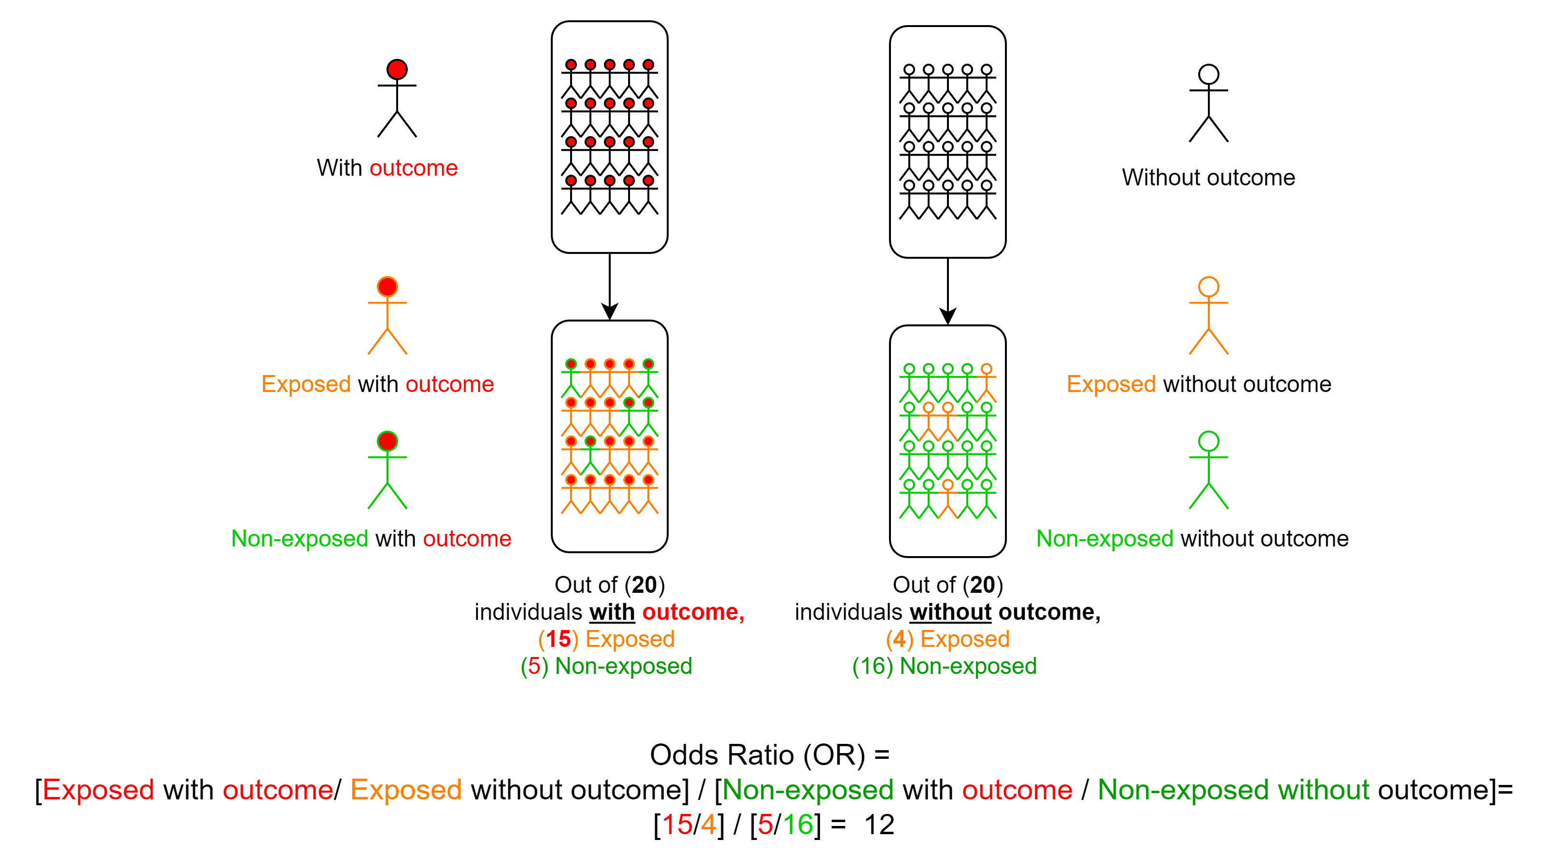
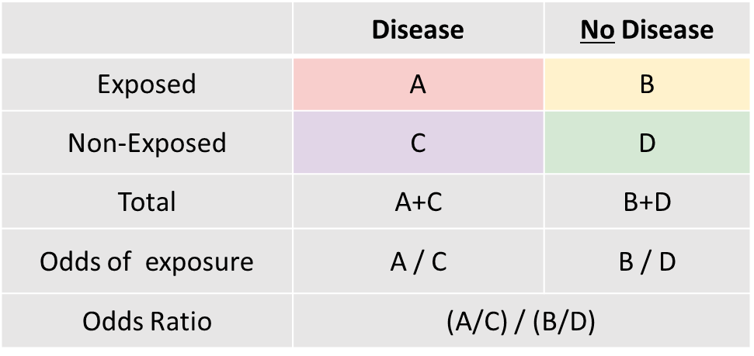
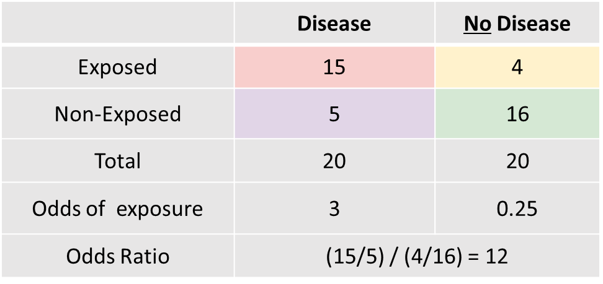
Case-Control Studies
Notes:
Example - Figure (case-control study)
The figure illustrates a case-control design.
In this study, there are two groups, a group of individuals with the outcome (20 with red circles) and a group of individuals without the outcome (20 with white circles). The two groups are investigated for their exposure states (or their exposure status is measured). Individuals with a positive exposure are colored in orange while individuals with a negative exposure (without the exposure) are colored in green.
Τηε Οδδσ οφ εξποσυρε αμονγ δισεασεδ ισ τηε νυμβερ οφ εξποσεδ ινδιϖιδυαλσ ιν τηε δισεασε γρουπσ το τηε νυμβερ οφ νον−εξποσεδ ινδιϖιδυαλσ ιν τηε δισεασεδ γρουπ:
(Οδδσ οφ εξποσυρε αμονγ τηε δισεασεδ = Α/Χ = 15/5 = 3).
Τηε Οδδσ οφ εξποσυρε αμονγ νον−δισεασεδ ισ τηε νυμβερ οφ εξποσεδ ινδιϖιδυαλσ ιν τηε νον−δισεασεδ γρουπσ το τηε νυμβερ οφ νον−εξποσεδ ινδιϖιδυαλσ ιν τηε νον−δισεασεδ γρουπ:
(Οδδσ οφ εξποσυρε αμονγ τηε νον−δισεασεδ = Β/Δ = 4/16= 0.25).
Ιφ τηερε ισ α ποσιτιϖε ασσοχιατιον βετωεεν δισεασε ανδ εξποσυρε, ωε εξπεχτ τηε οδδσ οφ εξποσυρε αμονγ δισεασε ωουλδ βε γρεατερ τηαν τηε οδδσ οφ εξποσυρε αμονγ νον−δισεασεδ (αλσο κνοων ασ Οδδσ ρατιο, σινχε ωε αρε χομπαρινγ τηε τωο οδδσ)
Οδδσ οφ εξποσυρε αμονγ δισεασεδ (Α/Χ = 15/5= 3)
Οδδσ οφ εξποσυρε αμονγ νον−δισεασεδ (Β/Δ = 4/16 = 0.25)
Οδδσ ρατιο = Οδδσ οφ εξποσυρε αμονγ δισεασεδ (Α/Χ) “διϖιδεδ βψ” Οδδσ οφ εξποσυρε αμονγ νον−δισεασεδ (Β/Δ) = (15/5) / (4/16) = (15/5 ) / (4/16 ) = 12
Τηε Οδδσ ρατιο ισ γρεατερ τηαν 1, τηισ ινδιχατεσ α ποσιτιϖε ασσοχιατιον βετωεεν τηε εξποσυρε ανδ ουτχομε.
-----------------------------
The table summarizes the results of the study. The rows represent the exposure status (i.e. exposed and non-exposed) while the columns represent the outcome status (i.e. disease and non-disease). For example, cell A is the number of exposed individuals with the outcome (15 individuals) while cell D is the number of nonexposed individuals without the outcome (16 individuals).

Slide 11
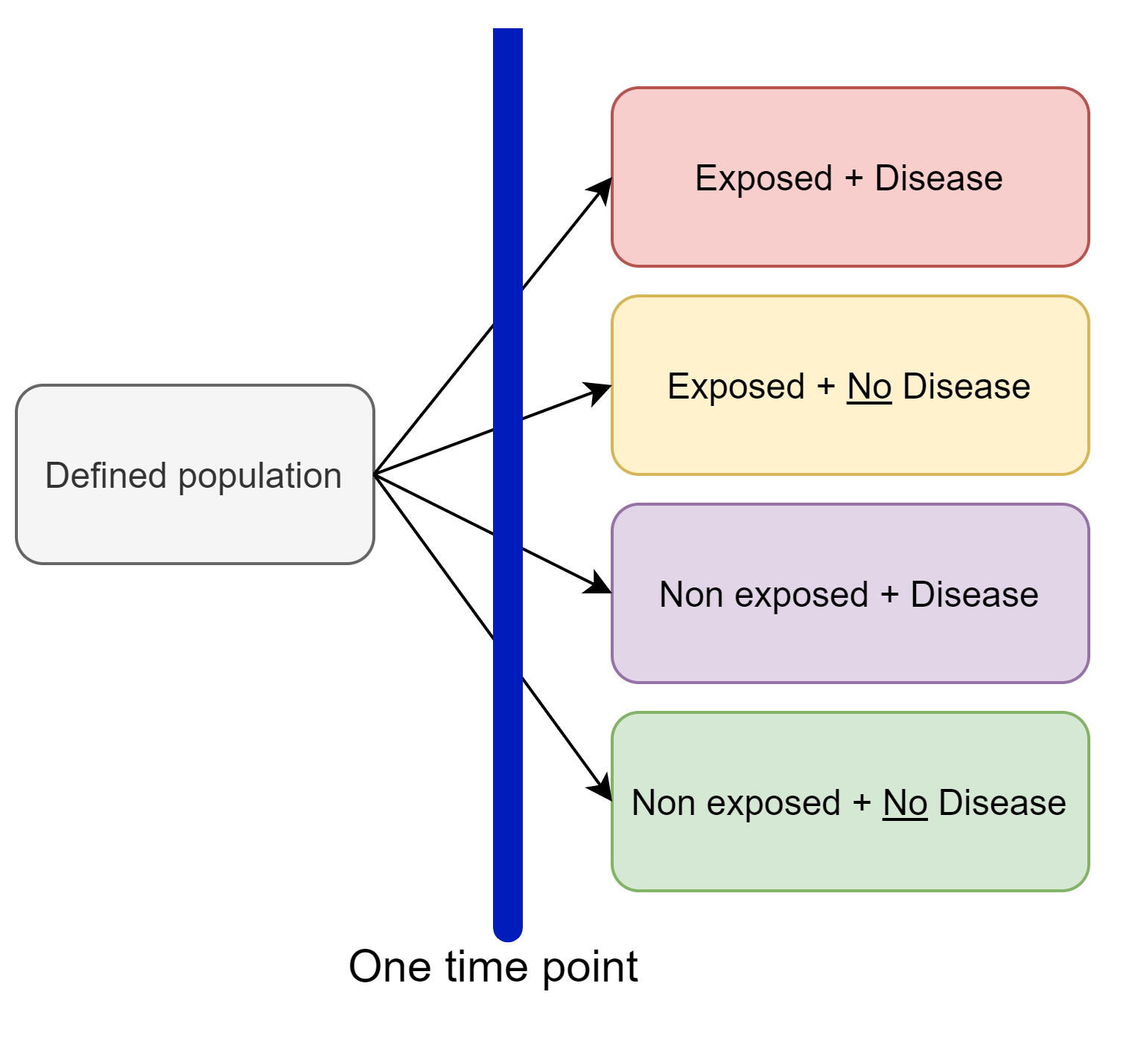
Cross Sectional Studies
 | Disease | No Disease | Total
Exposed | A | B | A+B
Non-Exposed | C | D | C+D
Total | A+C | B+D | A+B+C+D
Notes:
Cross Sectional Studies
Aim:
To estimate disease or exposure frequency in a defined population. Formulate hypothesis.
Design
Δεφινε α ποπυλατιον ατ α τιμε ποιντ.
Φορ εαχη ινδιϖιδυαλ, χολλεχτ τηε εξποσυρε ανδ δισεασε μεασυρεμεντσ σιμυλτανεουσλψ
Ινφορματιον ρεγαρδινγ μυλτιπλε εξποσυρεσ ανδ δισεασεσ μαψ βε χολλεχτεδ.
Σινχε ινφορματιον ισ χολλεχτεδ ατ α σινγλε τιμε ποιντ, χασεσ οφ δισεασεσ αρε χονσιδερεδ πρεϖαλεντ χασεσ (ωε χαν’τ δετερμινε ιφ τηισ ισ α νεω ορ αν ολδ χασε)
Εϖιδενχε οφ αν ασσοχιατιον βετωεεν εξποσυρε ανδ δισεασε μαψ βε δετερμινεδ υσινγ τωο αππροαχηεσ (σεε ιντερπρετατιον)
Analysis
There are several methods to analyze a cross sectional study:
Method 1
Χομπαρε τηε πρεϖαλενχε οφ δισεασε αμονγ εξποσεδ ινδιϖιδυαλσ ανδ χομπαρε ιτ το τηε πρεϖαλενχε οφ δισεασε αμονγ νον−εξποσεδ ινδιϖιδυαλσ:
Πρεϖαλενχε οφ δισεασε αμονγ εξποσεδ ινδιϖιδυαλσ = (Α / (Α+Β))
πρεϖαλενχε οφ δισεασε αμονγ νον−εξποσεδ ινδιϖιδυαλσ (Χ / (Χ+Δ))
Μετηοδ 2
Χομπαρε τηε πρεϖαλενχε οφ εξποσυρε αμονγ δισεασεδ ινδιϖιδυαλσ ανδ χομπαρε ιτ το τηε πρεϖαλενχε οφ εξποσυρε αμονγ νον−δισεασεδ ινδιϖιδυαλσ:
πρεϖαλενχε οφ εξποσυρε αμονγ δισεασεδ ινδιϖιδυαλσ (Α / (Α+Χ))
πρεϖαλενχε οφ εξποσυρε αμονγ νον−δισεασεδ ινδιϖιδυαλσ (Β / (Β+Δ))
Τηε φιρστ αππροαχη ισ λικε α χοηορτ στυδψ αναλψσισ (σταρτ ωιτη εξποσυρε ανδ εστιματε τηε δισεασε)
Τηε σεχονδ αππροαχη ισ λικε α χασε−χοντρολ στυδψ αναλψσισ (σταρτ ωιτη δισεασε ανδ εστιματε τηε εξποσυρε)
Characteristics, strengths, and limitations
Cross-sectional studies are observational. They provide a snapshot in time examining the characteristics (or study variables) for a population. However, because data on exposure and outcome is collected simultaneously, the sequence of events is not known, which is necessary if we want to determine if a causal relationship exists between exposure and outcome. Cross-sectional studies have several advantages; they are easy to conduct and require a short period of time, multiple exposures and outcomes can be measured, and data collection can be complete. Disadvantages include; cannot determine a causal relationship since temporal information is not collected, rare exposures are hard to study, cannot measure incidence or relative risk.
Examples of cross-sectional studies
-National Health and Nutrition Examination Survey (NHANES):
-Behavioral Risk Factor Surveillance System (BRFSS): This is a health-related telephone survey conducted in the U.S. and collects data on health-related risk behaviors, chronic health conditions, and use of preventive services.
Examples of cross-sectional studies for air pollution
-Effect of long-term exposure to air pollution on anxiety and depression in adults: A cross-sectional study
(Vert, C., Sánchez-Benavides, G., Martínez, D., Gotsens, X., Gramunt, N., Cirach, M., Molinuevo, J.L., Sunyer, J., Nieuwenhuijsen, M.J., Crous-Bou, M. and Gascon, M., 2017. Effect of long-term exposure to air pollution on anxiety and depression in adults: A cross-sectional study. International journal of hygiene and environmental health, 220(6), pp.1074-1080.)

Slide 12
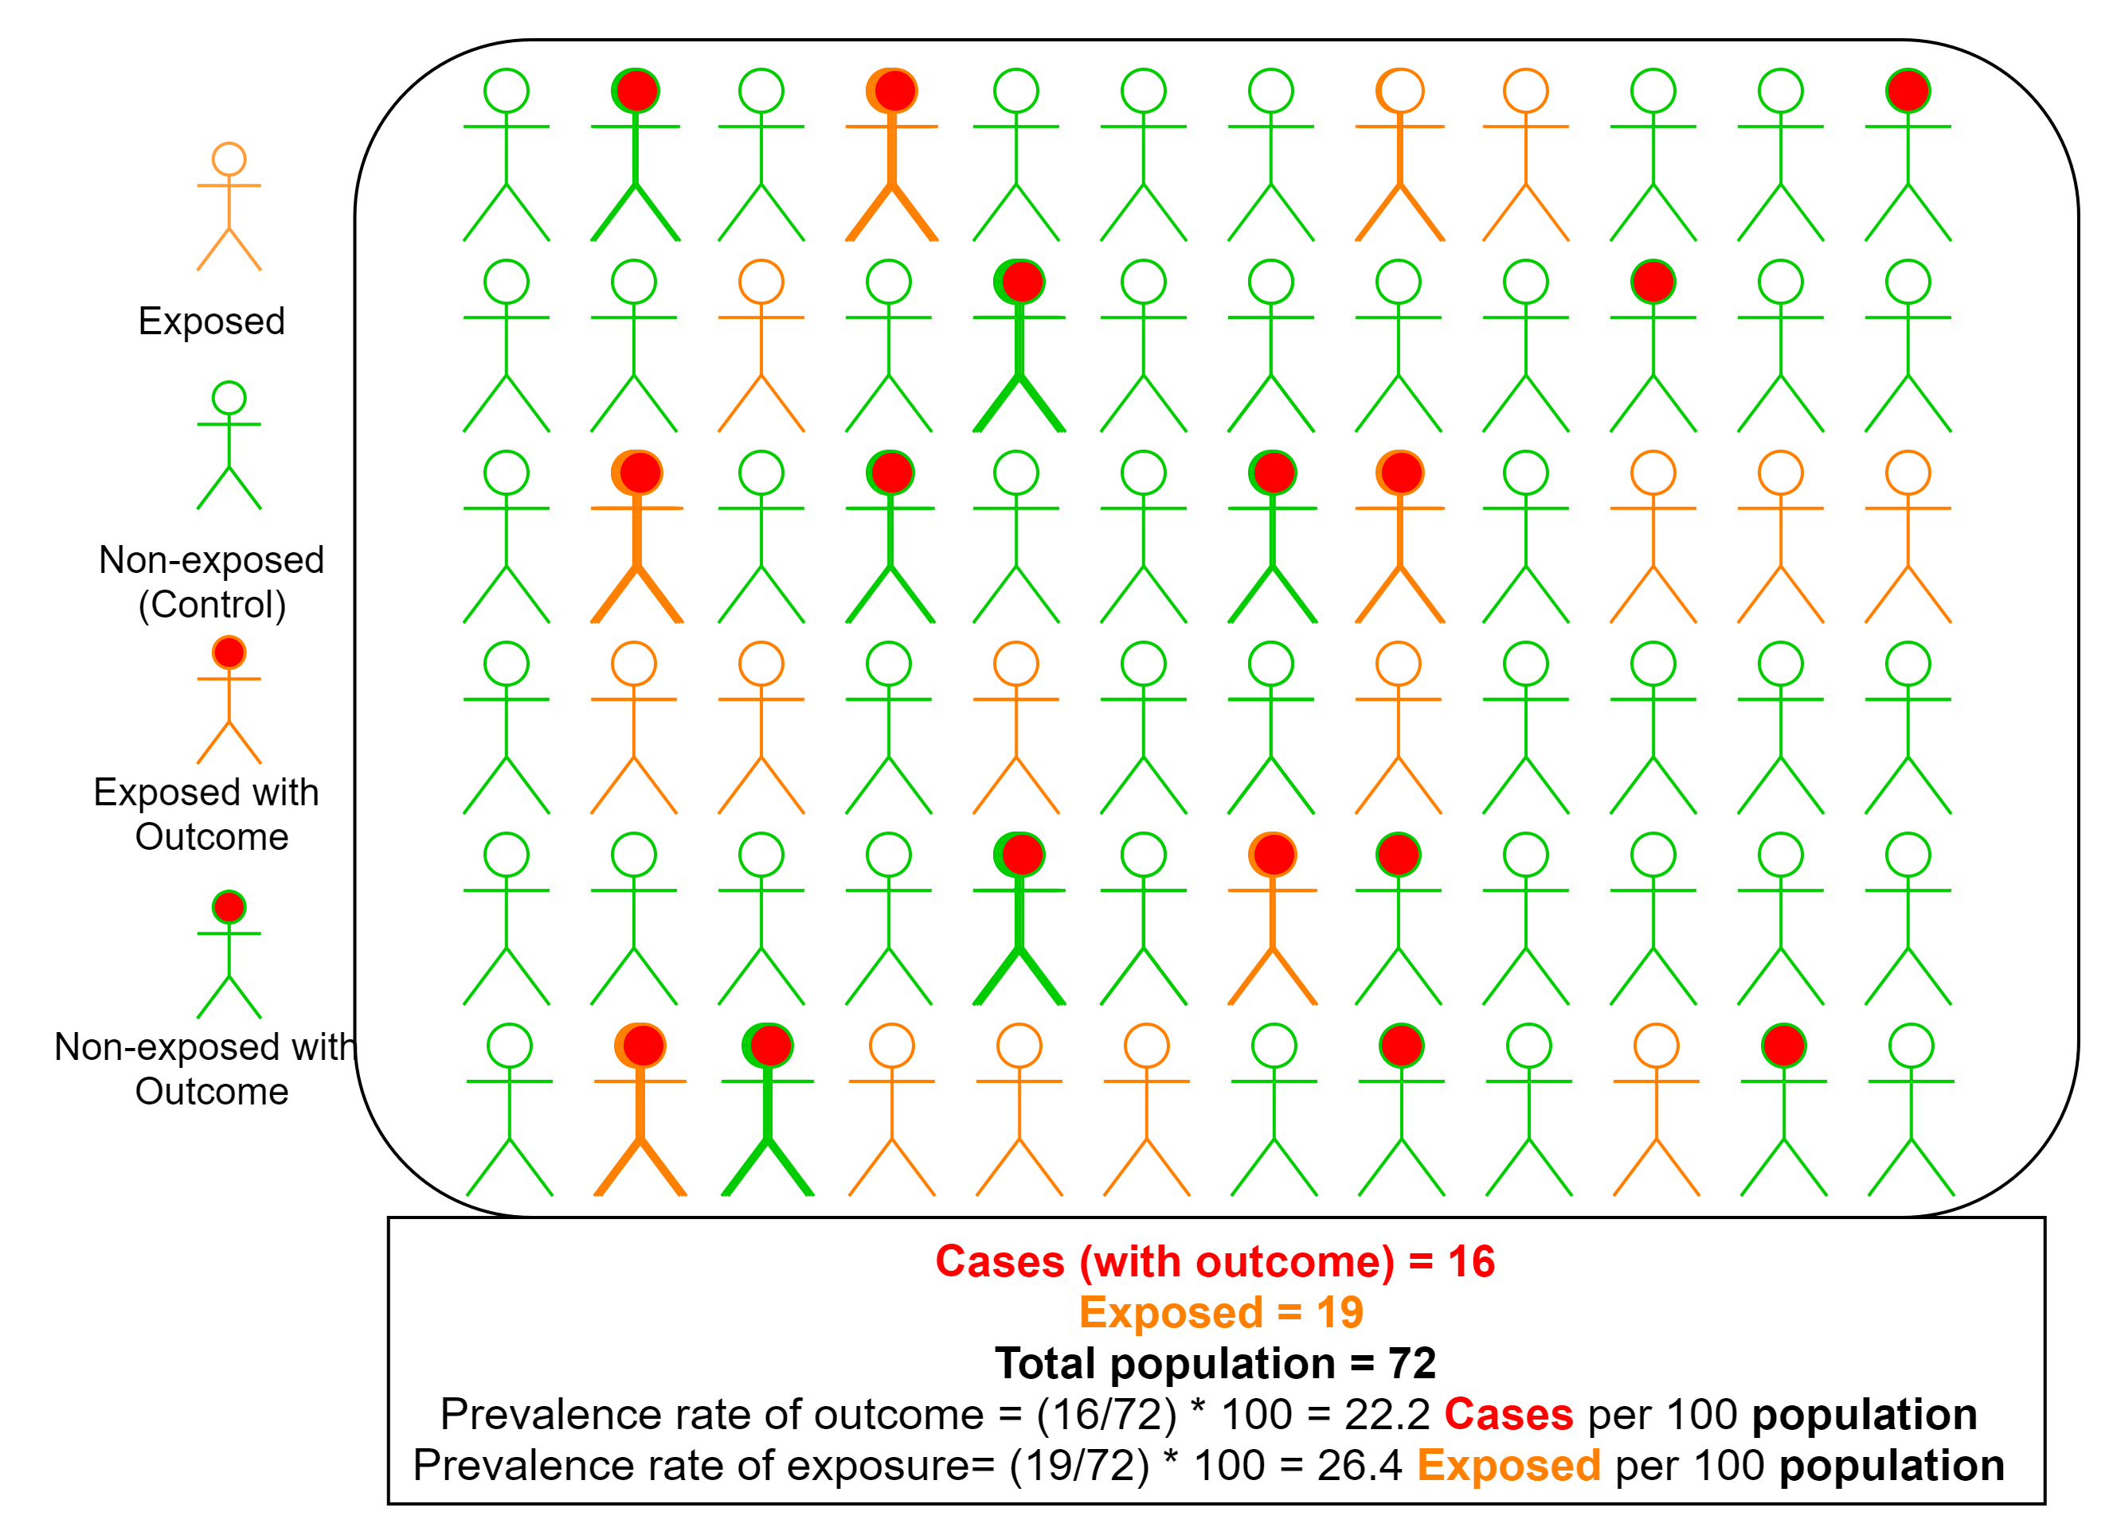
Cross Sectional Studies
 | Disease | No Disease | Total
Exposed | A | B | A+B
Non-Exposed | C | D | C+D
Total | A+C | B+D | A+B+C+D
 | Disease | No Disease | Total
Exposed | 5 | 14 | 19
Non-Exposed | 11 | 42 | 53
Total | 16 | 56 | 72
Notes:
Example from figure
We can estimate the following:
Frequency of disease/non-disease
Frequency of exposure/non-exposure
Prevalence of disease/non-disease
Prevalence of exposure/non-exposure
Odds ratio (like a case control study)

Slide 13
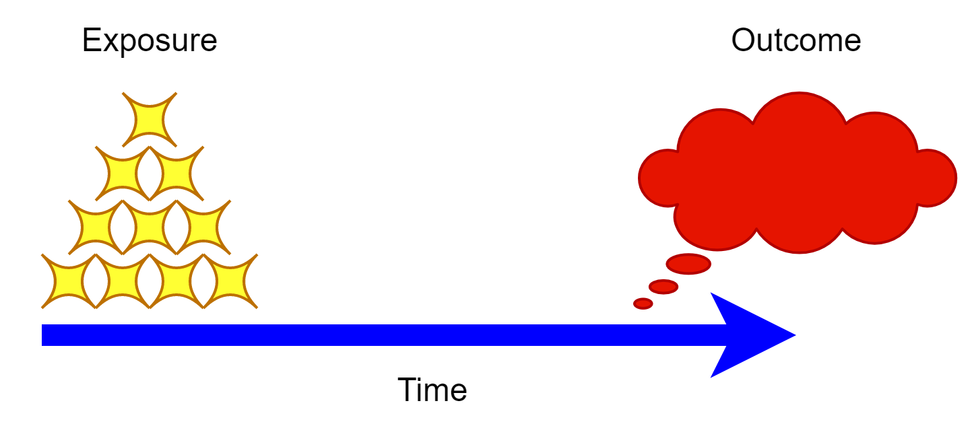
Time Series
Sequence of health-related measurements
Regular time intervals
Is there a temporal pattern indicating an association?
Notes:
Time-series design
Time series in epidemiology is conducted by collecting a sequence of health-related measurements (exposures and outcome) at regular time periods. These measurements maybe investigated whether they are associated with each other by investigating temporal patterns.
Example (image) we check whether the exposure is associated with the outcome which occurs at later time.

Slide 14
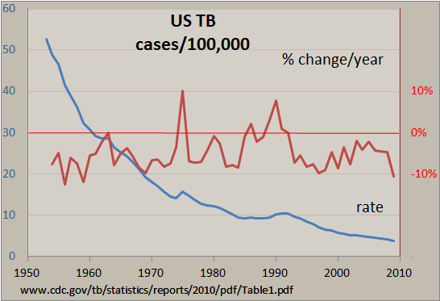
Time Series
The Epidemic curve:
Exposure source
Exposure duration
Likely exposure period
Incubation period
Magnitude of outcome
Time trend in outcome
Notes:
The Epidemic Curve
An epidemic curve is a visual display of the data from the time of exposure till the outcome. Important information can be collected from an epidemic curve including the following.
Exposure source, which may be a point or continuous source:
Point source → when the exposure occurs over a narrow time period.
Continuous source → when the exposure occurs over a longer time period.
Exposure duration
Most likely exposure period.
Incubation period: the time from exposure to the causative agent until the first symptoms develop and is characteristic for each disease agent. The incubation period may be used to determine the causative agent. Incubation periods may be as short as hours or long as year. Long incubation periods are called “latency period.”
Magnitude of the outcome or illness
The time trend or distribution of cases over time.
Secular trend → Long term trend more than one year.
Seasonal trend → Periodic increases and decreases in the occurrence of the outcome, which may be predictable. Examples include the trend of the seasonal influenza.
Age, period, and cohort effect
Age effect → The change in the rate of an outcome according to age irrespective of cohort or calendar time (or period). For example, the risk of cancer increases with age irrespective of the cohort or calendar time.
Cohort effect → The change in the rate of an outcome according to birth year irrespective of age or calendar time (or period). For example, The Hiroshima bombing survivors.
Period effect → The change in the rate of an outcome according to calendar time irrespective of age or cohort.
-----------------
The graph represents the number of US TB cases per 100,00 population over 60 years (blue line), while the red line represents the annual % change.
-----------------
(Source: https://www.cdc.gov/training/quicklearns/exposure/index.html)

Slide 15
Time Series - Example
Per capita cigarette consumption and male lung cancer incidence in the United States over the last century.
Source: Doss, M., 2016. Changing the paradigm of cancer screening, prevention, and treatment. Dose-Response, 14(4), p.1559325816680539.
Notes:
The image shows the trends of per capital cigarette consumption and make lung cancer incidence in the United States over the last century. The lung cancer incidence closely follows the trend in Per capital cigarette consumption.
Doss, M., 2016. Changing the paradigm of cancer screening, prevention, and treatment. Dose-Response, 14(4), p.1559325816680539.
Examples of Time Series in Air Pollution studies
-Mortality and air pollution in london
Schwartz, J. and Marcus, A., 1990. Mortality and air pollution j london: a time series analysis. American journal of epidemiology, 131(1), pp.185-194.

Slide 16
Summary
Study Design | Description | Strength | Weakness
Cross sectional | “Snapshot” in time. Both exposure and disease status are collected. May be used to measure frequency and prevalence of disease or exposure. | Easy and inexpensive to conduct. Can measure multiple exposure and outcomes simultaneously. Control over measurements and study population Can determine prevalence | Temporality cannot be determined Potential bias if low response rate Not optimal for rare exposure or outcomes Cannot determine incidence or relative risk
Case-Control | Individuals with outcome are compared to those without the outcome in terms of their exposure status. | Effective for rare outcomes Less expensive and time consuming to cohort studies. Determines the odds ratio (in rare outcomes the odds ratio is a good estimate of the relative risk) | Potential recall bias Cannot determine incidence or prevalence Only one outcome may be studied
Cohort | Study starts with exposure status and individuals are followed up. Outcome rates are compared between exposed and non-exposed. Can be either retrospective or prospective. | “Gold standard” for observational studies Temporality established (time sequence of events Able to determine incidence and relative risk | Expensive to conduct Time consuming Not optimal for rare outcomes
Time Series | A sequence of health-related outcomes or measurements are gathered over several time periods. | Determine temporality or sequence of events Determine change in health-related events over time In infectious disease outbreaks may be able to determine the point source of infection Generate hypothesis of causality | Ecological bias Potential age, cohort, and period effect.

Slide 17
Sources and references
Merrill, R.M., 2008. Environmental epidemiology: principles and methods. Jones & Bartlett Learning.
https://www.cdc.gov/training/quicklearns/exposure/index.html
Doss, M., 2016. Changing the paradigm of cancer screening, prevention, and treatment. Dose-Response, 14(4), p.1559325816680539.
Kannel, W.B. and McGee, D.L., 1979. Diabetes and cardiovascular disease: the Framingham study. Jama, 241(19), pp.2035-2038.
Belanger, C.F., Hennekens, C.H., Rosner, B. and Speizer, F.E., 1978. The nurses’ health study. Am J Nurs, 78(6), pp.1039-1040.
Zmirou, D., Gauvin, S., Pin, I., Momas, I., Sahraoui, F., Just, J., Le Moullec, Y., Bremont, F., Cassadou, S., Reungoat, P. and Albertini, M., 2004. Traffic related air pollution and incidence of childhood asthma: results of the Vesta case-control study. Journal of Epidemiology & Community Health, 58(1), pp.18-23.
Vert, C., Sánchez-Benavides, G., Martínez, D., Gotsens, X., Gramunt, N., Cirach, M., Molinuevo, J.L., Sunyer, J., Nieuwenhuijsen, M.J., Crous-Bou, M. and Gascon, M., 2017. Effect of long-term exposure to air pollution on anxiety and depression in adults: A cross-sectional study. International journal of hygiene and environmental health, 220(6), pp.1074-1080.
Schwartz, J. and Marcus, A., 1990. Mortality and air pollution j london: a time series analysis. American journal of epidemiology, 131(1), pp.185-194.

Slide 18
Reading List
Rothman, K.J., Greenland, S. and Lash, T.L. eds., 2008. Modern epidemiology. Lippincott Williams & Wilkins.
Gordis 2014. Epidemiology, Philadelphia, PA, Saunders/Elsevier.
Szklo, M. and Nieto, F.J., 2014. Epidemiology: beyond the basics. Jones & Bartlett Publishers.

