Slide 1
www.carteeh.org

Slide 2
Lecture #40: Undertaking Health Impact and Burden of Disease Assessment of Traffic-Related Air Pollution—Part 2
Haneen Khreis
Texas A&M Transportation Institute
H-Khreis@tti.tamu.edu, (979) 317-2799 x42799
The author declares that there is no conflict of interest
Lecture Track(s): HT/TT/PPT
Notes:
Health Track (HT)—mainly targeted at urban planners, transportation planners, and engineers with limited knowledge of public health-related concepts;
Transportation Track (TT)—mainly targeted at environmental epidemiologists and public health professionals with limited knowledge of transportation-related concepts; and;
Planning and Policy Track (PPT)—mainly targeted at planners, civil servants, and policy and decision makers with particular interest in the science-policy link.

Slide 3
Introduction
Quantitative burden of disease (BoD) and health impact assessments (HIA) provide methods for quantifying the positive and/or negative health impacts of baseline conditions (burden of disease assessments) and public policies, projects and programs (health impact assessments), and the distribution of these impacts
The definitions, overall methods, examples, strengths and limitations of these methods, and steps for conducting a BoD or HIA have been overviewed in details in lecture #38 and 39
This lectures runs through an example for conducting a BoD assessment for traffic-related air pollution (TRAP) from start to finish
Notes:
BoD and HIA methods identify the public health impacts including the health risks and benefits of baseline scenarios and current and/or proposed plans or policies outside the healthcare sector
This provides relevant information for public health professionals, policy makers and the public and can answer important questions such as
How many cases (mortality, morbidity) are due to traffic-related exposures such as TRAP?
How many cases can we prevent if we make X change?
How much does it cost us?
What are the most cost-effective solutions?
How can we quantify these impacts ourselves?
How can we engage communities and communicate the impacts of transport policy on their health?
How can we catalyze the public’s understanding?
For policy decision-making, it is important to understand and be able to quantify the full-chain from source, through pathways, to the ultimate health outcomes (Nieuwenhuijsen et al., 2017)

Slide 4
The Full-Chain Framework
Source: Center for Advancing Research in Transportation Emissions, Energy, and Health (CARTEEH), 2019. Available from: https://www.carteeh.org/
Notes:
This graphic depicts the full-chain of events from traffic activity to traffic emissions which include both tailpipe and non-tailpipe emissions (the latter referring to emissions resulting from brake, tire and road surface wear and abrasion and the resuspension of road dust). These emissions disperse into ambient air depending on multiple factors which are highly variable such as wind speed, wind direction and atmospheric stability, local and regional terrain, and background air pollution concentrations from other sources such as industry, agricultural emissions and coal and wood burning. The result of this dispersion is elevated concentrations of air pollutants, through primary emissions or through the formation of secondary pollutants like Ozone. Humans are exposed to these air pollutants in ambient air, or indoors through the infiltration of outdoor air pollutants. Human exposures and their inhaled doses which reach target organs or tissues are also determined by various dynamic factors such as mobility patterns, distance from the source, height, physical activity and transport mode choice. Human exposures to TRAP can elicit a wide range of adverse health effects and population health impacts. On the upstream of this graphic is an icon for technologies and disruptors which includes emerging transportation technologies such as automated and electric vehicles. Such technologies can impact the levels of traffic activity and/or vehicle tailpipe and non-tailpipe emissions which influences the dispersion, human exposures and human health impacts subsequently.

Slide 5
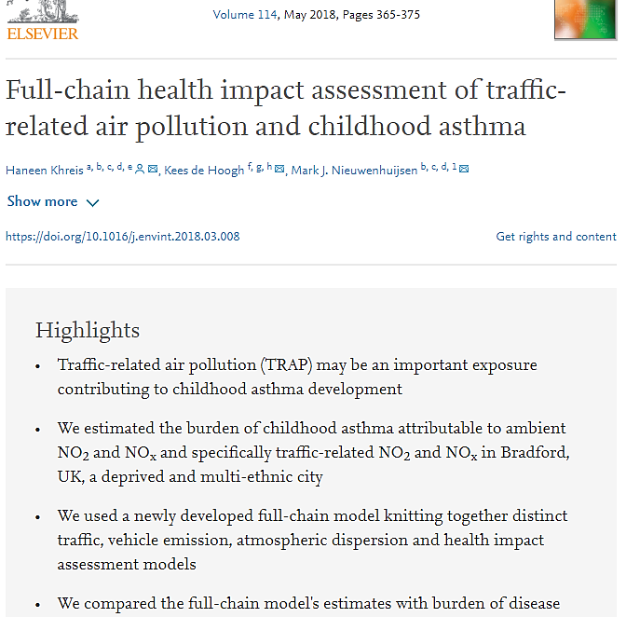
Example of a Full-Chain Analysis
Notes:
This lecture runs through this example of conducting a full-chain BoD analysis of TRAP and childhood asthma in Bradford in the United Kingdom

Slide 6
Overarching Methodology
This example employs a full-chain modeling approach where the various events of the full-chain framework are modeled and inputted into the next step to ultimately estimate the number of annual new childhood asthma cases that could be attributable to TRAP
Nitrogen dioxide (NO₂) was the pollutant used for the main analysis as there is sufficient epidemiological evidence showing a statistically significant association between NO₂ and new childhood asthma (Thurston et al., 2020) and as NO₂ is a good marker for traffic in urban areas
The hazard identification includes the selection of the exposure of interest and the health outcome of interest for which there is sufficient epidemiological evidence for a causal relationship
Source: Khreis and Nieuwenhuijsen, 2019
Notes:
A full-chain BoD assessment of TRAP and the burden on new childhood asthma is explained in this lecture
NO₂ was the pollutants used in the analysis
The strongest epidemiologic evidence for a causal relationship with new-onset childhood asthma comes from studies that used NO₂ as the TRAP metric
The full-chain approach that was employed in this analysis is shown in the figure on this slide. Estimates for air pollution (NO₂) and the burden of childhood asthma were also derived using a land-use regression model but these will not be further discussed in this lecture
The next slides explain the steps of the full-chain model including traffic modeling, emissions modeling, atmospheric dispersion modeling, exposure assignment, the selection of exposure-response functions and baseline health data

Slide 7
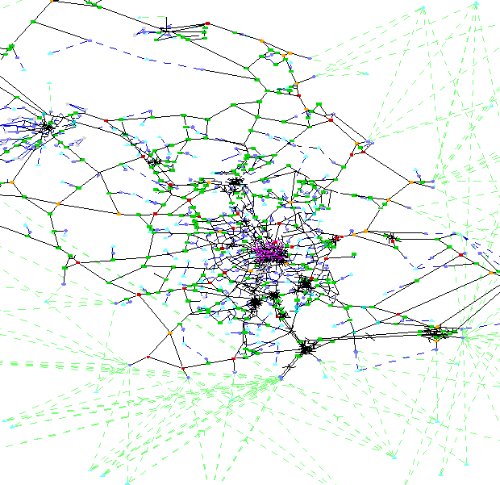
Traffic Modeling
To model traffic activity on the road network of interest, a meso-scopic traffic model called SATURN was used
Trips are allocated based on a route choice model using a trip matrix for the demand and characteristics of the road network as the supply
The model estimated traffic flows in the unit of passenger car units per hour (PCU) and average speed (km/hour) for three simulation time periods (AM, interpeak and PM peak hours)
Using traffic flow data measured at traffic counters in the same study area, diurnal profiles for traffic can be created and traffic over 24 hours in the weekday and weekend established
4,500 road links
1,359 km coverage
3 simulation time periods
Notes:
Simulation and Assignment of Traffic to Urban Road Networks model (SATURN) used to model traffic and average speed for:
1 x AM peak hour (08:00-09:00)
Inter-peak hour (the average inter-peak hour between 10:00-16:00); and
1 x PM peak hour (17:00-18:00)
The road network specifies the physical structure of the roads upon which trips occur (e.g. the link lengths, link capacities, geographical locations)
The trip matrix specifies the number of trips from zone i to zone j, for all zones included in the traffic network
Both the road network and the trip matrix are the inputs to a route choice model
Trips are allocated to routes based on the route choice model, and the total flows along road links and the corresponding network costs (e.g. travel times or average generalized cost) are calculated
After the first round of traffic assignment, the simulation model takes the road link allocated traffic and creates another more accurate cost-flow relationship by working out the delays that will occur at the network’s junctions due to the assigned flows
As such, the simulation model provides a more detailed representation of what is happening at each junction in the network considering (1) the additional delays that road users turning on roads may suffer compared to those driving straight ahead, and (2) the ability of cars to get out at a give-way junction depending on the availability of gaps in the traffic going past.
The result is a closer estimation of the cost-flow relationships, which are then passed back to the assignment model, allowing a second set of routes to be allocated
This iterative process is referred to as the ‘assignment-simulation loops’
The loops are essential because the simulated turn-based flow-delay curves that are initially passed to the assignment model are only approximations, which disregard the interactions between the network’s links while determining delays
Several sources of interactions exist between links, including shared lanes, signal optimisation and co-ordination, merging and weaving, etc., and these are considered in the subsequent assignment and simulation loops
The loops between the assignment and simulation are iterative and keep running until the model converges
Model convergence occurs when all the routes stabilise and reasonably steady flows are obtained. This is judged by calculating the changes in flow relative to the previous loop; values which need to be very small (e.g. < 5%)

Slide 8
Traffic Fleet Mix
The traffic flows estimated from the model do not split the traffic into the different vehicle classes which each have different emission rates that can be calculated using “emission factors” (discussed in next slides)
The typical practice is to find the traffic fleet mix in the area from published datasets, for example from the National Atmospheric Emissions Inventory (NAEI) in England
There were 167 applicable vehicle classes for the year of analysis which fall under broad categories shown in the next slide and are split further by emission standard, emission after-treatment technology, and weight category, for example, a diesel city bus that is double decker, with a EURO 5 emission standard and a selective catalytic reduction technology
Notes:
The SATURN link traffic flows in PCU/h at each simulated time (AM peak hour, inter-peak hour, and PM peak hour) were extracted into an excel spreadsheet and these were converted into vehicles/h. The proportions of vehicle kilometer split by vehicle class/type for year 2009 in Urban England were extracted from The National Atmospheric Emissions Inventory (NAEI) spreadsheets. The basic fleet percentages used for the fleet mix split are shown in the next slide. The converted traffic flows in vehicles/h and the NAEI vehicle class percentages were used to proportion the vehicle flows into its different vehicle classes/types. Motorcycles were excluded from the current analysis as no emission factors could be established for them using the emission modeling methodology of this study, and as their percentages are low (1.51%) and are even likely to be lower in Bradford than nationally reported figures.
The NAEI spreadsheets are freely available from the Department for Environment Food & Rural Affairs website at: http://naei.defra.gov.uk/data/ef-transport and give vehicle proportions by vehicle class (e.g. passenger car, light duty vehicles, heavy duty vehicles, buses, coaches and motorcycles), EURO emission standard (pre-EURO to EURO 5/V), catalyst status (for petrol vehicles), weight class, and exhaust after-treatment technology where applicable.
The resulting flows of each vehicle class in vehicles/h were further split into EURO emission standards, catalyst status (in the case of petrol passenger cars), weight categories (in the case of LDVs, HDVs, buses and coaches), and exhaust after-treatment technology including Exhaust Gas Recirculation (EGR) (Zheng et al., 2004) or Selective Catalytic Reduction (SCR) (Blakeman et al., 2007) (in the case of EURO V diesel HDVs). These proportions, as extracted from the NAEI spreadsheets, are shown in Table 8 and Table 9, and represent year 2009 in Urban England (National Atmospheric Emissions Inventory and Ricardo Energy and Environment, 2014). All road types were assumed to be Urban. When the catalyst of a petrol vehicle failed, the NAEI spreadsheet recommends using pre-EURO emission factors for that vehicle, and this recommendation was followed. The proportion of EURO V HDVs equipped with a SCR and EGR were 0.75 and 0.25, respectively (National Atmospheric Emissions Inventory and Ricardo Energy and Environment, 2014). In the public service vehicle category, the proportion of buses and coaches were 0.72 and 0.28, respectively (National Atmospheric Emissions Inventory and Ricardo Energy and Environment, 2014).

Slide 9
Traffic Fleet Mix
Urban England (outside London) Vehicle Fleet Composition - 2009
Passenger cars (82.26%)
Light Duty Vehicles (12.54%)
Heavy Duty Vehicles (2.13%)
Buses and Coaches (1.55%)
Motorcycles (1.51%)
55.43% petrol
26.83% diesel
0.73% petrol
11.81% diesel
1.70% diesel rigid HDVs
0.43% diesel artic HDVs
1.12% buses
0.43 coaches
Source: National Atmospheric Emissions Inventory and Ricardo Energy and Environment (2014)

Slide 10
Emissions Modeling
Average-speed-emission functions were used to estimate each vehicle’s type emission rate
Vehicle emissions (g/km), for a certain pollutant and a vehicle type, are functions of average speed over a trip, where average speed was estimated from the traffic modeling step
E= f (𝑣 ̅)
The Computer Programme to Calculate Emissions from Road Transport (COPERT 4) was used o extract average-speed-emission functions
COPERT 4 is developed and coordinated by the European Commission's Joint Research Centre and the European Environment Agency
For each road link in the road network, the sum of vehicle emissions across all 167 vehicle classes was assigned to that specific road link for the 24 hours in the weekday and weekend
The average-speed-emission functions were only available for nitrogen oxides (NO_{x}) and not NO₂. Conversion to NO₂ was done at a later stage.
Notes:
The main methodology used for estimating road vehicle emissions is calculating vehicle emission factors (g/km), for a certain pollutant and a given vehicle type, are functions of average vehicle speed over a trip
These models have developed and evolved over many years, through several projects/ initiatives and have involved many organizations right across Europe
Perhaps because of this there is a lack of clarity about the data and methods used to establish the average-speed emission functions
Some suggested emission factors are determined using a chassis dynamometer, where the engine is run over a test cycle and its emissions collected and analyzed

Slide 11
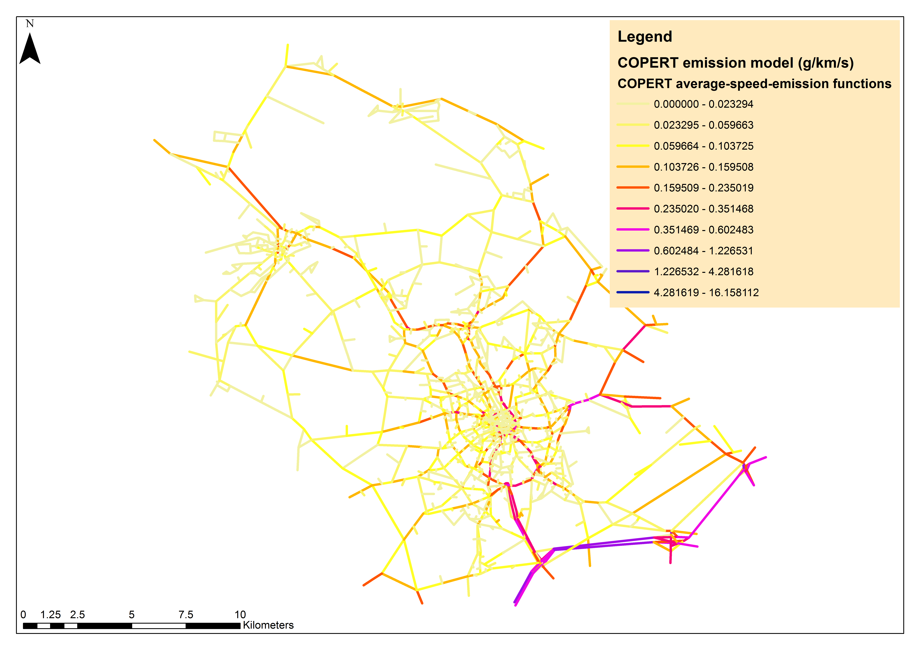
Emission Modeling
Notes:
The graphic in this slide shows the distribution of vehicle emission rates in grams/kilometer/second across the road network under study, for NOx, at the link level. This data was used as input to the next model: the atmospheric dispersion model

Slide 12
Atmospheric Dispersion Modeling
The next step was to convert vehicle emission rates to ambient air pollution concentrations through modeling the atmospheric dispersion of emissions
A commercial atmospheric dispersion model called Atmospheric Dispersion Modelling System-Urban (ADMS-Urban) was used for that purpose
Gaussian plume model
Key inputs are source parameters, diurnal profiles of emissions, meteorological data, traffic emission rates, background air pollution concentrations from other sources and the output or receptor points at which air pollution levels would be estimates
Outputs can be generated through a variety of formats such as hourly, monthly or yearly air pollution concentrations. In this case, the model was used to estimate annual air pollution concentrations
Notes:
One of the most commonly used dispersion modeling packages in the UK is the Atmospheric Dispersion Modelling System; referred to as ADMS, with ADMS-Urban being its most comprehensive and up-to-date version. ADMS-Urban is a PC-based model, which simulates the atmospheric dispersion of pollutant emissions from traffic, industrial and domestic sources, within urban areas. Cambridge Environmental Research Consultants first developed the system in the UK in 1990. Currently over eighty local authorities, including Bradford Metropolitan District Council, use ADMS-Urban for their Review and Assessment of air quality and to develop air pollution action plans and corrective strategies when needed. ADMS-Urban is also a recognized tool under the UK National Air Quality Strategy process; which further supports its use.
The ADMS-Urban model uses a Gaussian plume distribution to calculate pollutant concentrations except in the case of vertical distribution under convective/unstable atmosphere conditions where the model employs a skewed Gaussian. The framework of the ADMS-Urban model including its key inputs, processes/modeling options and outputs as shown in the next slide and described in full in the software’s manual (Cambridge Environmental Research Consultants Ltd, 2014).
Briefly, the inputs required are 1) source parameters of the included sources (e.g. road, industrial and grid sources); 2) time varying emissions to account for e.g. diurnal changes in traffic flows and, consequently, emissions; 3) meteorological data including site data (surface roughness and latitude), wind speed, wind direction, cloud cover; 4) background concentrations of the modelled pollutants and 5) locations of receptor points or grids. The outputs generated could be 1) short-term air pollution concentrations (over an hour or 15 minutes) and 2) long-term air pollution concentrations represented as annual averages, percentiles or exceedances.

Slide 13
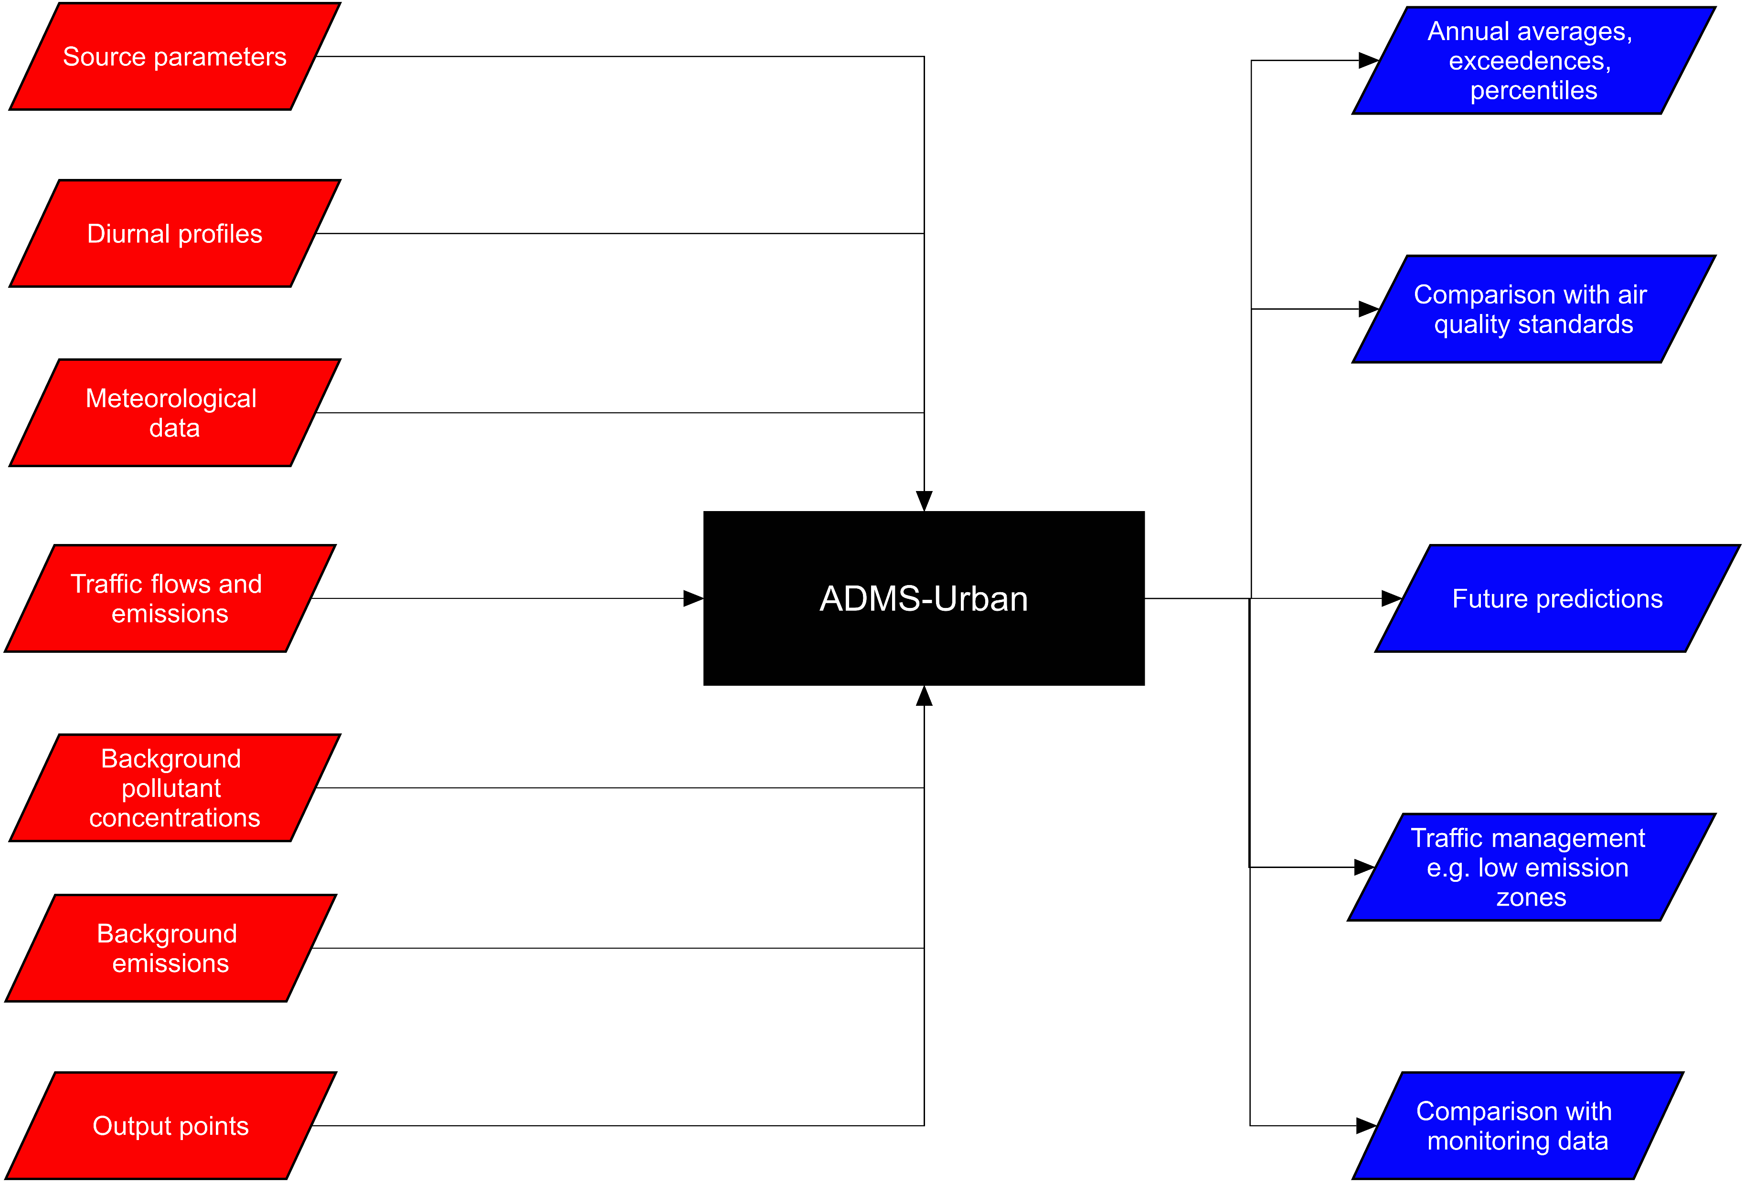
Atmospheric Dispersion Modeling
Notes:
This graphic shows the key inputs and outputs for ADMS-Urban.
Compilation of Input Data for of ADMS-Urban
Site and Meteorological Data
The ADMS-Urban model requires input data about the modeling site and meteorological conditions. The meteorological data was entered through a prepared meteorological data file including the following parameters in a series of hourly sequential data covering year 2009:
‘YEAR’: the year
‘TDAY’: the Julian day number
‘THOUR’: time of data
‘T0C’: temperature in Cº
‘U’: wind speed in m/s
‘PHI’: wind direction in degreesº
‘P’: precipitation rate in mm/h
‘CL’: cloud cover in oktas
‘RHUM’: relative humidity in percent
This data is used in the model to calculate the boundary layer height and other parameters used in the dispersion simulations. The meteorological data was obtained from the Bingley Samos weather station (metoffice.gov.uk, ND) which was 9.7 km of the city centre (Bradford’s City Hall) and had the following coordinates: 53°48'39.6"N 1°51'54.0"W. To verify this weather station’s readings, this data was aggregated and compared to annual data published on-line by the commercial company Weather Underground (https://www.wunderground.com/). No anomalies were detected. A further inspection of the location of the meteorological site revealed that the site was in an open and a less built-up area than the dispersion site (i.e. the Bradford metropolitan area). Therefore, the meteorological site was considered ‘Parkland, open suburbia’, rather than the (default) ‘Large urban area’ categorization selected for the dispersion site. Due to the presence of buildings, the wind speed is expected to decrease in large urban areas when compared to parkland or open suburbia (e.g. rural locations). This effect was, therefore, taken into account by using different categorizations and surface roughnesses for the dispersion versus the meteorological site.
Site and Meteorological Conditions entered in ADMS-Urban
Site data
Input (default value)
Rationale and description, where applicable
Latitude
53.8º (52º)
Latitude and longitude coordinates for Bradford, United Kingdom in Decimal are 53.79391, -1.75206
Dispersion site – surface roughness (m)
1.5 (0.5, ‘Parkland, open suburbia)
Surface roughness at the dispersion site (in meters) is based on land use and corresponding values for different land use types are given in the model. The value 1.5 corresponds to ‘Large urban areas’, which was considered most appropriate
Dispersion site – use advanced option?
Checked and following data entered – surface albedo = 0.23 (0.23), Priestley-Taylor parameter = 1 (1), minimum Monin-Obukhov length (m) = 30 (30) were defined
Surface albedo = 0.23 (the ground is not snow covered), Priestley-Taylor parameter = 1 (moist grassland), Minimum Monin-Obukhov length (m) = 30 (cities and large towns), Precipitation = Same as met. Site
Met. measurement site – surface roughness (m)
0.5 (Use dispersion site value)
The meteorological measurement site characteristics were considered different from those at the dispersion site as the meteorological measurement site was in the urban area of Bradford but in an open and less built-up area. The value 0.5 corresponds to ‘Parkland, open suburbia’, which was considered most appropriate
Meteorological data
Input (default value)
Rationale and description, where applicable
Met. Data
From file
A comma-separated file with a. met extension containing a series of hourly sequential data covering year 2009. Missing data were identified using the value ‘-999’. A total of 779 hours was the maximum missing number of hours (for the CL parameter) in the year 2009 (9% of the data)
Height of recorded wind (m)
10 (10)
Default value selected, no other specific data was available
Met. data in sectors of (degrees)
Checked – 10 (10)
Wind direction measurements were reported to the nearest 10 degrees (i.e. wind data are in 10-degree sectors)
Met. Data are hourly sequential
Checked
The meteorological data was a series of hourly sequential data covering year 2009
Background Air Quality Data
NO_{x} air pollution background data was also needed in the dispersion modeling to account for the NO_{x} contribution of air pollution sources other than traffic. Multiple sources of background air pollution data were considered, including:
A site in Bingley, which was classified by CBMDC as a background station, but had a high annual NO_{x} mean of 81 µg/m³ and hence was excluded;
24 urban background NOx measurements sites conducted for another research project (ESCAPE) which had an average annual NO_{x} of 38.4 µg/m³; and
Background air pollution maps from Department for Environment, Food and Rural Affairs (DEFRA) which give spatially varying annual NO_{x} concentrations at 1km x 1km grids covering sources like industry, rail, domestic, aircraft emissions, regional rural concentrations
Model’s validation indicated that using the spatially varying background concentrations from DEFRA’s map rather the constant concentration from the ESCAPE’s diffusion tubes resulted in better model performance. As such, and because spatially varying background concentrations were considered more realistic, the DEFRA background map was used in final analyses.
The varying NO_{x} background concentrations ranged from about 8.5 to 71 (mean = 14.73) µg/m³, based on the grid’s location. The underlying modeling suite meets the requirements for uncertainty specified in the European Air Quality Directives (Department for Environment Food and Rural Affairs, N.D.). The background concentrations originated from the following sources: industry, domestic, aircraft, rail, point sources, rural sources and “others”, as described in more detail in Department for Environment Food and Rural Affairs documentation.
In the main analysis, all the traffic sources were excluded from the final NO_{x} background concentrations used, to avoid any double counting of TRAP. The only TRAP component that was included on top of the NO_{x} background concentrations was that estimated by ADMS-Urban. The traffic sources excluded are motorways, trunk A roads, primary A roads and minor roads and cold starts. The exclusion of minor roads and cold starts, however, may result in a worse performance of the ADMS-Urban model as these sources were not explicitly included in the SATURN traffic network, which was focused on main and strategic roads. As such, an additional sensitivity analysis explored the impact of adding minor road and cold start concentrations to the ADMS-Urban models’ estimates.
Road Emission Sources Data
4,500 road sources and their NO_{x} emission rates defined in g/km/s were used in the dispersion modeling. Road source emission rates were entered directly into the model and were not calculated from traffic flow data and the model’s in-built database of traffic emission factors; as regularly practiced. This bypassed the in-built emission models/average-speed-emission functions and was done to enable a full and exhaustive comparison of the impact of emission factors on the final modeling outputs (air quality and subsequently health impacts). Also, the traffic flow categorization permitted within ADMS-Urban was restricted to a maximum of 6 vehicle categories: passenger car < 3.5 t; London taxi/Hackney carriage < 3.5 t; LDVs < 3.5 t; motorcycles/moped < 3.5 t; HDVs ≥ 3.5 t; and buses/coaches ≥ 3.5 t. This was a much less detailed description of the traffic fleet than constructed in the present study which modelled 167 vehicles classes instead.
The emission rate in g/km/s from each road/link was calculated as the product of the emission factor in g/km for each vehicle class on the link (at that specific link’s speed), the number of vehicles/hour for each vehicle class on the link, summed across all vehicle classes on each link and multiplied by a time conversion factor (Equation below):
$$Road link emission rate \left(\frac{\frac{g}{km}}{s}\right)=\sum{(vehicle class specific emission factor at link speed (g/km)}∗number of vehicles in each class)∗ \left(\frac{1 hour}{3600 seconds}\right)$$
This process was undertaken for the 24 daily hours in both the weekdays and the weekend (this data was used to develop time varying emission factors; described next). Thus, at each road link, and in each hour of the day, an emission rate was calculated.
As only 1 dataset of road sources emissions can be entered in ADMS-Urban (i.e. it is not possible to enter the 24-hour emissions datasets to be modelled), the AM peak hour was the one selected to be directly used in the model’s run. A Microsoft Access database, in ADMS-Urban Emission Inventory format, was prepared as an input file. The Emission Inventory contained the AM emission rates; other road characteristics including source names; road widths (an average of 17 m) and geographical locations of the start and end of each road link.
The maximum number of road sources possible to model in one ADMS-Urban (version 3.0.0.) run was 3000. Therefore, road links and their emissions had to be split in smaller input files and runs; the concentration results of which at the same set of output points were summed up at the end of the modeling. This was considered an acceptable practice in this study where chemistry was not modelled and the same set of output points were used in every run. Further, this was checked by running 1500 roads at once and then splitting them into 3 input files of 500 roads each, the NO_{x} sum of which was equal to the results of the bigger run.
Time Varying Emission Factors
Unless otherwise specified, the emissions rates in ADMS-Urban are assumed to be constant across all hours of the day; based on the hour that has been input in the model. As such the effect of the traffic, and therefore the emissions, diurnal variations are disregarded. This is likely to impact the final estimated air pollution and exposure levels and therefore the associated health impacts. To compensate for this, an additional modeling option specifying time varying emission factors was used to enable modeling NO_{x} concentrations from vehicle emissions that vary by hour of the day. The ‘time varying emission factors’ option within the model was checked and a single set of hourly time varying emission factors, for each hour in a weekday and a weekend, were specified. These factors needed to be entered manually, for each model run, as no automatic import option existed.
The time varying emission factors were calculated as follows. At each individual link, traffic flows across all weekday and weekend hours were estimated either using the SATURN outputs, or, where not modelled, using the data from automatic traffic counters in the study area. At each hour of the weekday and the weekend and at each link, the link’s emission rates (g/km/s) were calculated by linking the hour’s traffic flow at that link with the COPERT average-speed-emission functions (. At each hour, a ratio between each link’s emission rate and that link’s emission rate in the AM peak hour was calculated and considered as the time varying emission factor for that specific link. The median value of the time varying emission factors across all links, at each hour, was selected as the time varying emission factor of that hour. The median value was selected instead of the average value as the distribution of time varying emission factors was skewed to the right and an average value, being highly susceptible to the influence of high outliers, did not result in standard reasonable traffic trends. Conversely, the use of the median value allowed replicating standard traffic diurnal profiles. During the simulation, the ADMS-Urban model used the time varying emission factors to multiply the AM hour emission rates for each road (the only input) by the appropriate factor specified for each hour.
Output Points (Grids Data)
The grids data screen within the model allows the user to define the points at which the air pollution concentrations, of NO_{x} in this case, will be output by the model (. 46,452 specified output points within Bradford were selected at which the NO_{x} concentrations will be output by the model. The specified output points covered a box of ≈ 40 * 33 km and were exactly the same points used to construct another air pollution model in Bradford, which estimated NO_{x} concentrations at a spatial resolution of 100 * 100 m grids.
Each of the 46,452 specified output points represented the middle point of a 100 * 100 m grid. Although TRAP can vary within these 100 * 100 m grids, a finer grid was not considered feasible in this study due to the impracticality of running the ADMS-Urban model multiple separate times to allow for a higher number of output points (the maximum total number of output points possible to enter in one run is 51,005) and as the model run times was very long and partly depended on the number of specified output points. A finer grid was also not expected to have a crucial impact on the final results, due to the nature of this study where air pollution concentrations are finally averaged over census tracts for the health impact assessment.
Another 126 points representing the locations of 118 diffusion tubes and 8 fixed-site monitoring stations in Bradford were added and their data was used for validation. These points differed in locations, coverage, site selection and purpose, and therefore, allowed to explore the impact of different validation datasets on air quality modeling performance (Khreis et al., 2017b).

Slide 14
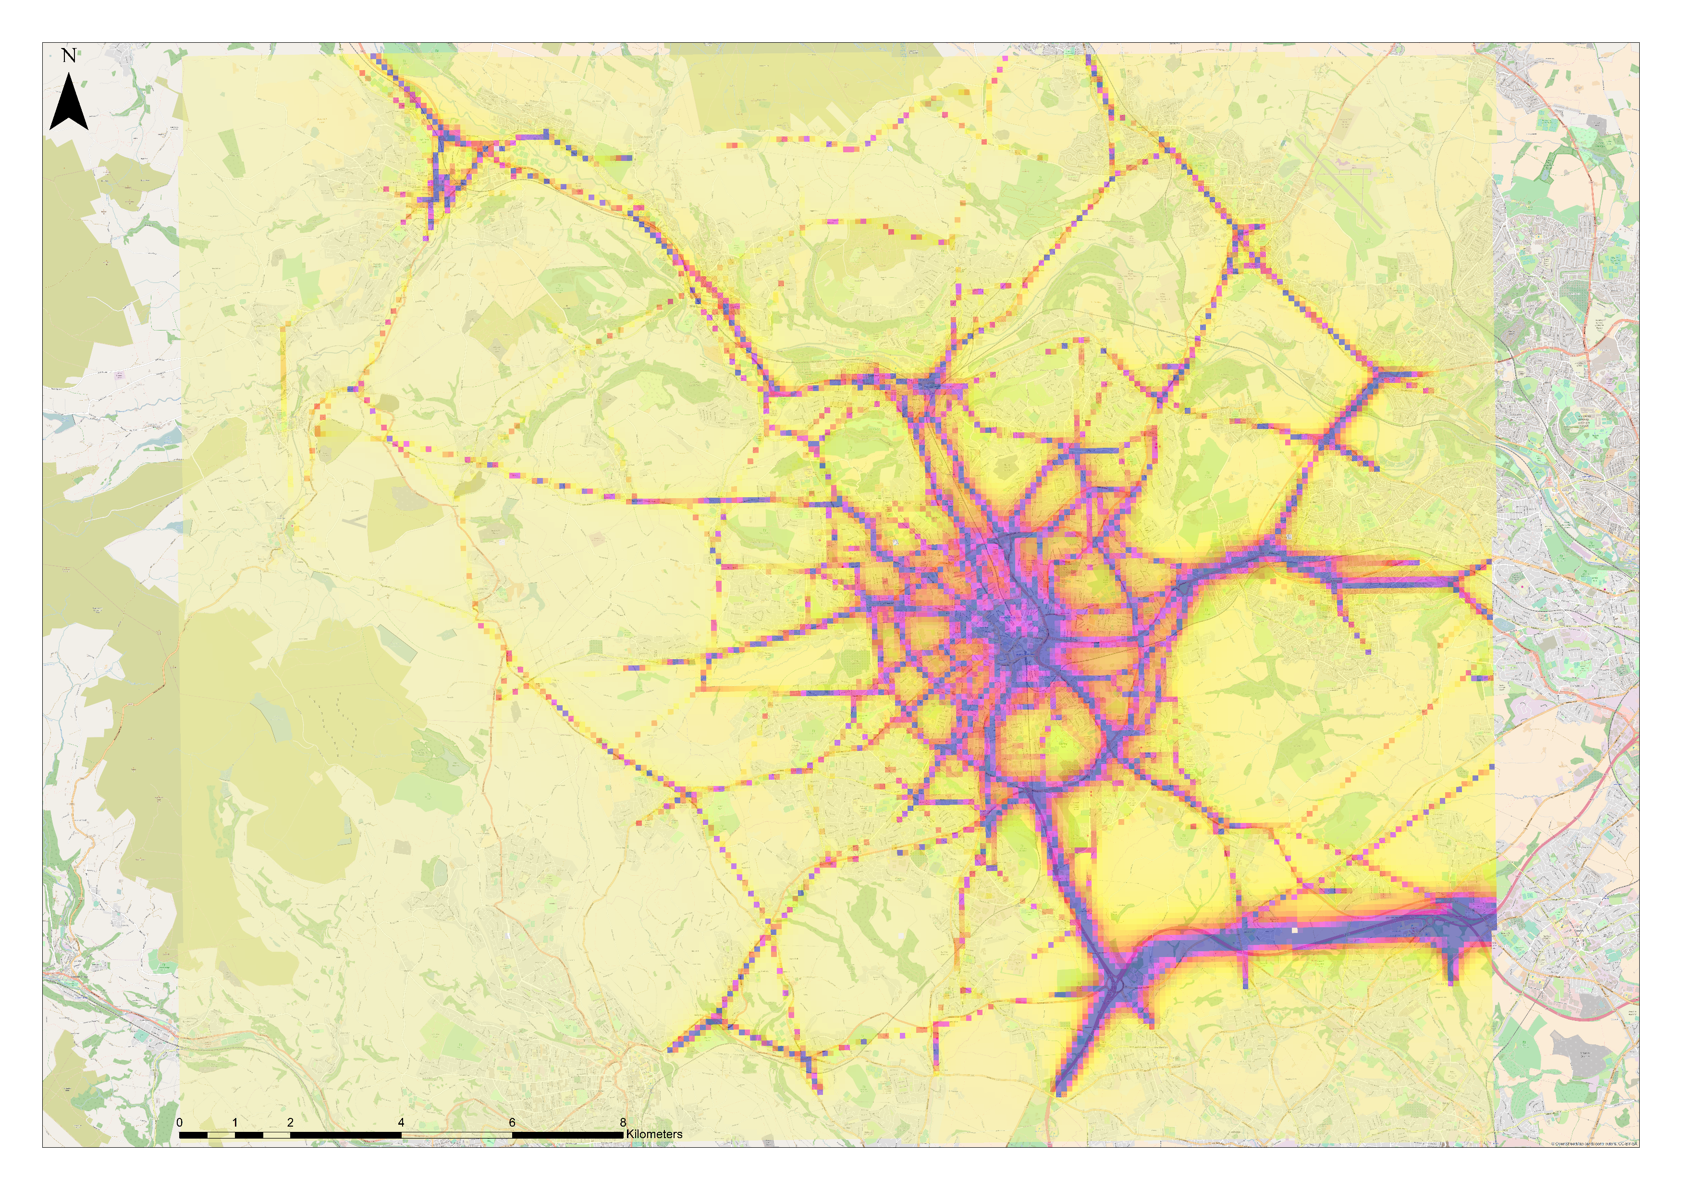
Atmospheric Dispersion Modeling Results
Annual NOx concentrations for 2009 in µg/m³

Slide 15
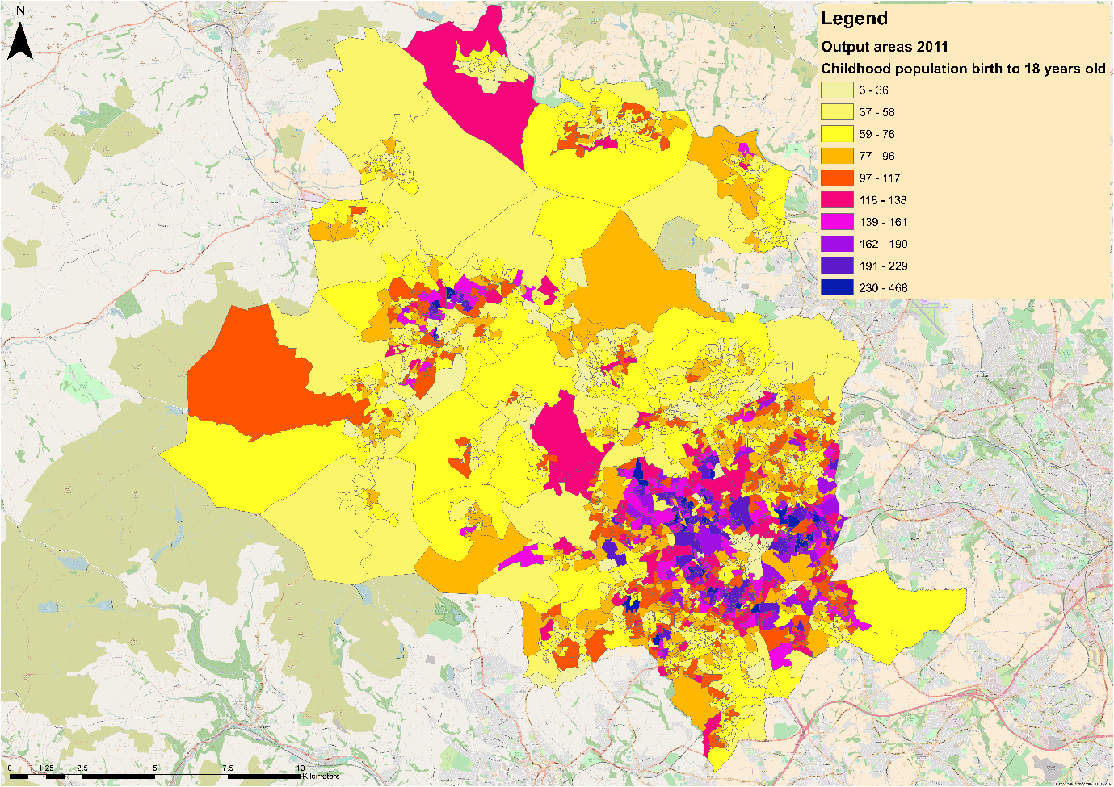
Exposure Assignment
NO₂ was generated by conversion of the NOx levels estimated from the atmospheric dispersion models using one average Bradford-specific NO₂/NO_{x} ratio
This ratio was calculated using data from 41 measurement sites across Bradford (Cyrys et al., 2012)
At those sites, the NO₂/NO_{x} ratio ranged from 0.39 to 0.75 with a calculated average of 0.60. The average value was used for the conversion
Notes:
The ‘output area’ was the lowest geographical level at which census population data were available. This was the geographical level used to assign childhood population data, exposure data, attributable fraction and attributable cases. The characteristics of Bradford’s output areas listed below.
Number of output areas: 1,528 output areas
Total number of children in all output areas (birth – 18 y.o.): 143,472 children
Average number of children in all output areas (birth – 18 y.o.): 94 children
Minimum number of children in an output area (birth – 18 y.o.): 3 children
Maximum number of children in an output area (birth – 18 y.o.): 468 children
Percentage of children ≤ 6 years old (pre-school age) in all output areas: 44.7%
Percentage of children > 6 years old (school age) in all output areas: 55.3%
Average area of all output areas (m²): 239,802
Minimum area of an output area (m²): 3,817
Maximum area of an output area (m²): 15,395,650
There were 1,528 output areas in which a total of 143,472 children lived (year 2011). The digital boundaries of the output areas were extracted from the UK Data Service: ‘Boundary Data Selector’ (https://borders.ukdataservice.ac.uk/). The childhood population and age data were extracted from the UK Data Service: ‘InFuse’ (http://infuse.ukdataservice.ac.uk/). The 2011 census data were used as these were considered more compatible with the 2009 exposure estimates than the 2001 census data; the only other dataset available. The childhood population data within the output areas’ digital boundaries is shown above. Most children lived in the areas within and around the Ring Road; in the South East of Bradford.
The census tracts’ average annual exposure levels for NOx were obtained by intersecting the air pollution maps with the underlying census maps and summarizing the raster cell values (from the air pollution maps) contained within each underlying census tract/polygon (using the ‘isectpolyrst’ tool in the Geospatial Modelling Environment suite version 0.7.4.0.).
Where there was no intersection between the raster air pollution layers and the polygon boundaries (i.e. no underlying air pollution estimate because the census coverage was larger), these polygons were excluded from the analysis. The number of such polygon were 156(/1,528). In these areas, 10,089(/143,472) children, or ≈ 7%, of all children between birth and the age of 18 years lived. Therefore, this exclusion is expected to under estimate the burden of childhood asthma attributed to air pollution in Bradford.

Slide 16
Exposure-Response Assessment
The exposure-response functions (ERF) were sourced from a meta-analysis which quantified the association between multiple traffic-related air pollutants, including NO₂, and the subsequent onset of asthma in children aged birth to 18 years old (Khreis et al., 2017)
As discussed in lecture #39, sourcing ERF from meta-analyses is preferable in the absence of local ERFs
Khreis et al. (2017) found that for every 4 μg/m³ increase in NO₂ exposure, the risk of children developing asthma increases by 5% and this increase is statistically significant and robust to multiple sensitivity analyses

Slide 17
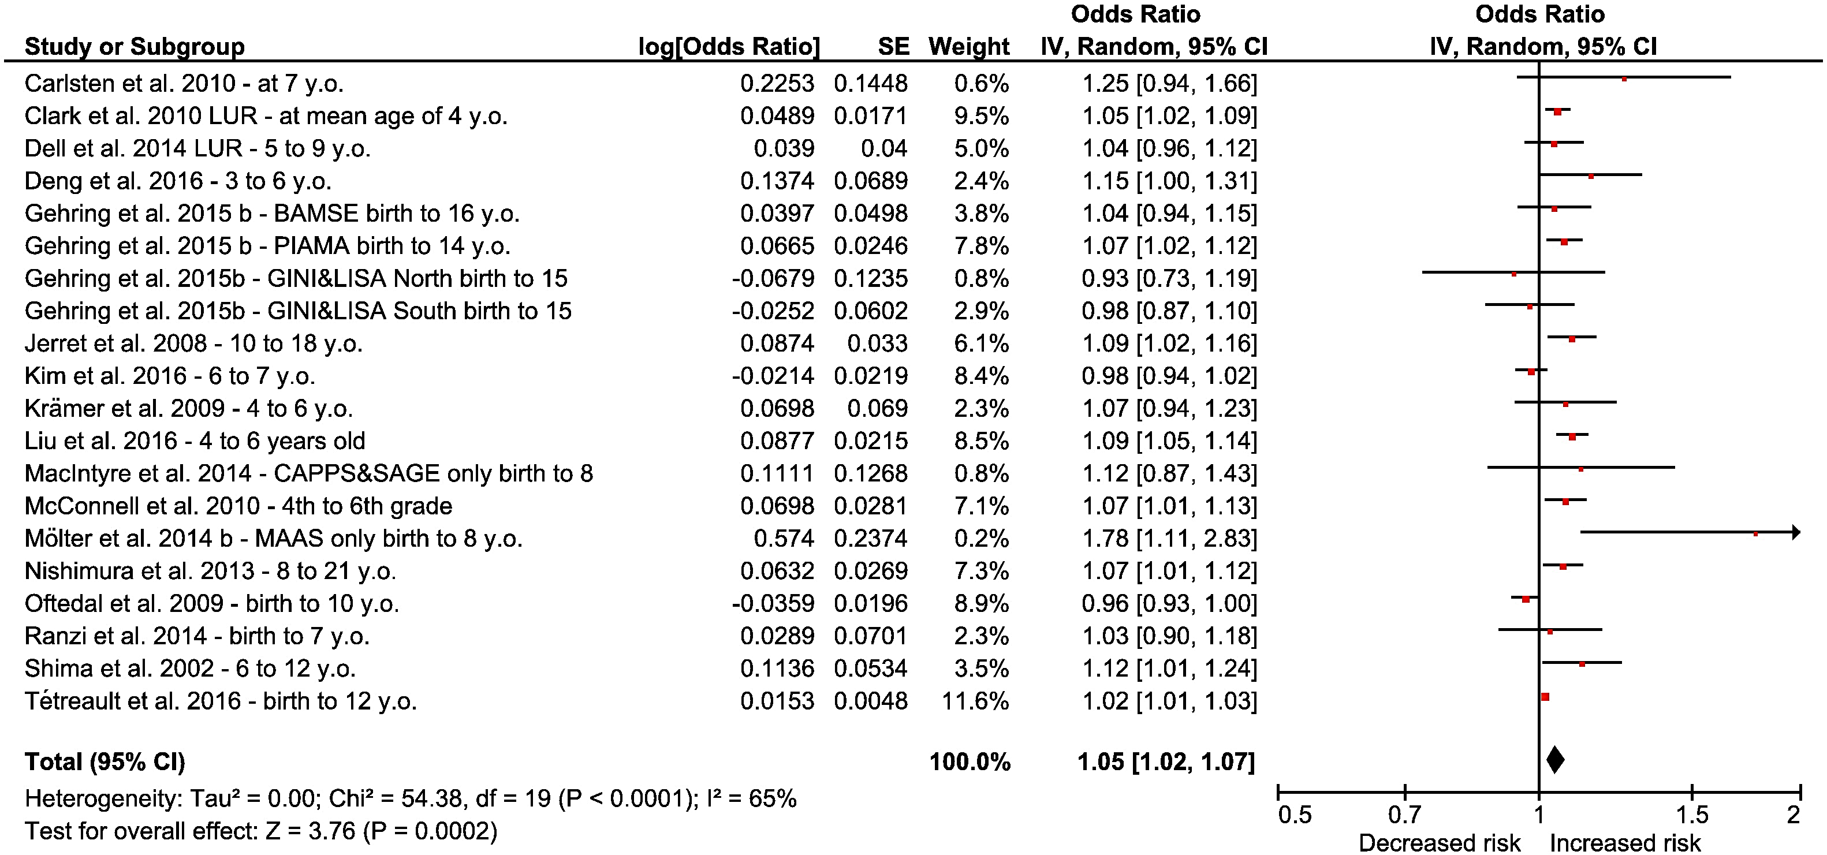
Exposure-Response Assessment
Exposure-response function/ risk estimate
NO₂ random-effects meta-analyses. Individual and summary random-effects estimates for associations between NO₂ per 4 μg/m³ and asthma at any age. Source: Khreis et al. (2017)
Notes:
In the overall meta-analysis for NO₂, the random-effects overall risk estimate for asthma development was statistically significantly increased (for 4 µg/m³ NO₂, overall risk estimate = 1.05, 95% CI 1.02, 1.07). Yet, there was substantial and statistically significant heterogeneity (see Figure above). Results from the fixed-effects model were comparable (see original paper). Random-effects overall risk estimate remained statistically significantly increased in all sensitivity analyses. In the age-specific meta-analysis, the random-effects overall risk estimate was increased and statistically significant for both age groups. Heterogeneity remained high in both analyses.

Slide 18
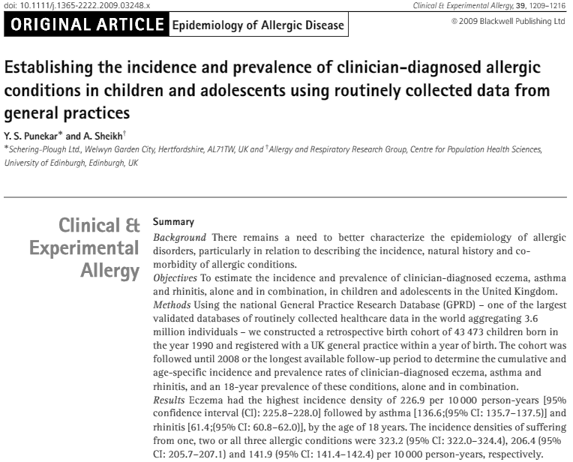
Baseline Health Data
136.6 asthma cases per 10,000 person-years, by the age of 18 years
Notes:
The incidence rate of asthma in children from birth to 18 years old in Bradford was not found in the peer reviewed or the grey literature. Instead, the national incidence rate of childhood asthma (birth to 18 years old) in the UK was used. This was extracted from Punekar and Sheikh (2009) who reported 137 clinician-diagnosed asthma cases per 10,000 person-years, by the age of 18 years, as identified for 43,473 children indexed in the General Practice Research Database (GPRD).
In another Bradford specific publication, Mebrahtu et al. (2015) identified asthma, based on diagnostic and prescription codes in the primary care database, in 13,734 children aged 0 to 7 years, participating in the Born in Bradford cohort (Wright et al., 2013). Using the data reported in this paper, an asthma incidence rate of 123 per 10,000 person-years, by the age of 7 years, was calculated. However, and as the authors note, this figure is likely to be conservative due to the asthma diagnosis difficulties in this age range (Mebrahtu et al., 2015). Indeed, Bradford is known to have childhood asthma rates higher than national and regional averages. Hence, Mebrahtu et al. (2015) also established another outcome termed ‘wheezing disorders based on treatment’ which identifies the existence of at least two drug prescriptions indicated for the treatment of asthma a minimum of 1 week and a maximum of 12 months apart. Based on this outcome, an asthma incidence rate (‘based on treatment’) of 442 per 10,000 person-years, by the age of 7 years, was calculated. Both incidence rates calculated from Mebrahtu et al. (2015) were used in sensitivity analyses to explore the influence of the background incidence rates in the impact assessment (Künzli, 2002).

Slide 19
Health Impacts Modeling
Standard methods explained in lecture #39
1,528 output areas which census data was available for -- childhood population (birth – 18 years old) extracted -- 132,819 kids
Asthma incidence rate from the literature
Expected asthma cases due to all causes =
childhood population * childhood asthma incidence rate
Risk estimate _{exposure difference} =
Exp(((Ln(risk estimate/exposure_{current}) * (exposure_{difference})
Notes:
Exposure-response functions were extracted from the meta-analyses undertaken in this research study. The risk estimates for asthma development from these exposure-response functions had to be scaled to the difference in exposure between the reference (2009) average exposure level at each census tract and for the investigated exposure reduction scenario:
Scenario #1: air pollution reduced to zero; and
To scale a risk estimate to the exposure difference between the reference and the counterfactual scenarios, standard methods were used – see lecture #39

Slide 20
Health Impacts Modeling
The population attributable fraction (PAF) -- the proportional reduction in morbidity that would occur if exposure to air pollution was reduced or to an alternative ideal exposure scenario (zero)
PAF = (Risk estimate_{exposure difference} -1)/Risk estimate_{exposure difference}
Attributable number of cases = PAF*expected asthma cases due to all causes
Sum-up all attributable number of cases across all census tracts
Notes:
The population attributable fraction (PAF) is the proportional health burden of the health outcome of interest that is attributable to the difference in exposure level between the exposure reduction and the reference. PAF is a standard metric used in BoD and HIA studies and can be calculated as shown above.

Slide 21
Results and Discussion
Number and percentage of incident childhood asthma cases estimated with specific contribution of traffic to that burden
Likely underestimated because the atmospheric dispersion modeling estimates are underestimated by over 31% at traffic sites (Khreis et al., 2018b)
Estimated Annual Attributable Asthma Cases in Bradford using the COPERT-based Dispersion Models (baseline asthma incidence = 137 per 10,000 person-year, baseline asthma incident cases = 1827)
Pollutant | Attributable cases | Attributable cases lower 95% CI | Attributable cases upper 95% CI | Percentage of all cases | Attributable cases to traffic
NO₂ | 321 | 139 | 428 | 18% | 62 (3%)
Estimated Annual Attributable Asthma Cases in Bradford using the COPERT-based Dispersion Models (baseline asthma incidence = 137 per 10,000 person-year, baseline asthma incident cases = 1827) complemented by minor road and cold start concentrations
Pollutant | Attributable cases | Attributable cases lower 95% CI | Attributable cases upper 95% CI | Percentage of all cases | Attributable cases to traffic
NO₂ | 394 | 173 | 520 | 22% | 128 (7%)
Notes:
The advantage of the full-chain approach is that you parse out the specific contribution of traffic to the overall air pollution levels and the attributable health burden
However, these estimates are likely underestimated as the validation of the atmospheric dispersion modeling results showed that the models’ estimates were an underestimation, especially at traffic sites
The addition of minor road and cold start concentrations almost doubled the asthma cases attributable to traffic, bringing the percentage of the air pollution attributable asthma cases from 3% up to 7% for traffic-NO2 and from 6% up to 12% for traffic-NOx. Interestingly, the inclusion of minor roads and cold starts also brought the estimates of the two exposure models, the dispersion and the land-use regression models, closer
The underestimation is most likely a result of overestimating average traffic speeds in the traffic model (i.e. underestimating congestion and start-stop driving) and the underestimation of vehicle emissions in the emission model, both issues discussed widely in the literature – see for example PhD thesis by Khreis: Khreis, Haneen Rami Inad (2018) Early-Life Exposure to Traffic-Related Air Pollution and Risk of Development of Childhood Asthma: A Systematic Review and Meta-Analysis, a Novel Exposure Assessment Study and a Health Impact Assessment. PhD thesis, University of Leeds. Available from: http://etheses.whiterose.ac.uk/19936/

Slide 22
Take-Home Messages
Full-chain BoD or HIA allow to quantify the specific contribution of traffic (or other sources) to the burden of disease attributable to air pollution
It involves multiple steps including knitting together distinct models of traffic activity, vehicle emissions, atmospheric dispersion and burden of disease assessment
The validation of the final results depend of the validation of the individual steps’ results like validating traffic flows and speeds, vehicle emissions (though measurements are often absent), and air pollution concentrations. The health impacts are predictive estimates and are not validated
Often, the atmospheric dispersion modeling results represent underestimation of real air pollution levels, and this issue is prominent at traffic sites
Estimates are also sensitive to the baseline incidence rate used in the analysis
The estimates, however, are useful and can be used in policy decision making by for example, incorporating them into cost-benefit analysis
Notes:
There are currently no exhaustive exercises of the chain’s validation
There is a need of improving the accuracy of input at each step of the chain (e.g. traffic models under predict congestion, emission rates not independently validated)
Sources of error:
Traffic activity; vehicle proportions; vehicle emission standards; emission factors; spatial alignment of sources; application and compatibility of models; dispersion modeling configuration; modelled vs. true exposures; reliability of health outcomes diagnosis
Air pollution contributes to the development of childhood asthma and is responsible for a substantial but preventable BoD.
Full-chain quantitative HIA models provide valuable but underutilized tools to estimate the BoD associated with air pollution, whilst specifically disentangling the contribution of traffic to this burden.
Such BoD estimates are relevant for numerous stakeholders as they provide defensible numeric indices of health risk factors, inform the health benefit-risk trade-off of public policies and provide the basis for mainstream economic evaluations such as cost-benefit analyses.
As it stands, full-chain quantitative HIA modelling is in its early development and is a laborious and highly time-consuming process which carries numerous uncertainties, especially at the initial stages of traffic and emission modelling. T
he earlier the errors occur on the full-chain, the more influence they are likely to have on the final results. The feasibility, utility, validity and resolution of the full-chain quantitative HIA models and their supporting data need to be improved in the future.
This can be done through the systematic collation, provision and verification of input data, the further validation of and improvements in the chain’s whole and distinct steps and the application of the modelling to real-life questions and scenario analysis, ideally with the participation of different disciplines and stakeholders.

Slide 23
List of Abbreviations
ADMS-Urban: Atmospheric Dispersion Modelling System Urban
BoD: Burden of Disease
CI: Confidence Intervals
DEFRA: Department for Environment, Food and Rural Affairs
ERF: Exposure-Response Functions
HIA: Health Impact Assessment
NO₂: Nitrogen Dioxide
OR: Odds Ratio
PAF: Population Attributable Fraction
PCU: Passenger Car Units
RR: Risk Ratio
SATURN: Simulation and Assignment of Traffic to Urban Road Networks model
TRAP: Traffic-Related Air Pollution
UK: United Kingdom

Slide 24
References
Cambridge Environmental Research Consultants Ltd, C. E. R. C. 2010. ADMS-Urban, An Urban Air Quality Management System, User Guide, Version 3.0. Cambridge, UK: Cambridge Environmental Research Consultants Ltd, C.E.R.C.
Cyrys, J., Eeftens, M., Heinrich, J., Ampe, C., Armengaud, A., Beelen, R., Bellander, T., Beregszaszi, T., Birk, M., Cesaroni, G. and Cirach, M., 2012. Variation of NO2 and NOx concentrations between and within 36 European study areas: results from the ESCAPE study. Atmospheric Environment, 62, pp.374-390.
Khreis, H., Kelly, C., Tate, J., Parslow, R., Lucas, K. and Nieuwenhuijsen, M., 2017. Exposure to traffic-related air pollution and risk of development of childhood asthma: a systematic review and meta-analysis. Environment international, 100, pp.1-31.
Khreis, H., de Hoogh, K., Zietsman, J. and Nieuwenhuijsen, M.J., 2018b. The impact of different validation datasets on air quality modeling performance. Transportation Research Record, 2672(25), pp.57-66.
Khreis, H., de Hoogh, K. and Nieuwenhuijsen, M.J., 2018. Full-chain health impact assessment of traffic-related air pollution and childhood asthma. Environment international, 114, pp.365-375.

Slide 25
References
Khreis, H. and Nieuwenhuijsen, M.J., 2019. The health impacts of urban transport: Linkages, tools and research needs. In Measuring Transport Equity (pp. 131-142). Elsevier.
Mebrahtu, T.F., Feltbower, R.G. and Parslow, R.C., 2015. Effects of birth weight and growth on childhood wheezing disorders: findings from the Born in Bradford Cohort. BMJ open, 5(11).
National Atmospheric Emissions Inventory, N. A. E. I. and Ricardo Energy and Environment, R.-A. 2014. Vehicle fleet composition projections (Base 2013) - National Atmospheric Emissions Inventory.
Nieuwenhuijsen, M.J., Khreis, H., Verlinghieri, E., Mueller, N. and Rojas-Rueda, D., 2017. Participatory quantitative health impact assessment of urban and transport planning in cities: A review and research needs. Environment international, 103, pp.61-72.
Punekar, Y.S. and Sheikh, A., 2009. Establishing the incidence and prevalence of clinician‐diagnosed allergic conditions in children and adolescents using routinely collected data from general practices. Clinical & Experimental Allergy, 39(8), pp.1209-1216.
Thurston, George D., John R. Balmes, Erika Garcia, Frank D. Gilliland, Mary B. Rice, Tamara Schikowski, Laura S. Van Winkle et al. "Outdoor Air Pollution and New-Onset Airway Disease. An Official American Thoracic Society Workshop Report." Annals of the American Thoracic Society 17, no. 4 (2020): 387-398.
Wright, J., Small, N., Raynor, P., Tuffnell, D., Bhopal, R., Cameron, N., Fairley, L., Lawlor, D.A., Parslow, R., Petherick, E.S. and Pickett, K.E., 2013. Cohort profile: the Born in Bradford multi-ethnic family cohort study. International journal of epidemiology, 42(4), pp.978-991.

Slide 26
Reading List
Khreis, Haneen Rami Inad (2018) Early-Life Exposure to Traffic-Related Air Pollution and Risk of Development of Childhood Asthma: A Systematic Review and Meta-Analysis, a Novel Exposure Assessment Study and a Health Impact Assessment. PhD thesis, University of Leeds. Available from: http://etheses.whiterose.ac.uk/19936/
O'Connell, E. and Hurley, F., 2009. A review of the strengths and weaknesses of quantitative methods used in health impact assessment. Public health, 123(4), pp.306-310.

