Slide 1
www.carteeh.org

Slide 2
Lecture #38: Quantitative Health Impact and Burden of Disease Assessment
Haneen Khreis
Texas A&M Transportation Institute
H-Khreis@tti.tamu.edu, (979) 317-2799 x42799
The author declares that there is no conflict of interest
Lecture Track(s): HT/TT/PPT
David Rojas-Rueda
Colorado State University
David.rojas@colostate.edu
The author declares that there is no conflict of interest
Lecture Track(s): HT/TT/PPT
Notes:
Health Track (HT)—mainly targeted at urban planners, transportation planners, and engineers with limited knowledge of public health-related concepts;
Transportation Track (TT)—mainly targeted at environmental epidemiologists and public health professionals with limited knowledge of transportation-related concepts; and;
Planning and Policy Track (PPT)—mainly targeted at planners, civil servants, and policy and decision makers with particular interest in the science-policy link.

Slide 3
Introduction
Public policies have overreaching impacts on the economy, the environment, the society and public health
Policies in one sector can impact outcomes in other sectors
Specifically, policies, projects and programs in the non-health sector can have substantial impacts on public health
Notes:
Extracted from Mueller et al. (2020):
“Environmental, economic, social and other public policies are often so closely related that a decision in one sector affects the objectives and performance of another sector. To acknowledge this, in the past, public policies have been assessed based on their environmental, economic, or social impacts. Considering explicitly the impacts of public policies on population health is a relatively new field.”

Slide 4
Introduction
Assessing the health impacts of public policies, projects and programs, especially when this assessment is quantitative, is a relatively new field
Burden of disease and health impact assessments provide methods for quantifying the positive and/or negative health impacts of baseline conditions (burden of disease assessments) and public policies, projects and programs (health impact assessments), and the distribution of these impacts

Slide 5
Introduction
Burden of disease and health impact assessments provide means for improving public health through evidence-based policy making and also for including health in all policies
The assessments include a combination of methods whose aim is to assess the health impacts from public policies, projects and programs that do not necessarily have health as an (primary) objective (Lock, 2000)
These assessments are multidisciplinary in nature and should include stakeholders engagement and public participation components (Nieuwenhuijsen et al., 2017) but they often do not
Applications include national policy appraisal, local urban planning, transport, and water and agricultural projects (Lock, 2000)
This presentation will focus on local urban and transport planning with a special reference to traffic-related air pollution (TRAP)
Notes:
Extracted from Mueller et al. (2020):
“Health impact assessment (HIA) is an important tool to integrate health evidence into the policy decision-making process, and introduce and protect public health in all policies. HIA is a tool that can help policy-makers foresee how different interventions, policies and programs outside the health sphere, will affect health and well-being by informing on the associated health benefits and risks (Ståhl et al. 2006). HIA combines different methods and procedures to systematically identify and judge all relevant, whether intended or unintended, exposure pathways and health effects the proposed intervention, policy or program might have on the health of a population and the distribution of those effects within this population (Mindell et al. 2003; WHO 1999). Most HIAs are carried out prospectively and aim to give an outlook on expected health consequences in the future (Wismar et al. 2007). Because health is usually a strong-weighing factor to the public, outcomes of HIAs can raise health awareness and advocacy and can influence the decision-making process (Jacobs & Shapiro 1994; Burstein 1998). Therefore, outcomes of HIAs can have a strong bearing on public policy proposals (Wismar et al. 2007).”

Slide 6
Definitions
Quantitative burden of disease (BoD) and health impact assessments (HIA) are more resource-intensive than qualitative exercises
BoD assessments define the contribution of a risk factor e.g. levels of air pollution to the burden of disease in a specific context/study area. This is done by calculating the fraction of disease or death in the population, attributable to the risk factor under investigation (Vander Hoorn et al., 2004)
HIA is described as ‘a combination of procedures, methods and tools by which a policy, program or project may be judged as to its potential impacts on the health of a population, and the distribution of those impacts within the population’ (World Health Organization, 2000)
HIA assesses changes in health risks or benefits i.e. health impacts attributable to a plan (project, program) or policy in the non-health sector
In brief, the difference between a BoD and a HIA is in whether scenarios comparing different exposures are investigated
Notes:
To systematically assess and quantify health impacts, many countries and cities are increasingly using Burden of Disease (BoD) and Health Impact Assessment (HIA)
BoD and HIA studies can identify public health impacts including the health risks and benefits of current and proposed transport plans or policies
The results of BoD and HIA are easy to grasp and therefore relevant for public health professionals, policy makers and the public. They are often presented to policy makers to aid their decision making and/or to the public to catalyze their understanding of health
BoD and HIA are terms which have been used interchangeably, but there are subtle differences between these two methods
HIA includes a scenario that results in changes in health risks or benefits whilst BoD only quantifies the burden of disease attributable to a risk factor (or an implicit scenario of eliminating the risk factor, e.g. reducing air pollution exposure levels to zero or a ‘safe threshold’)

Slide 7
Definitions
While BoD studies are, in nature, quantitative, HIA studies can be quantitative and/or qualitative
The most common HIA studies, especially in policy and practice circles, are qualitative, relying on qualitative evidence, social sciences, expert opinion and stakeholder knowledge to only identify the range of the health determinants associated with a plan or policy and the direction of the health impacts (i.e. whether these are risks or benefits)
HIAs can also include a quantitative assessment adopting a comparative risk assessment approach, by investigating the health impacts of different (positive and negative) exposures, across different scenarios (Briggs, 2008)
Notes:
HIAs can also include a quantitative assessment adopting a comparative risk assessment approach, by investigating the health impacts of different (positive and negative) exposures, across different scenarios (Briggs, 2008)
Both BoD and HIA, when quantitative, can provide numeric indices of health risk factors, inform the health benefit/risk trade-off of public policies and provide the basis for other economic evaluations such as cost-benefit analyses
This facilitates and adds defensibility to the inclusion of health in public policy

Slide 8
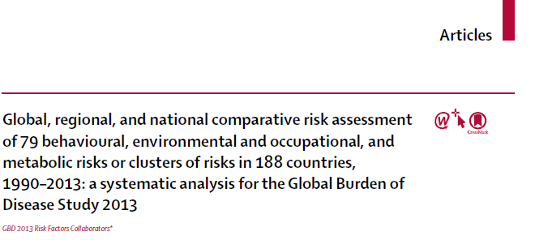
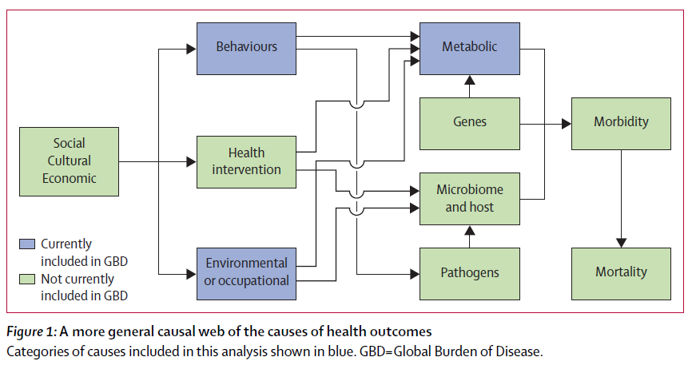
Source: GBD 2013 Risk Factors Collaborators, 2015
Notes:
This is an example of the global burden of disease (GBD) project. In this publication, the GBD present the causal framework of health determinants (also called social determinants of health) included in the GBD project. The GBD project is the most comprehensive burden of disease assessment available globally and includes most of the countries around the globe. You can see that the GBD includes health determinants related to behaviors, environmental and occupational, and metabolic. Other key health determinants are not included in the GBD, such as health interventions, genes, sociocultural, or economic factors. The GBD quantifies the morbidity and mortality related to those health determinants included in the blueish boxes.
- GBD 2013 Risk Factors Collaborators. (2015) Global, regional, and national comparative risk assessment of 79 behavioural, environmental and occupational, and metabolic risks or clusters of risks in 188 countries, 1990–2013: a systematic analysis for the Global Burden of Disease Study 2013. Lancet. 386(10010):2287-2323.

Slide 9
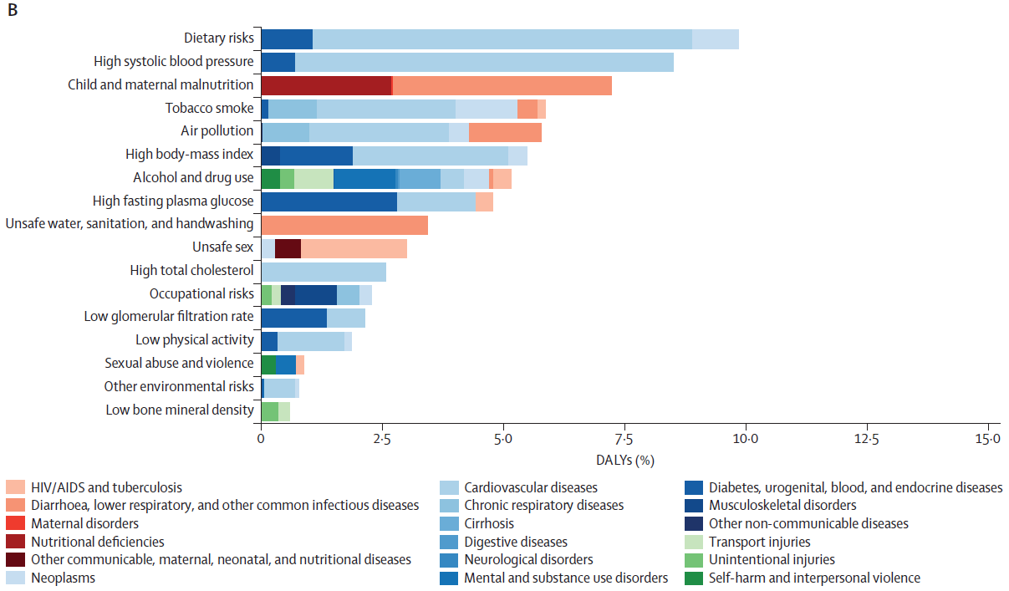
Source: GBD 2013 Risk Factors Collaborators, 2015
Notes:
This figure is an example of how the GBD project reports the quantification of health outcomes related to multiple health risk factors. In the Y-axis, the health risk factors are presented. The X-axis represents the health outcome, in this case, measured in percentage of disability-adjusted life years or DALYs. The different colors represent deferent diseases and diagnoses that are related to the risk factors on the Y-axis. The burden of disease approach helps to understand the magnitude of the health impacts (bar length) and the relevance of such health risk factors compared to other risk factors (Y-axis order).
- GBD 2013 Risk Factors Collaborators. (2015) Global, regional, and national comparative risk assessment of 79 behavioural, environmental and occupational, and metabolic risks or clusters of risks in 188 countries, 1990–2013: a systematic analysis for the Global Burden of Disease Study 2013. Lancet. 386(10010):2287-2323.

Slide 10
Methods
Undertaking a quantitative BoD or HIA combines several steps including:
defining the exposure(s) of interest, exposure(s) measures and ranges;
defining the health outcome(s) of interest associated with the exposure(s) and their frequency (incidence) amongst the exposed population;
selecting exposure-response functions (risk estimates) to quantify the strength of association between selected exposure(s) and selected health outcome(s);
combining exposure(s) data with population data and exposure-response functions to quantify the attributable proportional health burden of the health outcome of interest and;
quantifying the uncertainty in the estimated health burden (range of potential effects) (Perez et al., 2009, World Health Organization, 2015)
Notes:
The steps above ar needed to conduct a quantitative burden of disease or health impact assessment

Slide 11
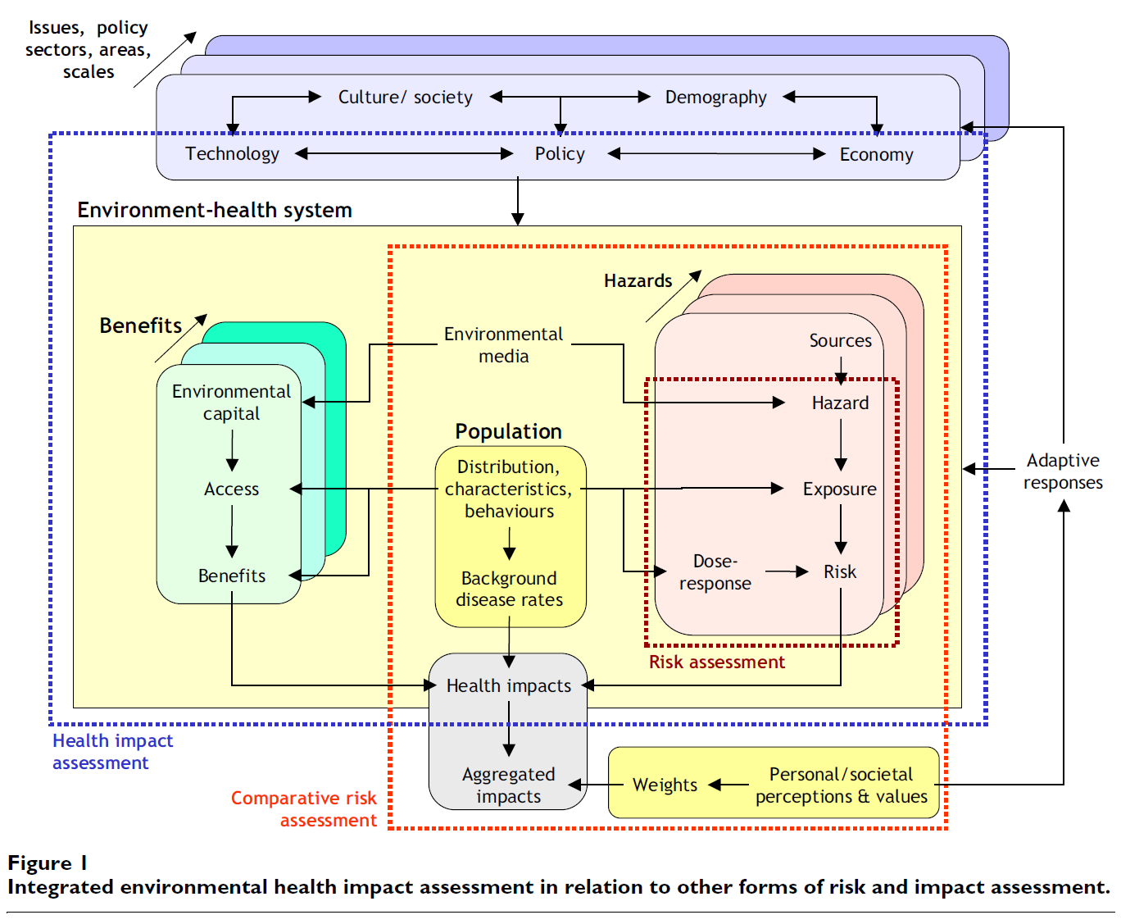
Source: Lebret, 2015
Notes:
This figure shows the different BoD and HIA parts in relation to other risk and impacts assessments.
The quantitative BoD are represented by the “Risk Assessment.”
The combination of a Quantitative BoD in the context of policy results in a quantitative health impact assessment.
- Lebret E. (2015) Integrated Environmental Health Impact Assessment for Risk Governance Purposes; Across What Do We Integrate?. Int J Environ Res Public Health. 13(1):ijerph13010071.

Slide 12
Examples including Traffic-Related Air Pollution
In the last two decades, quantitative BoD and HIA studies of transport projects and TRAP have seen a large increase especially in the academic literature (Mueller et al., 2020)
Much of the research and studies conducted are restricted to the academic literature although it has potential to be used in policy and practice
This section of the presentation provides an overview of some key recent studies on TRAP’s health impacts as assessed in BoD and HIAs
Notes:
Extracted from Mueller et al. (2020):
“These HIA studies relied on modeling methods and tools that are still largely restricted to research, but if developed further and improved, have the potential to be used in practice. This, as mentioned above, reflects a communication gap between the different sectors. While researchers have the know-how to develop and apply quantitative HIA models, they lack the sense and experience of knowing whether their counterfactual scenarios are realistic and the developed models and tools are often not user-friendly. On the other hand, practitioners, policy and decision-makers lack the motivation, knowledge, methods and tools (i.e. resources) to routinely carry out these health impact modeling exercises to inform their decision-making process (Nieuwenhuijsen et al. 2017; Mindell et al. 2010). “

Slide 13
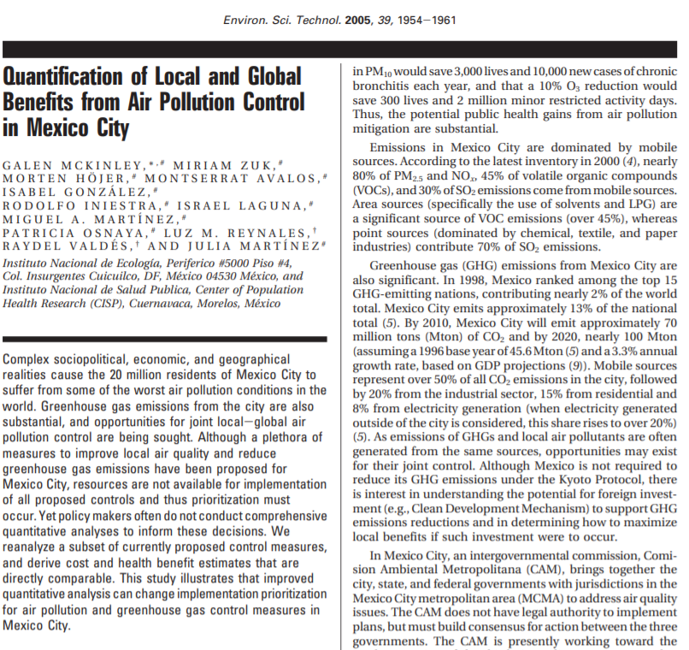
Examples including TRAP
Highlights:
Quantified health benefits and costs of air pollution control measures for Mexico City
Measures included the city’s taxi fleet renovation, metro network expansions and the introduction of hybrid buses
Measures were estimated to reduce city’s PM₁₀ by 1% and O₃ by 3%
Health benefits were substantial and outweighed investment costs, with benefit-cost ratios being 3.4, 0.8 and 1.3 for the taxi fleet renovation, metro expansion and hybrid bus introduction, respectively
Notes:
This study looked at specific control measures in the transport policy field (and beyond) and modeled their potential impacts on air quality and health including an estimate of the cost to benefit ratio, particularly useful for policy applications
Three transport control measures were investigated as below:
Taxi fleet renovation → 80% of old taxis replaced by 2007, fuel efficiency increases from 6.7 to 9 km/L, compliance with Tier I standards in 1999 and newer models
Metro expansion → 76 km of new construction by 2020, new ridership assumed to come from microbus transport, recuperation value of capital included using a 30-year useful life, 5 km will be constructed between 2003 and 2010, and 71 km between 2011 and 2020
Hybrid buses → 1029 hybrid buses brought into circulation, replacing diesel buses, by 2006, emissions factors are for Orion-LMCS VI hybrid diesel buses for New York City
The health impacts that were studies separately for each control measure were premature mortality, chronic bronchitis, cardiovascular and respiratory hospital admissions, respiratory room emergency visits and minor restricted activity days
Benefit to cost ratio was calculated for each measure, and then the measures were ranked based on those ratios

Slide 14
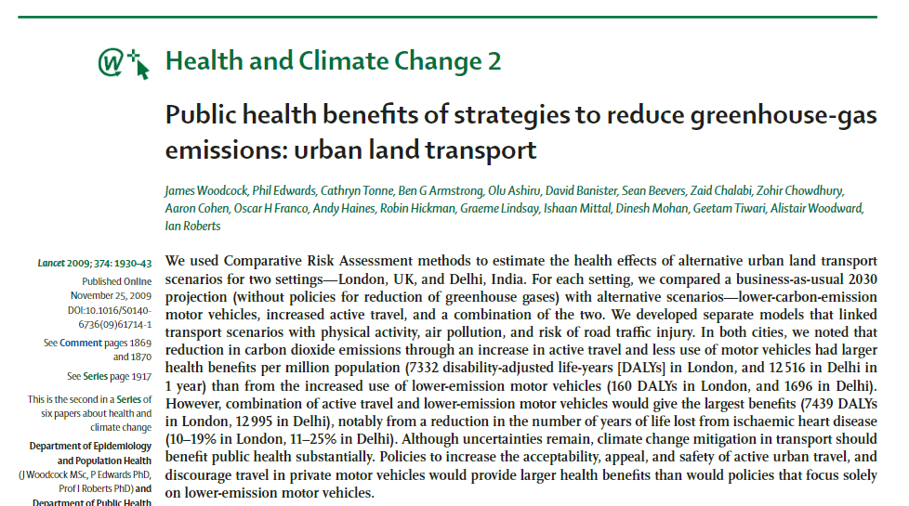
Examples including TRAP
Highlights:
Estimated the health impacts of alternative urban land transport scenarios for London and Delhi
Changes in physical activity, air pollution, and risk of road traffic injury were assessed
The authors found that a combination of low-carbon-emission vehicles and the uptake of active transport would reduce PM_{2.5} levels most effectively from 10.1 µg/m³ to 7.4 µg/m³ for London and from 88.7 µg/m³ to 72.3 µg/m³ for Delhi, saving annually 319 DALYs and 2,749 DALYs, respectively
Notes:
This study was conducted in the context of climate change and investigated health pathways beyond air pollution from traffic
The study investigated two hypothetical scenarios and one scenario which represents the combination of those two, namely, the adaptation of lower-emission motor vehicles (cars, motorcycles, and trucks) and reduction in travel by motor vehicles with a switch to active travel
The study areas were London, United Kingdom and Delhi, India
Both reductions in premature deaths and DALYs were estimated
For London and Delhi, the increased active travel, scenarios saved more DALYs than did the lower-carbon emission motor vehicle scenarios
The combined scenario resulted in the largest health benefits

Slide 15
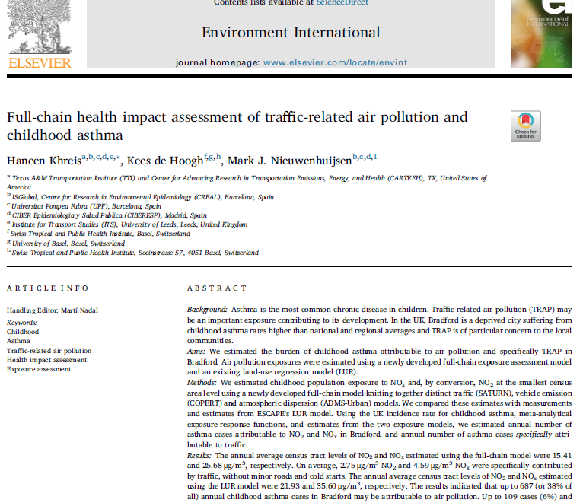
Examples including TRAP
Highlights:
Estimated the burden of childhood asthma attributable to traffic-related NO₂ and NO_{x} in Bradford
Used a full-chain HIA framework modeling traffic activity, emissions, air pollution, human exposure and health impacts
Found that 128 (7%) and 219 (12%) of all asthma cases may be attributable to traffic-related NO₂ and NO_{x} respectively
Notes:
This study was set in Bradford, a multi-ethnic city in the North of England
It followed a classical burden of disease assessment methodology combining information on exposure estimates, baseline incidence rates of the outcome of interest and meta-analytical exposure-response functions
It also compared the burden of disease estimates using the full-chain approach to using a land-use regression model for the same pollutants but these differences will not be further discussed in this presentation
The full-chain approach involved modeling traffic on the network using SATURN traffic simulation and assignment model. Outputs from the SATURN model which mainly included average traffic speeds on a link basis and traffic flows were then used to assign the traffic fleet mix in the region by using the 2009 standard fleet compositions in Urban England as extracted from the National Atmospheric Emissions Inventory and Ricardo Energy and Environment, 2014. the traffic volumes, average speeds, and the fleet mix were then used to estimate the NOx emissions using NOx average-speed-emission functions from the COPERT 4 version 10.0 emission model (spreadsheets are freely available at: http://naei.beis.gov.uk/data/eftransport). NOx emissions estimations were done for 167 applicable average-speed-emission functions that were sourced and coded onto an Excel spreadsheet. The emission rates were then entered into a commercial atmospheric dispersion model called ADMS-Urban version 3.0.0., alongside hourly sequential meteorological data covering year 2009. NOx background data as sourced from the Department for Environment Food and Rural Affairs, 2016, at the 1 km×1 km grid levels was used to complement the traffic component modeled by ADMS-Urban. NOx was finally converted to NO2 using factors derived from observations/measurements conducted in the same study area. The model was validated against measurements from 41 sites and achieved an R2= 0.6. in line with previous work, the model was found to underestimate NOx at 36 out of the 41 sites by between 3.7% to 71.1%; or on average by 23.5% (12.3 μg/m3 NOx) across all sites.
The estimated NOx and NO2 exposures were used to assign human exposures to kids at the “output area” census level which was the lowest/ smallest geographical level at which census data was provided. This was the geographical level used to assign childhood population data (birth to 18 years old), exposure data, population attributable fraction and attributable number of asthma cases.
These estimates were used to calculate the burden of disease attributable to the specific portion of NOx and NO2 coming from traffic using a standard burden of disease assessment methodology.

Slide 16
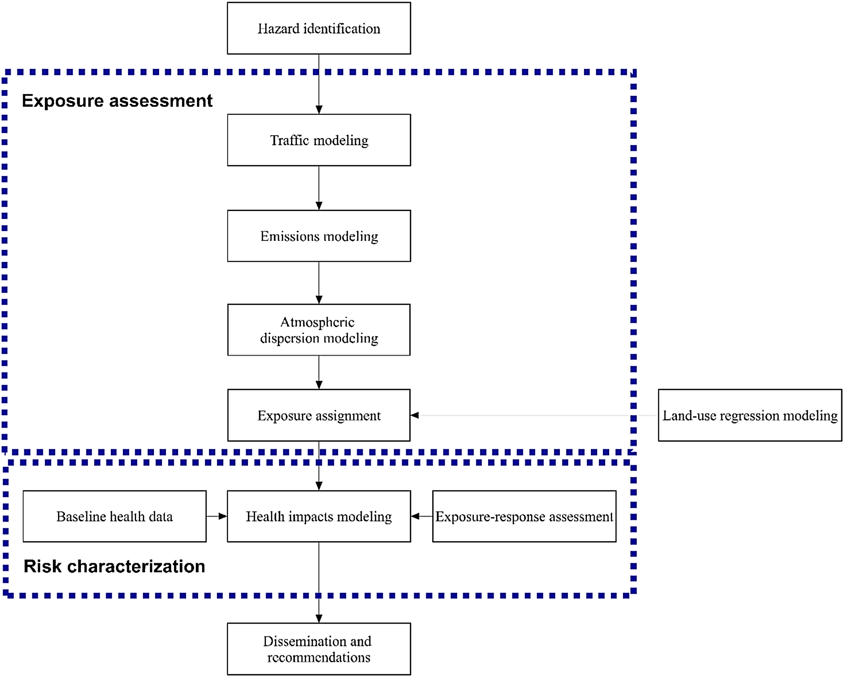
Full-Chain HIA of Traffic-Related Air Pollution
Source: Khreis at al. (2018)

Slide 17
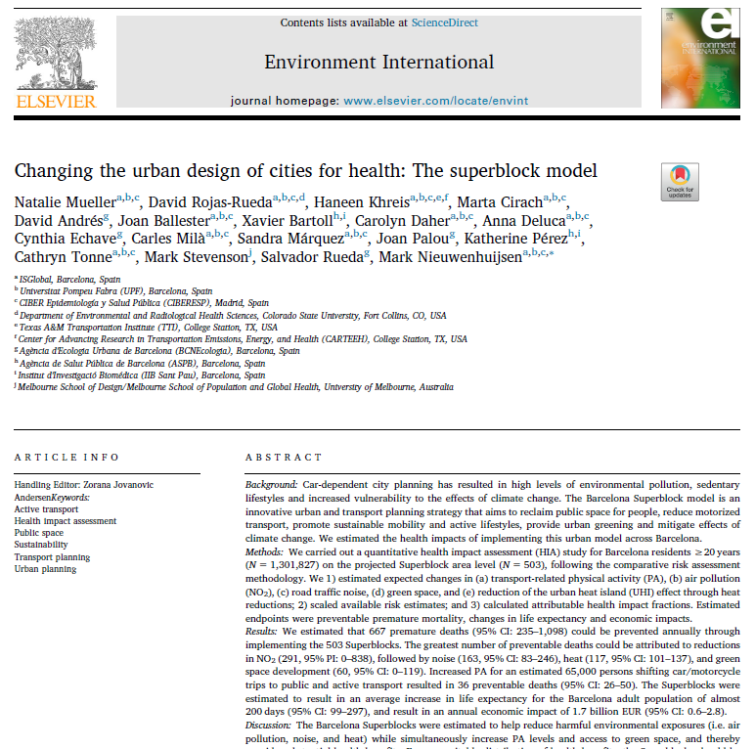
Examples including TRAP
Highlights:
Estimated the number of premature deaths that could be prevented annually with the Barcelona Superblocks model investigating changes in air pollution, noise and heat reductions and increases in green space and transport physical activity
Found that NO₂ can be reduced from 47.18 μg/m³ to 35.72 μg/m³ resulting in 291 preventable premature deaths in Barcelona (the greatest number of preventable deaths due to any exposure)
Notes:
This study was conducted in the city of Barcelona, Spain.
The health impact assessment assessed the potential impacts of the Barcelona Superblock model which is an innovative urban and transport planning strategy that aims to reclaim public space for people, reduce motorized transport, promote sustainable mobility and active lifestyles, provide urban greening and mitigate effects of climate change.
The study followed a quantitative health impact assessment (HIA) methodology for Barcelona residents ≥20 years (N = 1,301,827) on the projected Superblock area level (N = 503), following the comparative risk assessment methodology.
The authors estimated 1) estimated expected changes in (a) transport-related physical activity (PA), (b) air pollution (NO2), (c) road traffic noise, (d) green space, and (e) reduction of the urban heat island (UHI) effect through heat reductions; 2) scaled available risk estimates; and 3) calculated attributable health impact fractions. Estimated endpoints were preventable premature mortality, changes in life expectancy and economic impacts.
Baseline nitrogen dioxide (NO2) concentrations (2012) were calculated and averaged at the Superblock area level using the Street 5.2 air quality model (KTT Umweltberatung und Software Dr. Kunz GmbH, 2005). Changes in NO2 concentrations were modeled and reflect the expected 19.2% car/motorcycle share reduction, including changes in vehicle fleet and increased average speeds due to avoidance of congestion (Barcelona City Council, 2014).
The association between NO2 and mortality was quantified using a linear exposure-response function (Atkinson et al., 2018). The RR and PAF corresponding to the exposure level difference between baseline and the Superblock scenario were calculated at the Superblock area level. The expected changes of other traffic-related air pollutants (TRAPs), such as particulate matter (e.g. PM2.5), were not modeled for the Superblock scenario, and therefore, health impacts could not be estimated.

Slide 18
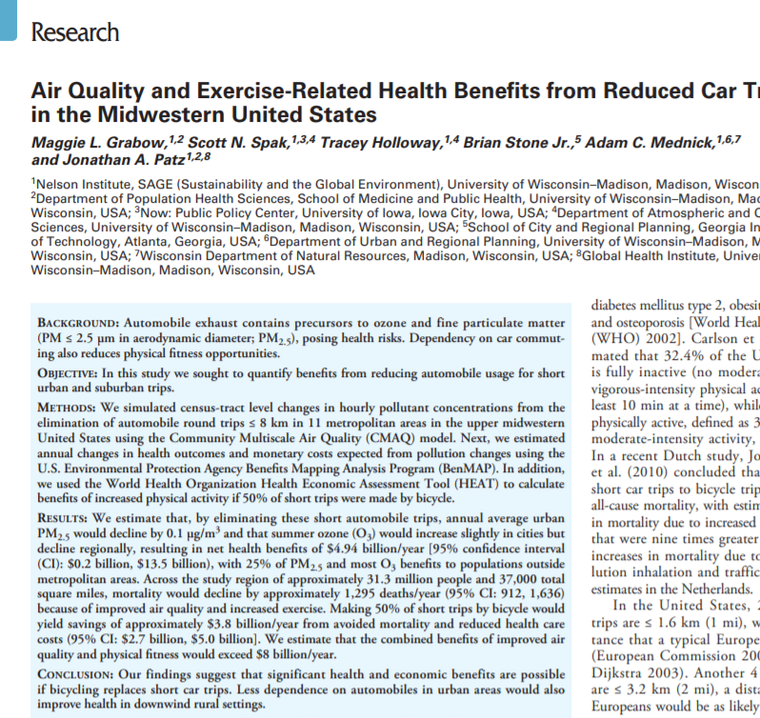
Examples including TRAP
Highlights:
Estimated the health impacts of eliminating shorter car trips (≤ 8 km) and replacing 50% of these trips with the bicycle in 11 metropolitan regions in the USA in order to improve air quality
Found that the annual average urban PM_{2.5} concentration would decline by 0.1 µg/m³ and mortality would decrease by 1,295 deaths per year
608 fewer deaths due to improved air quality and 687 fewer deaths due to increased physical activity
Notes:
This study quantified the quantify the potential benefits from reducing automobile usage for short urban and suburban trips.
The authors simulated census-tract level changes in hourly pollutant concentrations from the elimination of automobile round trips ≤ 8 km in 11 metropolitan areas in the upper midwestern United States using the Community Multiscale Air Quality (CMAQ) model.
They estimated annual changes in health outcomes and monetary costs expected from pollution changes using the U.S. Environmental Protection Agency Benefits Mapping Analysis Program (BenMAP). In addition, they used the World Health Organization Health Economic Assessment Tool (HEAT) to calculate benefits of increased physical activity if 50% of short trips were made by bicycle.

Slide 19
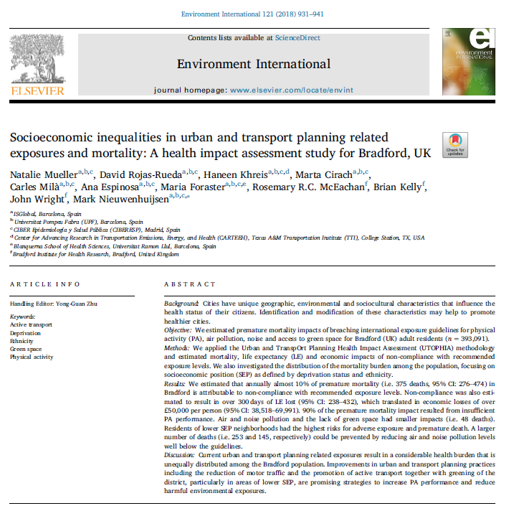
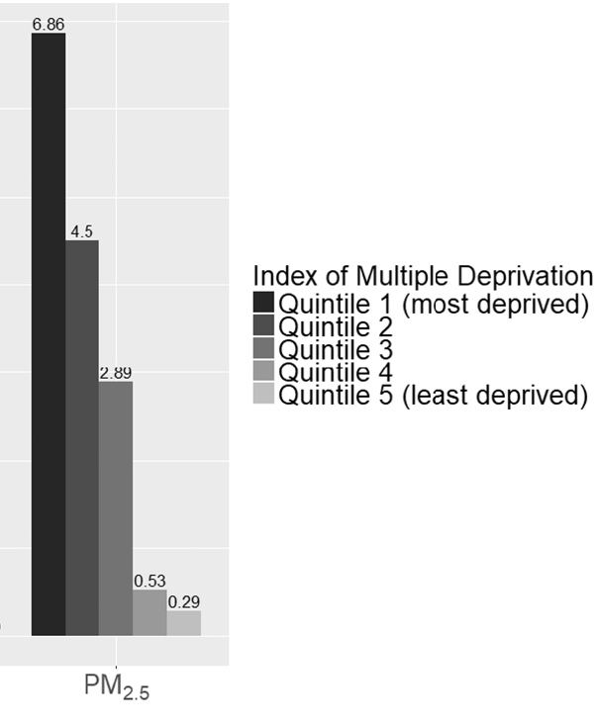
Examples including TRAP
Highlights:
Estimated the number of premature deaths related to air pollution in Bradford, UK.
Deaths per 100,000 persons
Source: Mueller et al., (2018)
Notes:
This study was conducted in the city of Bradford, UK.
The health impact assessment assessed the potential impacts of the urban environmental risk factors related to the built environment and transport in Bradford, UK.
The study followed a quantitative health impact assessment (HIA) methodology for Bradford residents ≥20 years (N = 393,091), following the comparative risk assessment methodology.
The authors estimated 1) estimated expected changes in (a) physical activity (PA), (b) air pollution (PM2.5), (c) road traffic noise, and (d) green space (access to parks =>0.5 ha within 300m linear distance from home) based on the WHO and EC recommendations; 2) scaled available risk estimates; and 3) calculated attributable health impact fractions. Estimated endpoints were preventable premature mortality, changes in life expectancy and economic impacts.
Baseline particulate matter less than 2.5 micrometers of diameter (PM2.5) concentrations (2010) were calculated and compared to those levels recommended by WHO.
The association between PM2.5 and mortality was quantified using a linear exposure-response function (WHO, 2014). The RR and PAF corresponding to the exposure level difference between baseline and WHO air quality guidelines scenario were calculated at the Lowers Super Output Area (LSOA) level.
A comparison of the mortality rates related to PM2.5 in the scenario were estimated by LSOA deprivation index. The findings showed that the most deprived areas in Bradford suffer from more air pollution mortality.

Slide 20
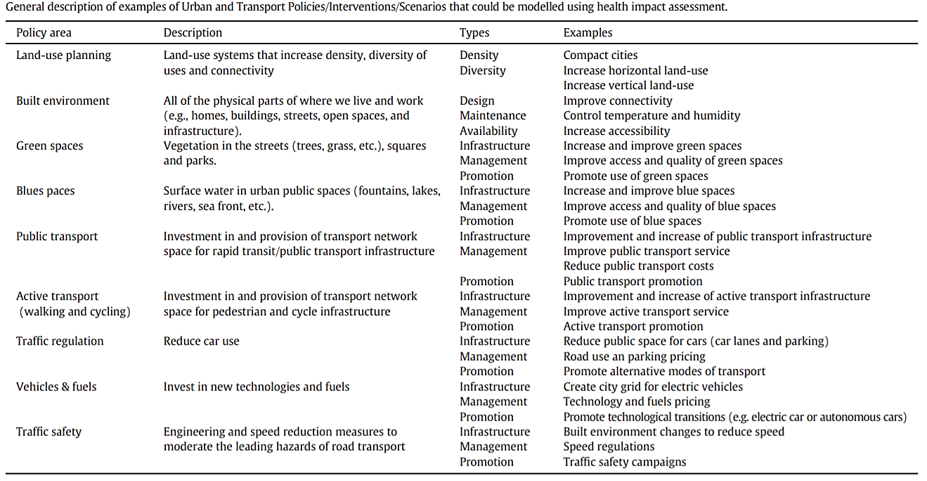
Strengths of BoD and HIAs
Source: Nieuwenhuijsen et al., 2017
Notes:
Quantitative assessments can be used to evaluate a range of potential scenarios like those shown in this slide.

Slide 21
Strengths of BoD and HIAs
Have the potential to integrate health evidence into the policy decision-making process, and introduce and protect public health in all policies
Policy decision-makers may give more weight to outcomes that are measurable/ quantifiable
Such exercises may raise the public awareness of the health implications of current and proposed policy scenarios
Can (should) be carried out prospectively to give an outlook on expected health consequences in the future, before they occur, and devise mitigation strategies accordingly
Can disentangle the complexity of the multitude of risk/protective factors operating simultaneously
Quantitative estimates allow the comparison of alternatives (i.e. different counterfactual or policy scenarios) and provide insight into the best available choice from a health, and economic, standpoint
Notes:
Extracted from Mueller et al. (2020):
“Health impact assessment (HIA) is an important tool to integrate health evidence into the policy decision-making process, and introduce and protect public health in all policies. HIA is a tool that can help policy-makers foresee how different interventions, policies and programs outside the health sphere, will affect health and well-being by informing on the associated health benefits and risks (Ståhl et al. 2006). HIA combines different methods and procedures to systematically identify and judge all relevant, whether intended or unintended, exposure pathways and health effects the proposed intervention, policy or program might have on the health of a population and the distribution of those effects within this population (Mindell et al. 2003; WHO 1999). Most HIAs are carried out prospectively and aim to give an outlook on expected health consequences in the future (Wismar et al. 2007). Because health is usually a strong-weighing factor to the public, outcomes of HIAs can raise health awareness and advocacy and can influence the decision-making process (Jacobs & Shapiro 1994; Burstein 1998). Therefore, outcomes of HIAs can have a strong bearing on public policy proposals (Wismar et al. 2007).”

Slide 22
Strengths of BoD and HIAs
Can help identify subpopulations that would disproportionally be affected or disadvantaged by the intervention, policy or program which provides valuable information on unjust differences and possible gradients of susceptibility and health status
Because health is usually a strong-weighing factor to the public, outcomes of BoD and HIAs can raise health awareness and advocacy and can influence the decision-making process
Can directly inform cost-benefit analysis and transport investment appraisal schemes
Context specific – sensitive to contextual variables and underlying population and health parameters
Notes:
Extracted from Mueller et al. (2020):
“Health impact assessment (HIA) is an important tool to integrate health evidence into the policy decision-making process, and introduce and protect public health in all policies. HIA is a tool that can help policy-makers foresee how different interventions, policies and programs outside the health sphere, will affect health and well-being by informing on the associated health benefits and risks (Ståhl et al. 2006). HIA combines different methods and procedures to systematically identify and judge all relevant, whether intended or unintended, exposure pathways and health effects the proposed intervention, policy or program might have on the health of a population and the distribution of those effects within this population (Mindell et al. 2003; WHO 1999). Most HIAs are carried out prospectively and aim to give an outlook on expected health consequences in the future (Wismar et al. 2007). Because health is usually a strong-weighing factor to the public, outcomes of HIAs can raise health awareness and advocacy and can influence the decision-making process (Jacobs & Shapiro 1994; Burstein 1998). Therefore, outcomes of HIAs can have a strong bearing on public policy proposals (Wismar et al. 2007).”

Slide 23
Limitations of BoD and HIAs
Quantitative BoD and HIAs have been mainly used in research and the academic literature and less so for practice and policy purposes
Might be because the existing methods and tools are very resource intensive and do not meet the needs of the end users
There is a lack of full-chain analyses which are more useful for policy making
The counterfactual scenarios investigated for research purposes do not often reflect real scenarios or proposals that can be under consideration in the policy decision-making arena
These methods are predictive in nature and not empirical or observational research – the quality of the input data and the rigor of the assumptions is key to the validity and plausibility of quantified health impacts
It is uncertain whether the predicted health impacts would actually occur
There is a lack of standards and best practices for quantitative BoD and HIA (Mueller et al., 2020)
Notes:
Extracted from Mueller et al. (2020):
“Like any model, quantitative HIA modeling processes have limitations that need to be acknowledged. Quantitative HIA is rather an indicative than empirical research tool and carries uncertainties in the estimation of health impacts (Parry & Stevens 2001). Currently, there is a lack of standards and best practices. The predictive validity and plausibility of quantified health impacts depends on the application and interpretation of the available supportive evidence (Thomson et al. 2008). Uncertainty is introduced where epidemiological evidence is lacking or causality has not been established. HIA draws on assumptions and extrapolations, where gaps in knowledge on true properties of parameters exist.
Most often HIAs make use of counterfactual scenarios that describe ideal situations. However, these ideal situations are often too optimistic, hardly attainable and bear little relevance to authorities and policy-makers (Nieuwenhuijsen et al. 2017). HIAs are fundamentally different from evaluation studies and pre-post intervention studies. It remains uncertain whether health impacts will truly occur as estimated. Therefore, outputs of HIA studies can only be interpreted as an indication of the magnitude of expected health impacts under the counterfactual scenario. Health impacts are sensitive to contextual settings and underlying population parameters and depend largely on the baseline exposure level, the exposure’s distribution among the population as well as the general health status of that population. Therefore, varying results can be expected for varying settings and contexts, which can also be considered as a strength of such assessments as they speak to local contexts. Furthermore, health impact estimations are incapable of reflecting and capturing personal choices and intrinsic motivations for behavior change that are implied by the counterfactual scenario (e.g. choosing the bicycle over the car to help reduce air pollution levels in the city).”

Slide 24
Limitations of BoD and HIAs
Lack of epidemiological evidence (Dose- or Exposure-Response Functions)
Exposures
Outcomes
Populations
Only provide a partial quantification of the reality
Notes:
BoD and HIA are limited in scope and impact due to the lack of availability of epidemiological evidence (dose- or exposure-response functions). Although several risk factors and air pollutants have been suggested to be related to multiple health outcomes (morbidity and mortality), only those relationships that are based on causal epidemiology can be quantified. In other words, only a few health outcomes can be linked (and quantified) to some risk factors or air pollutants. BoD and quantitative HIA approaches are only available for those exposure-response functions based on high-quality cohort studies, time-series analysis, and meta-analyses.
In addition, although robust epidemiological evidence could be available to link TRAP and health outcomes, in most cases this evidence will apply only for certain populations, such as adults or children. So applying the epidemiological evidence in BoD and HIA will only capture the health impact in such populations.
Finally, these limitations probably only provide a partial quantification of reality. Future advances on epidemiological evidence will improve BoD and HIA capacities and provide a better estimation of the health impacts related to TRAP.

Slide 25
Limitations of BoD and HIAs
Suffer from uncertainties and errors due to input data such as the exposure proxies used, exposure-response functions used, resolution of the exposure estimates, baseline health conditions, and accuracy of population parameters and risk estimates for that population
The interpretability of the health outcomes can be challenging, depending on the audience (Mueller et al., 2020)
Most BoD and HIAs in the literature lack participatory and stakeholder engagement aspects, and do not follow a full-chain approach which can pinpoint the sources of adverse exposures and attributable health impacts (Nieuwenhuijsen et al., 2017)
Most BoD and HIAs in the literature do not account for time delays (Nieuwenhuijsen et al., 2017)

Slide 26
Research Gaps
The lack of participatory integrated full-chain BoD and HIA models
The lack of consideration of multiple exposures, interdependencies and uncertainties of the real world
The lack of assessment of plausible, real world scenarios or counterfactual exposures that are/can be under consideration by cities and local authorities
The lack of monetization of the assessed health impacts which can better inform policy and be incorporated in e.g. transportation investment appraisal
The lack of already set-up models and high quality datasets to be used for policy purposes (e.g. the World Health Organization’s Health Economic Assessment Tool (HEAT) for walking and cycling)

Slide 27
Future Directions
Develop participatory integrated full-chain BoD and HIA models
Account for multiple exposures, interdependencies and uncertainties of the real world
Work with stakeholders to assess plausible, real world scenarios or counterfactual exposures that are/can be under consideration by cities and local authorities
Monetize the assessed health impacts
Set-up and synthesize models and high quality datasets to be used for policy purposes including developing a comprehensive strategy for searching for quality input data and models’ validation

Slide 28
Take-Home Messages
The number of BoD and HIA studies related to urban and transport planning is increasing rapidly
There is yet a need for novel participatory integrated full-chain HIA models, methods and tools that assess the full-chain of events from initial planning decisions and scenarios
There is a need to consider multiple exposures and complexities, interdependencies and uncertainties of the real world
These methods have developed but are mainly restricted to the research realm and not used to their full potential in policy and practice
Notes:
There is a communication gap between the sectors where non-academic stakeholders lack the tools, knowledge and interest to carry out a quantitative HIA while academics/researchers lack the expertise and understandings as to what extent scenarios are plausible, realizable and acceptable to local authorities or policy makers (Nieuwenhuijsen et al., 2017)

Slide 29
List of Abbreviations
BoD: Burden of Disease
DALYs: Disability-Adjusted Life-Years
GBD: Global Burden of Disease
HIA: Health Impact Assessment
O₃: Ozone
PM₁₀: Particulate Matter with a diameter less than 10 micrometers
TRAP: Traffic-Related Air Pollution

Slide 30
References
Briggs, D.J., 2008. A framework for integrated environmental health impact assessment of systemic risks. Environmental Health, 7(1), p.61.
GBD 2013 Risk Factors Collaborators. 2015. Global, regional, and national comparative risk assessment of 79 behavioural, environmental and occupational, and metabolic risks or clusters of risks in 188 countries, 1990–2013: a systematic analysis for the Global Burden of Disease Study 2013. Lancet. 386(10010):2287-2323.
Grabow, M.L., Spak, S.N., Holloway, T., Stone Jr, B., Mednick, A.C. and Patz, J.A., 2012. Air quality and exercise-related health benefits from reduced car travel in the midwestern United States. Environmental health perspectives, 120(1), pp.68-76.
Khreis, H., de Hoogh, K. and Nieuwenhuijsen, M.J., 2018. Full-chain health impact assessment of traffic-related air pollution and childhood asthma. Environment international, 114, pp.365-375.
Lebret E. 2015. Integrated Environmental Health Impact Assessment for Risk Governance Purposes; Across What Do We Integrate?. Int J Environ Res Public Health. 13(1):ijerph13010071.
Lock, K., 2000. Health impact assessment. BMJ, 320(7246), pp.1395-1398.
McKinley, G., Zuk, M., Höjer, M., Avalos, M., González, I., Iniestra, R., Laguna, I., Martínez, M.A., Osnaya, P., Reynales, L.M. and Valdés, R., 2005. Quantification of local and global benefits from air pollution control in Mexico City.
Mueller, N., Rojas-Rueda, D., Khreis, H., Cirach, M., Andrés, D., Ballester, J., Bartoll, X., Daher, C., Deluca, A., Echave, C. and Milà, C., 2020. Changing the urban design of cities for health: The superblock model. Environment international, 134, p.105132.
Mueller, N., Rojas-Rueda, D., Nieuwenhuijsen, M.J., 2020. Quantitative Health Impact and Burden of Disease Assessment of Traffic-Related Air Pollution. Book Chapter, Traffic-Related Air Pollution: Emissions, Human Exposures, and Health. Editors: Khreis, H., Nieuwenhuijsen, M., Ramani, T., Zietsman, J. Elsevier

Slide 31
References
Mueller N, Rojas-Rueda D, Khreis H, Cirach M., Milà C., Espinosa A., Forater M., McEachan r., Kelly B., Wright J., Nieuwenhuijsen, M. 2018. Socioeconomic inequalities in urban and transport planning related exposures and mortality: A health impact assessment study for Bradford, UK. Environ Int. 2018;121(Pt 1):931-941.
Nieuwenhuijsen, M.J., Khreis, H., Verlinghieri, E., Mueller, N. and Rojas-Rueda, D., 2017. Participatory quantitative health impact assessment of urban and transport planning in cities: A review and research needs. Environment international, 103, pp.61-72.
Perez, L., Künzli, N., Avol, E., Hricko, A.M., Lurmann, F., Nicholas, E., Glliland, F., Peters, J. and McConnell, R., 2009. Global goods movement and the local burden of childhood asthma in southern California. American Journal of Public Health, 99(S3), pp.S622-S628.
Vander Hoorn, S., EzzATI, M., Rodgers, A., Lopez, A.D. and Murray, C.J., 2004. Estimating attributable burden of disease from exposure and hazard data. Comparative quantification of health risks: global and regional burden of disease attributable to selected major risk factors. Geneva: World Health Organization, pp.2129-40.
Woodcock, J., Edwards, P., Tonne, C., Armstrong, B.G., Ashiru, O., Banister, D., Beevers, S., Chalabi, Z., Chowdhury, Z., Cohen, A. and Franco, O.H., 2009. Public health benefits of strategies to reduce greenhouse-gas emissions: urban land transport. The Lancet, 374(9705), pp.1930-1943.
World Health Organization, 2000. Health impact assessment: main concepts and suggested approach - Gothenburg consensus paper.
World Health Organization, 2015. Quantitative assessment of environmental health impacts at population level [Online]. Available: http://www.who.int/heli/tools/quantassess/en/ [Accessed 12 January 2017].

Slide 32
Reading List
Alotaibi, R., Bechle, M., Marshall, J.D., Ramani, T., Zietsman, J., Nieuwenhuijsen, M.J. and Khreis, H., 2019. Traffic related air pollution and the burden of childhood asthma in the contiguous United States in 2000 and 2010. Environment international, 127, pp.858-867.
Khreis, H., Cirach, M., Mueller, N., de Hoogh, K., Hoek, G., Nieuwenhuijsen, M.J. and Rojas-Rueda, D., 2019. Outdoor air pollution and the burden of childhood asthma across Europe. European Respiratory Journal, 54(4).
Khreis, H., Ramani, T., de Hoogh, K., Mueller, N., Rojas-Rueda, D., Zietsman, J. and Nieuwenhuijsen, M.J., 2019. Traffic-related air pollution and the local burden of childhood asthma in Bradford, UK. International Journal of Transportation Science and Technology, 8(2), pp.116-128.
Nieuwenhuijsen, M.J., Khreis, H., Mueller, N. and Rojas-Rueda, D., 2020. Health impact assessment of transport planning and policy. In Advances in Transportation and Health (pp. 309-328). Elsevier.
Stevenson, M., Thompson, J., de Sá, T.H., Ewing, R., Mohan, D., McClure, R., Roberts, I., Tiwari, G., Giles-Corti, B., Sun, X. and Wallace, M., 2016. Land use, transport, and population health: estimating the health benefits of compact cities. The lancet, 388(10062), pp.2925-2935.
Tainio, M., 2015. Burden of disease caused by local transport in Warsaw, Poland. Journal of transport & health, 2(3), pp.423-433.
Xia, T., Nitschke, M., Zhang, Y., Shah, P., Crabb, S. and Hansen, A., 2015. Traffic-related air pollution and health co-benefits of alternative transport in Adelaide, South Australia. Environment international, 74, pp.281-290.

Slide 33
Acknowledgements
The author acknowledges substantial materials adapted from the chapter titled “Quantitative Health Impact and Burden of Disease Assessment of Traffic-Related Air Pollution” by Natalie Mueller, Mark J. Nieuwenhuijsen, and David Rojas-Rueda

