Slide 1
Lecture #33: Effects of Traffic-Related Air Pollution on Human Health—Toxicological and Mechanistic Evidence
Natalie M. Johnson, Ph.D.
Texas A&M University School of Public Health
Email: nmjohnson@tamu.edu; Office phone: 1-979-436-9325
The author declares that there is no conflict of interest
Lecture Track(s): HT
Notes:
Health Track (HT)—mainly targeted at urban planners, transportation planners, and engineers with limited knowledge of public health-related concepts;

Slide 2
Introduction
Experimental methods used in toxicology studies
  In vivo models help determine:
    Dose-response
    Specific pollutant effects
    Mechanisms of action
  Exposure systems
    Direct exposure to traffic
    Exposure to diesel exhaust (DE)
    Exposure to concentrated ambient particles (CAPs)
    Exposure to diesel exhaust particles (DEPs) or UFPs
Example of CAPs exposure system
Notes:
Laboratory-based inhalation toxicology studies using in vivo animal models are crucial to establishing causality between TRAP exposure and adverse outcomes observed in human populations.
Animal models provide controlled exposure conditions to aid in determining dose-response gradients and biological mechanisms of action. Moreover, investigators can study specific components of TRAP to determine effects. Rodent models, both rats and mice, have been extensively employed to research the effects of TRAP exposure.
Methods for generating and characterizing particulate air pollution in inhalation toxicology models have been reviewed in detail by Chen and Lippmann (2015). In general, models have employed various agents (i.e., components of PM) and particle sizes, fine and/or ultrafine fractions (UFPS, ultrafine particles) using different routes, most frequently inhalation via whole-body or nose-only chambers, but also intranasal and intratracheal instillation in some cases.
Some investigators have utilized ambient air exposures through direct exposure to traffic or polluted urban air (Mauad et al., 2015). TRAP has been extensively studied in animal models via direct exposure to freshly generated diesel exhaust (DE), for instance to study developmental (Ema et al., 2013) and cancer endpoints (Hesterberg et al., 2005). Here, rodents are exposed to both particulate and gaseous components.
Several research teams have utilized concentrated ambient particulate matter systems (CAPs) to deliver fine and ultrafine PM mixtures. Examples include the Harvard University Concentrated Ambient Particle System (HUCAPS) fitted with a size-selective inlet for ultrafine particles (< 100 nm) and the New York University Versatile Ambient Particle Concentrator Exposure System (VACES). The HUCAPS system concentrates ultrafine particles approximately 10 times that of ambient air concentrations. The gas-phase components of the ambient aerosol are present but are not concentrated by the system. The VACES system concentrates ambient PM at an equivalent factor to the HUCAPS system, with a slightly larger particle size distribution within the fine and ultrafine range.
The figure, from Chen and Lippmann (2015), shows a schematic design of the VACES system, which can be equip with telemetry monitoring for the evaluation of animal heart rate.
In addition to concentrated ambient particulate matter systems, aerosolizing PM from a defined source represents a complementary approach refined in its ability to generate consistent daily PM/UFP concentrations from distinct sources. In several models, Morgan and colleagues (Davis et al., 2013) have applied re-aerosolized nano-scale PM (< 200 nm) collected from a heavy traffic site nearby the Los Angeles I-110 Freeway using a high-volume ultrafine particle sampler.
Last, other groups have applied diesel exhaust particles (DEPs) in exposure models via intranasal application, oropharyngeal administration, and intratracheal instillation. Outcomes from instillation and inhalation exposures can results in differing pathological consequences in the lung, however, in the case of studying systemic effects, translocation of the particles into circulation may be relevant.
References:
Chen, L. C.; Lippmann, M. Inhalation toxicology methods: the generation and characterization of exposure atmospheres and inhalational exposures. Curr Protoc Toxicol 2015, 63, 24.4.1-24.4.23.
Mauad, T.; Rivero, D. H.; de Oliveira, R. C.; Lichtenfels, A. J.; Guimaraes, E. T.; de Andre, P. A.; Kasahara, D. I.; Bueno, H. M.; Saldiva, P. H. Chronic exposure to ambient levels of urban particles affects mouse lung development. Am J Respir Crit Care Med 2008, 178 (7), 721.
Ema, M.; Naya, M.; Horimoto, M.; Kato, H. Developmental toxicity of diesel exhaust: a review of studies in experimental animals. Reprod Toxicol 2013, 42, 1.
Hesterberg, T. W.; Bunn, W. B.; McClellan, R. O.; Hart, G. A.; Lapin, C. A. Carcinogenicity studies of diesel engine exhausts in laboratory animals: a review of past studies and a discussion of future research needs. Crit Rev Toxicol 2005, 35 (5), 379.
Davis, D. A.; Bortolato, M.; Godar, S. C.; Sander, T. K.; Iwata, N.; Pakbin, P.; Shih, J. C.; Berhane, K.; McConnell, R.; Sioutas, C.et al. Prenatal exposure to urban air nanoparticles in mice causes altered neuronal differentiation and depression-like responses. PLoS One 2013, 8 (5), e64128.

Slide 3
Summary of Nonhuman Evidence
Respiratory effects (animal models)
  Traffic exposure causes changes in lung structure
  Traffic-derived PM and CAPS exposure leads to allergic airway inflammation
    Indicative of asthmatic responses
    Airway inflammatory responses shown to differ by strain, indicating the ability to respond to oxidative stress may protect against adverse respiratory effects
Airway inflammatory response to DEPs
Notes:
In 2010, The Health Effects Institute (HEI) published a comprehensive report on the health effects associated with TRAP. Chapter 5 summarizes the a variety of outcomes in animal exposure models, which are summarized in the following slides.
A number of studies have investigated the effects of repeated exposure to traffic, DE and DEPs on the respiratory system in animals (primarily rodents). In general, these data show that exposures cause changes in lung structure, including fibrotic or emphysematous lesions. TRAP also causes increases in inflammatory cells (such as neutrophils and eosinophils). In addition, upon challenge with experimental allergens, TRAP exacerbates the allergic processes.
Along with inflammation, decreases in lung biochemical defenses (such as glutathione) indicate the role of oxidative stress in underlying pathology. Li et al. (2008) showed 6 months of exposure to DEP led to large numbers of inflammatory cells in the lungs of C57Bl/6 mice (highlighted in red box), which are more sensitive to oxidative stress, yet was largely absent in Balb/c mice, which may be more resistant to PM-driven oxidative stress.
The role of oxidative stress will be further discussed in subsequent slides.
References:
Health Effects Institute. Panel on the Health Effects of Traffic-Related Air Pollution. Traffic-related air pollution: A critical review of the literature on emissions, exposure, and health effects. United States: 2010. https://www.healtheffects.org/publication/traffic-related-air-pollution-critical-review-literature-emissions-exposure-and-health.
Li, Y. J.; Kawada, T.; Takizawa, H.; Azuma, A.; Kudoh, S.; Sugawara, I.; Yamauchi, Y.; Kohyama, T. Airway inflammatory responses to oxidative stress induced by prolonged low-dose diesel exhaust particle exposure from birth differ between mouse BALB/c and C57BL/6 strains. Exp Lung Res 2008, 34 (3), 125.

Slide 4
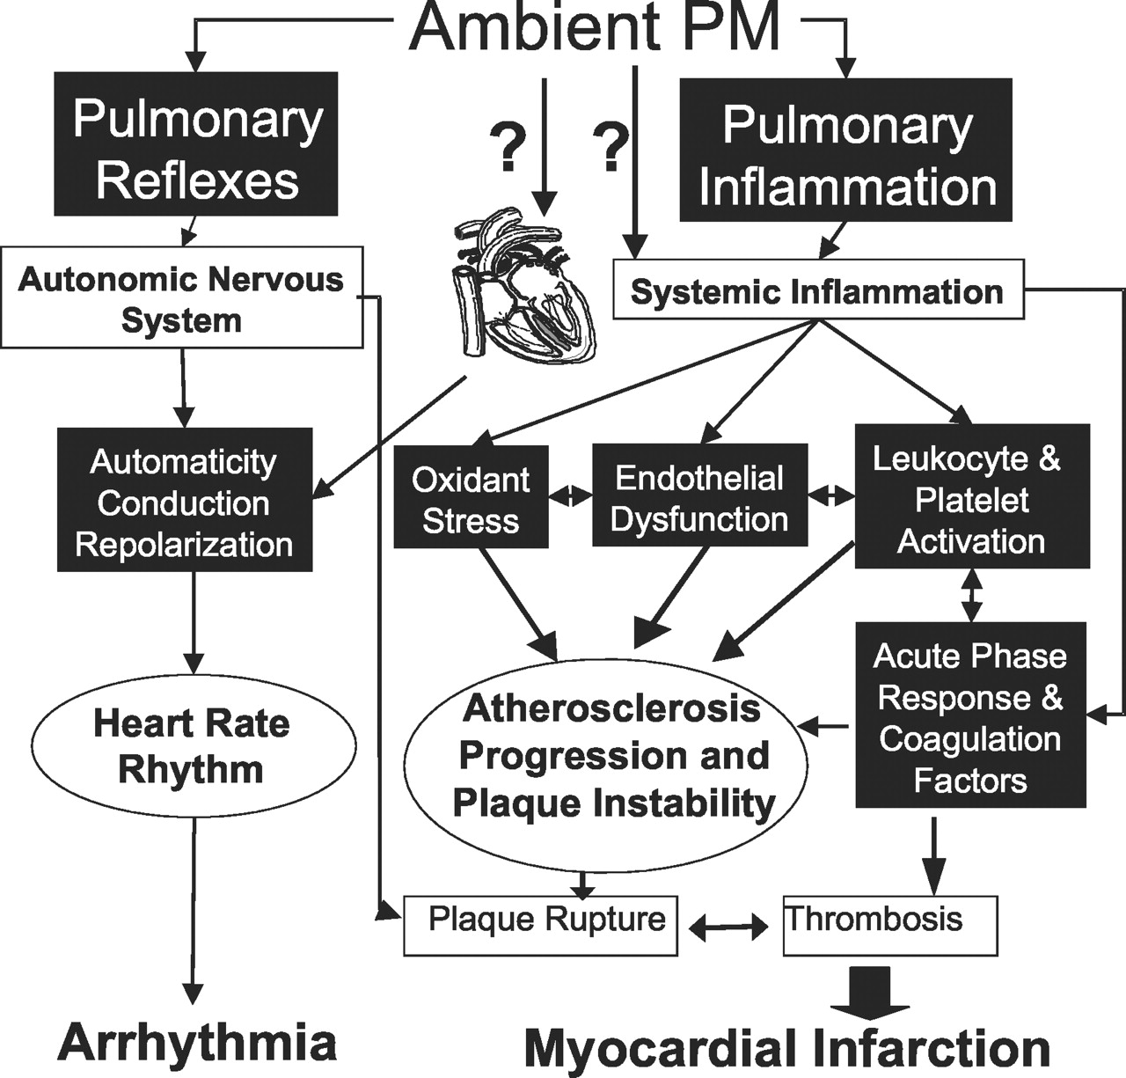
Summary of Nonhuman Evidence
Cardiovascular effects (animal models)
  Several cardiovascular effects from TRAP have been confirmed in vivo
    Myocardial injury in dogs exposed to polluted Mexico city air
    Decreased heart rate variability (HRV) in CAP-exposed mice
    Atherosclerosis/plaque instability
How TRAP leads to CVD Disease
Notes:
Naturally-exposed animals and controlled animal experiments (using healthy and diseased rodent models) have shed light on cardiovascular effects of TRAP.
Calderón- Garcidueñas et al. (2001) carried out natural studies in dogs (cited as a sentinel animal model) exposed to high TRAP in Mexico City. In this work, investigators observed increased foci of myocardial inflammation and capillary endothelial abnormalities (as well as neuropathologic abnormalities) in dogs from Mexico City in comparison to dogs from less polluted cities.
Also, a number of studies using susceptible animal models have provided support for cardiac and vascular effects of both acute and chronic exposures.
Chen and Hwang (2005) exposed C57BL/6, commonly used mouse strain, and ApoE-/- mice, which are prone to development of atherosclerosis, to fine PM via CAPs system. Exposed mice had altered heart rate variability (HRV) following long-term (5 months) of exposure. Heart rate variability is an indicator that the autonomic nervous system is properly functioning.
Adult Sprague- Dawley rats exposed to fine CAPs also showed PM-associated increase in cardiac oxidative stress (Rhoden et al 2005), which was prevented by pretreatment with atenolol (a B-adrenergic blocker) or glycopyrrolate (a cholinergic inhibitor).
Several models have indicated increased atherosclerotic plaque formation and vascular inflammation following CAP exposure. (Sun et al. 2005; Suwa et al. 2002)
Nemmar et al. 2002 and 2003a show ultrafine PM enhanced thrombosis, i.e., blood clotting, while fine PM induced inflammation.
Silva et al. 2005 showed particles enhanced thrombosis in a dose-dependent manner.
Wellenius et al. 2003 showed CAPs enhanced coronary-artery occlusion-induced S-T elevation, an endpoint related to cardiac ischemia.
Overall, these findings have supported the mechanistic framework for cardiovascular effects from TRAP (shown in the figure). Altered HRV can lead to arrhythmias, improper beating of the heart. Alternatively, formation of atherosclerotic plaques and induction of thrombosis may underlie myocardial infarction risk (i.e., heart attack).
References:
Health Effects Institute. Panel on the Health Effects of Traffic-Related Air Pollution. Traffic-related air pollution: A critical review of the literature on emissions, exposure, and health effects. United States: 2010. https://www.healtheffects.org/publication/traffic-related-air-pollution-critical-review-literature-emissions-exposure-and-health.
See chapter 5.

Slide 5
Summary of Nonhuman Evidence
Cancers (animal models)
  DE and DEP exposure shown to result in DNA damage and lung cancer in a variety of animal exposure models.
The International Agency for Research on Cancer (IARC) rates carcinogens based on evidence.
PAHs known carcinogens
  Nitroarenes, specific class in DE
Notes:
Early work in the 1980-90s showed mice and rats exposed to DE and DEPs had elevated oxidative DNA damage, DNA strand breaks, and bulky DNA adducts in the lungs of exposed animals.
This substantiated in vitro studies: Evidence exists that in vitro exposure of cells to DEP causes DNA and chromosomal damage, including bulky DNA adducts, oxidized bases, deletions, and chromosomal aberrations, which might lead to a broad spectrum of mutations.
Animal studies have demonstrated the ability of high concentrations of exhaust components in both diesel and gasoline- fueled engines to cause tumors in animals.
In rats, increased incidence of lung tumors, mortality, and impaired lung function from exposure to whole exhaust has been documented.
An association was found between 8-OHdG levels, marker of DNA damage, and tumor development in mice and rats treated with DEP.
In 1989, the International Agency for Research on Cancer (IARC) characterized the in vivo findings as "sufficient evidence of animal carcinogenicity," and, with "limited" evidence from epidemiological studies, classified diesel exhaust Category 2A, a "probable human carcinogen."
In 2012, IARC re-classified diesel engine exhaust as carcinogenic to humans (Group 1), based on sufficient evidence that exposure is associated with an increased risk for lung cancer in humans.
The Working Group concluded that gasoline exhaust was possibly carcinogenic to humans (Group 2B), a finding unchanged from the previous evaluation in 1989.
PAHs play a carcinogenic role in the lungs in regards to tumor formation, in particular nitroarenes, which are high in particulate emissions, notably from diesel exhaust.
Evaluations for ten nitroarenes, all of which have been detected in diesel-engine exhaust, are shown in the table (Benbrahim-Tallaa et al. 2012).
References:
Health Effects Institute. Panel on the Health Effects of Traffic-Related Air Pollution. Traffic-related air pollution: A critical review of the literature on emissions, exposure, and health effects. United States: 2010. https://www.healtheffects.org/publication/traffic-related-air-pollution-critical-review-literature-emissions-exposure-and-health.
See chapter 5.
Benbrahim-Tallaa, L.; Baan, R. A.; Grosse, Y.; Lauby-Secretan, B.; El Ghissassi, F.; Bouvard, V.; Guha, N.; Loomis, D.; Straif, K.; International Agency for Research on Cancer Monograph Working, G. Carcinogenicity of diesel-engine and gasoline-engine exhausts and some nitroarenes. Lancet Oncol 2012, 13 (7), 663.

Slide 6
Summary of Nonhuman Evidence
Metabolic disease (animal models)
  Insulin resistance (IR)
  Obesity (adiposity)
  Fatty-liver (i.e., non-
  alcoholic steatohepatitis
  (NASH)
Notes:
More recent evidence has emerged regarding TRAP and impact on metabolism and metabolic disease risk.
Investigators using the VACES system have shown mice exposed acutely and chronically to fine PM develop a variety of endpoints related to metabolic disease.
These include insulin resistance, a phenotype for type 2 diabetes, increased adipose tissues, and a fatty-liver phenotype with impaired hepatic glucose metabolism.
The figure (A) shows the liver cellular structure stained with H&E, as well as Sirius-red and Masson’s trichrome staining of hepatic collagen deposition. Investigators identified hepatic steatosis, i.e., fatty liver, along with increased inflammation and l fibrosis in the liver of the mice exposed to PM2.5 for 10 weeks.
References:
Sun, Q.; Yue, P.; Deiuliis, J. A.; Lumeng, C. N.; Kampfrath, T.; Mikolaj, M. B.; Cai, Y.; Ostrowski, M. C.; Lu, B.; Parthasarathy, S.et al. Ambient air pollution exaggerates adipose inflammation and insulin resistance in a mouse model of diet-induced obesity. Circulation 2009, 119 (4), 538.
Xu, X.; Liu, C.; Xu, Z.; Tzan, K.; Zhong, M.; Wang, A.; Lippmann, M.; Chen, L. C.; Rajagopalan, S.; Sun, Q. Long-term exposure to ambient fine particulate pollution induces insulin resistance and mitochondrial alteration in adipose tissue. Toxicol Sci 2011, 124 (1), 88.
Zheng, Z.; Xu, X.; Zhang, X.; Wang, A.; Zhang, C.; Huttemann, M.; Grossman, L. I.; Chen, L. C.; Rajagopalan, S.; Sun, Q.et al. Exposure to ambient particulate matter induces a NASH-like phenotype and impairs hepatic glucose metabolism in an animal model. J Hepatol 2013, 58 (1), 148.
Liu, C.; Xu, X.; Bai, Y.; Wang, T. Y.; Rao, X.; Wang, A.; Sun, L.; Ying, Z.; Gushchina, L.; Maiseyeu, A.et al. Air pollution-mediated susceptibility to inflammation and insulin resistance: influence of CCR2 pathways in mice. Environ Health Perspect 2014, 122 (1), 17.
Mendez, R.; Zheng, Z.; Fan, Z.; Rajagopalan, S.; Sun, Q.; Zhang, K. Exposure to fine airborne particulate matter induces macrophage infiltration, unfolded protein response, and lipid deposition in white adipose tissue. Am J Transl Res 2013, 5 (2), 224.
Bhatnagar, A. Could dirty air cause diabetes? Circulation 2009, 119 (4), 492.
Conklin, D. J. From lung to liver: how does airborne particulate matter trigger NASH and systemic insulin resistance? J Hepatol 2013, 58 (1), 8.

Slide 7
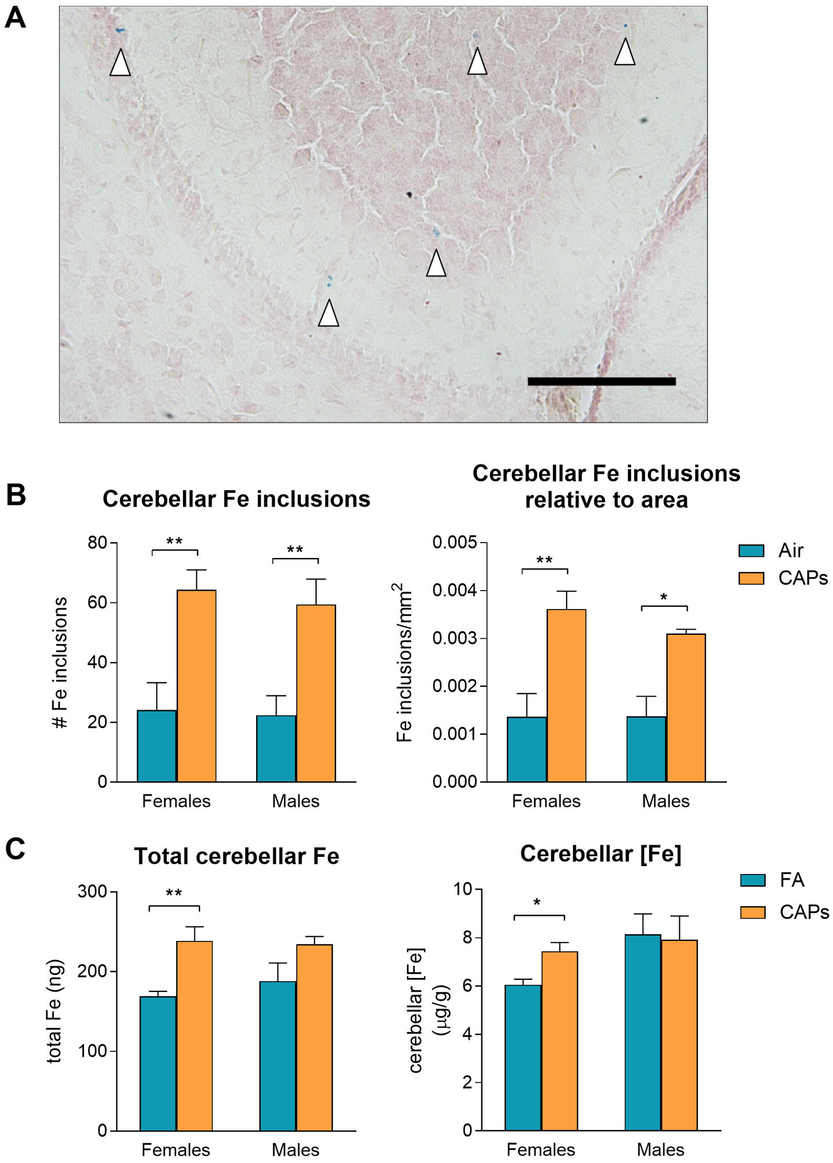
Summary of Nonhuman Evidence
Cognitive effects (animal models)
  Effect on learning, memory, and motor activity
  Driven via neuroinflammation
Developmental exposure
  Important window of susceptibility
  Often male-biased effects in animal models, which may mimic human evidence
  Structural and functional changes with effect on learning and behavior
Notes:
Laboratory studies provide support for the neurotoxic effects of exposure to TRAP. The toxicologic outcomes reviewed in the 2010 HEI review include in vivo effects of the traffic mix on neuropathologic markers and of CAPs on markers of inflammation in some regions of the brain. Neurologic outcomes studied after in vivo exposure to components of the traffic mix pertain to learning, memory, and motor activity.
An association between ambient PM and neuropathology was supported by the findings in the brains of 32 dogs exposed to high concentrations of PM in Mexico City (Calderón-Garcidueñas et al. 2002). Compared with the brains of 8 control dogs from less polluted cities, several neuropathologic markers were found in the dogs exposed to the higher PM concentrations. In addition, physical damage to the blood–brain barrier and neurodegenerative pathology were reported.
The neurodevelopmental effects of prenatal PM exposure have been documented in numerous animal studies. In the past ten years, the number of animal studies have expanded considerably (>25 studies) verifying the adverse cognitive effects and underlying neurotoxic mechanisms. In numerous models, prenatal exposure to fine and ultrafine PM leads to offspring cognitive and behavioral impairment, often in a sex-specific manner bias toward effects on male offspring. Findings from laboratory studies highlight how PM-induced neurological damage, including structural and functional changes, are region and sex, and timing-dependent.
As review by Payne-Sturges et al. 2019, in mice, prenatal exposures to fine and ultrafine particles caused enlarged lateral ventricles, an early and excessive myelination pattern, an increase in the size of the corpus callosum (the bridge connecting the two brain hemi- spheres), and a decrease in the hippocampal area (involved in emotional regulation, spatial navigation, and memory). Prenatal diesel exhaust exposure produced inflammation in fetal brain, decreased activity, increased anxiety, and brain microglial activation (indicating a pathological process) in males as adults. Prenatal diesel exhaust exposure in mice reduced locomotor activity and altered levels of neurotransmitters (dopamine, norepinephrine) in a region- specific manner. Chronic exposure of young adult mice to UFP produced depressive-like behaviors and impaired spatial learning and memory. In a series of studies, postnatal UFP exposures of mice produced a pattern of developmental neurotoxicity notably similar to the hypothesized mechanistic underpinnings of autism spectrum disorder.
UFP is likely the most toxic fraction of particulate air pollution and once inhaled can migrate to the central nervous system via the nasal cavity, circulating blood, or sensory nerves found in the gastrointestinal tract.
Potential cellular mechanisms responsible for air pollution-induced neurological damage include persistent glial activation with concomitant neuroinflammation and oxidative stress.
Elevated iron (Fe) concentrations in the brains of animals may underlie structural damage. This is shown in the figure from Klocke et al. 2018.
A) Representative image in a CAPs-exposed male. Arrows indicate locations of Fe3+ inclusions (i.e., blue staining). B) Gestational CAPs exposure significantly increased the number of cerebellar Fe inclusions as well as the density relative to cerebellar area. C) Fe elevations observed in histological analyses were confirmed. Fe was significantly increased in CAPs-exposed females. Although CAPs-exposed males experienced elevated Fe levels, the effect was not significant.
References:
Health Effects Institute. Panel on the Health Effects of Traffic-Related Air Pollution. Traffic-related air pollution: A critical review of the literature on emissions, exposure, and health effects. United States: 2010. https://www.healtheffects.org/publication/traffic-related-air-pollution-critical-review-literature-emissions-exposure-and-health.
See chapter 5.
Payne-Sturges, D. C.; Marty, M. A.; Perera, F.; Miller, M. D.; Swanson, M.; Ellickson, K.; Cory-Slechta, D. A.; Ritz, B.; Balmes, J.; Anderko, L.et al. Healthy Air, Healthy Brains: Advancing Air Pollution Policy to Protect Children's Health. Am J Public Health 2019, 109 (4), 550.
Klocke, C.; Sherina, V.; Graham, U. M.; Gunderson, J.; Allen, J. L.; Sobolewski, M.; Blum, J. L.; Zelikoff, J. T.; Cory-Slechta, D. A. Enhanced cerebellar myelination with concomitant iron elevation and ultrastructural irregularities following prenatal exposure to ambient particulate matter in the mouse. Inhal Toxicol 2018, 30 (9-10), 381.

Slide 8
Summary of Nonhuman Evidence
Other developmental effects (animal models)
  Birth outcomes (vary by model)
  Respiratory effects (established)
  Cardiometabolic effects (now emerging)
Notes:
Studies conducted in rodent models have demonstrated varying degrees of adverse birth outcomes following developmental exposure to TRAP. Some models report no effects on outcomes, such as abortion, stillbirth, intrauterine growth restriction or impact on birth weight. Limitations are associated with assessing some early outcomes, such as stillbirth, as well as differences in models, including species, strain, timing and type of exposure. Overall though, rodent models evaluating PM generated from various sources, like diesel exhaust-generated PM or concentrated ambient particles, confirm the effects on adverse birth outcomes. There is broad consensus on initial pollutant-induced growth restriction, with more variation in the long-term effects of altered offspring growth trajectories that is driven by differences in exposure models.
Rodent models employing prenatal PM exposure provide substantial evidence on offspring lung dysfunction and increased asthma susceptibility. Features of asthma, or allergic airway disease, can be characterized by measuring airway inflammation and hyperresponsiveness following an allergen exposure. In the figure from Manners et al. (2014), prenatal exposure to DEP followed by allergen (OVA) challenge results in enhanced pulmonary inflammation (A) and higher levels of inflammatory cells in lungs (B), including eosinophils and neutrophils, lymphocytes and macrophages. Offspring also showed increased airway resistance (C), a functional measure of asthmatic response.
Evidence of cardiac dysfunction and metabolic effects following developmental exposure to PM is only now emerging.
Manners, S.; Alam, R.; Schwartz, D. A.; Gorska, M. M. A mouse model links asthma susceptibility to prenatal exposure to diesel exhaust. J Allergy Clin Immunol 2014, 134 (1), 63.

Slide 9
Mechanisms
Direct
Indirect
  Inflammation
  Oxidative stress
Notes:
Underlying the various health effects, toxicology studies reveal a central role of inflammation and oxidative stress (as shown in the figure from Brook et al. 2010)
In pathway 1, fine PM and UFPs that reach the alveolar region of the respiratory tract generate a pro-inflammatory response. In addition to the pro-oxidants present on PM (PAHs and transition metals) contribute to oxidative stress. Oxidative stress is often defined as an imbalance of pro-oxidants and antioxidants. This imbalance can happen when the generation of reactive oxygen species, or free radicals, exceeds the available antioxidant defenses and is characterized by the presence of increased cellular concentrations of oxidized lipids, proteins, and DNA. Oxidative stress can trigger inflammatory reactions, which lead to an increased production of oxidants by activated phagocytes recruited to the airways, perpetuating the cycle of oxidative injury.
Reflected in the figure, “systemic” spill-over can result in an inflammatory response beyond the lung. Systemic oxidative stress and inflammation is reflected by numerous studies showing activated white blood cells (WBCs), platelets, and MPO (myeloperoxidase) and pro-inflammatory cytokines like interleukin (IL)-1B, IL-6, and TNF-a. The pro-inflammatory state is accompanied by a pro-oxidant state, which can be measured as oxidize lipids and decreased antioxidant capacity.
A question mark (?) indicates a pathway/mechanism with weak or mixed evidence or a mechanism of likely yet primarily theoretical existence based on the literature. For instance, vasculoactive molecules (e.g., ET, possibly histamine, or microparticles) from lung-based cells may also be involved.
These systemic actions may underlie effects on fat (adipose) and hepatic metabolism, thereby activating adipokines in fat via PAI, plasminogen activator inhibitor, and activating inflammation in the liver via C-reactive protein (CRP) and increasing clotting factors.
In pathway 2, perturbation of systemic autonomic nervous system (ANS) balance (i.e,, balance of PSNS, parasympathetic nervous system and SNS, sympathetic nervous system) or heart rhythm acts through particle interactions with lung receptors or nerves. These actions mediate vascular, blood and heart rate changes.
Alternatively, UFPs or particle constituents can directly translocate across the air-lung barrier into systemic circulation (pathway 3). This may alter the vasculature.
Brook, R. D.; Rajagopalan, S.; Pope, C. A., 3rd; Brook, J. R.; Bhatnagar, A.; Diez-Roux, A. V.; Holguin, F.; Hong, Y.; Luepker, R. V.; Mittleman, M. A.et al. Particulate matter air pollution and cardiovascular disease: An update to the scientific statement from the American Heart Association. Circulation 2010, 121 (21), 2331.

Slide 10
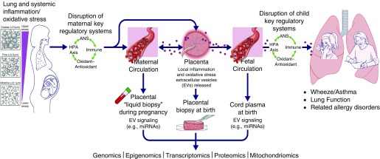
Mechanisms (prenatal exposure)
UFPs can directly cross placenta
TRAP-driven maternal/placental inflammation and oxidative stress can cause indirect effects influenced via epigenetic changes
Notes:
Likewise, in regards to prenatal exposure, effects are understood to be caused through two broad mechanisms, 1) by directly crossing the placenta, hence reaching fetal circulation, and/or 2) indirectly through an interplay of PM-driven maternal/placental inflammation, oxidative stress, and epigenetic modifications (as reviewed by Saenen et al. 2019)
The placenta is a multifunctional organ that connects the developing fetus to the uterus through the umbilical cord, providing oxygen and nutrients, removal of waste products, and serves as a barrier between maternal and fetal tissues. Evidence from in vivo animal exposure models, ex vivo human placental models, and recent direct evidence from human placentae demonstrate transport of ultrafine particles across the placental barrier indicating possible direct effects.
According to the “Developmental Origins of Health and Disease” (DOHaD) concept, the early-life environment is a critical period for fetal programming. In general, prenatal exposure to air pollution is associated with oxidative stress and epigenetic alterations in the placenta.
The figure from Wright and Coull (2019) shows the placenta as a target of prooxidant pollutant effects.. Ultrafine particles penetrate deeper into the lungs, have greater ability to induce oxidative stress, and more readily enter the systemic circulation in mothers, all features that may enhance toxicity in this schema. Programming effects may result from pollutant-induced shifts in a number of molecular, cellular, and physiological states and their interacting systems in mothers and children. Specific key regulatory systems susceptible to programming may influence vulnerability to respiratory diseases including both central and peripheral components of neuroendocrine pathways and autonomic nervous system functioning, which, in turn, influence the immune system. ANS = autonomic nervous system; HPA = hypothalamic–pituitary–adrenal; miRNAs = microRNAs. Illustrated by J. Gregory (Mount Sinai Health System).
Saenen, N. D.; Martens, D. S.; Neven, K. Y.; Alfano, R.; Bove, H.; Janssen, B. G.; Roels, H. A.; Plusquin, M.; Vrijens, K.; Nawrot, T. S. Air pollution-induced placental alterations: an interplay of oxidative stress, epigenetics, and the aging phenotype? Clin Epigenetics 2019, 11 (1), 124.
Wright, R. J.; Coull, B. A. Small but Mighty: Prenatal Ultrafine Particle Exposure Linked to Childhood Asthma Incidence. Am J Respir Crit Care Med 2019, 199 (12), 1448.

Slide 11
Discussion
Strengths of toxicological and mechanistic studies
  Controlled exposure conditions
  Can be done more quickly than human studies
Limitations
  Establishing relevance to human populations
Overall, toxicological and mechanistic studies provide important evidence of health effects and can inform development of epidemiological studies and burden of disease assessments
Notes:
Strengths of animal models include controlled exposures, often resulting in consistent dose, which is difficult to determine from epidemiologic studies. In vivo studies also can be studies relatively quickly, in terms of disease development, for many chronic endpoints.
Limitations, however, also revolve around dose, particularly in regards to extrapolation to human relevance. Many studies, especially early ones, used high doses to investigate effects. These have to be interpreted with caution in how they are related to human exposures. Newer models are focusing on relevant doses in animal studies to be most relevant to human risk assessment.
Differences in models, for instance species and strains, also makes it difficult to translate to human relevance. Overall, the outcomes from animal studies provide the critical piece of biological plausibility to help in establishing causality. Moreover, critical information related to mechanisms of action can be gleaned from toxicology studies.
Incorporating toxicological information into burden of disease assessments can aid in preventing underestimation of health effects.
References:
Grandjean, P.; Bellanger, M. Calculation of the disease burden associated with environmental chemical exposures: application of toxicological information in health economic estimation. Environ Health 2017, 16 (1), 123.

Slide 12
Research Gaps and Future Directions
Role of pollutant interactions
New-technology engine emissions
Dose-response studies (relevant levels and threshold for no effects)
Oxidative capacity of emissions
Notes:
Little is known about the health effects of traffic-emissions mixtures and pollutant interactions. Although much has been learned about the cardiac and respiratory effects of DE exposure, toxicologic studies need to further address the effects of exposure to emissions from gasoline-fueled engines, gaseous versus particulate components of traffic emissions, and road dust. Studies are also needed to address potential pollutant interactions in inducing health effects.
Emissions related to new-technology diesel engines and new fuel formulations require study. Changes in fuel and energy sources change emissions and will likely alter health risks associated with traffic exposure. There is a need to study the toxicology of emissions related to ethanol and biodiesel fuels, whose use is increasing, and to anticipate the potential health risks of new fuels as they emerge.
There is a need for additional dose–response and concentration–response studies. Studies are needed that use exposure concentrations relevant to ambient air in order to understand concentration–response relationships and to identify no-effect concentrations.
Measurements of the oxidant potential of exposure atmospheres are needed to test the hypothesis that health effects are related in part to the oxidative capacity of traffic emissions. Given the strong evidence of a role for oxidative stress in mediating air pollution’s health effects, there is a need to know the degree to which this stress comes from the exposure itself.
References:
Health Effects Institute. Panel on the Health Effects of Traffic-Related Air Pollution. Traffic-related air pollution: A critical review of the literature on emissions, exposure, and health effects. United States: 2010. https://www.healtheffects.org/publication/traffic-related-air-pollution-critical-review-literature-emissions-exposure-and-health.
See chapter 5.

Slide 13
Take-Home Messages
Toxicological studies in animal models provide strong evidence that TRAP alters
  Lung structure and function
  Allergic disease risk
  CVD risk
  Lung cancer risk
Substantial evidence is emerging related to TRAP exposure and
  Adverse cognitive effects (particularly prenatal exposure)
  Altered metabolic effects
  Lasting impacts on offspring respiratory and cardiometabolic health
Mechanisms may be direct or indirect via inflammation and oxidative stress
  Epigenetic changes underlie offspring health outcomes

Slide 14
List of Abbreviations
DE Diesel exhaust
DEPs Diesel exhaust particles
UFPs Ultrafine particles
CAPs Concentrated ambient particles
PAHs Polycyclic aromatic hydrocarbons
HRV Heart rate variability
CVD Cardiovascular disease
IARC International Agency for Research on Cancer

Slide 15
References
Health Effects Institute. (2010). Traffic-related air pollution: A critical review of the literature on emissions, exposure, and health effects. https://www.healtheffects.org/publication/traffic-related-air-pollution-critical-review-literature-emissions-exposure-and-health
Notes:
All other references cited in notes section

Slide 16
Reading List
Rodricks, J.V. 2007, Chapter 4: Toxic agents and their targets, in Calculated Risks: The toxicity and human health risks of chemicals in our environment, 2nd Edition, Cambridge University Press, New York.
ISBN-13: 978-0521788786

Slide 17
Acknowledgements
Dr. Mary Fox, Department of Health Policy and Management, Johns Hopkins Bloomberg School of Public Health, Baltimore, MD, 21205. mfox9@jhu.edu
Dr. Kirsten Koehler, Department of Environmental Health and Engineering, Johns Hopkins Bloomberg School of Public Health, Baltimore, MD, 21231. Kirsten.koehler@jhu.edu

