Slide 1
www.carteeh.org

Slide 2
Lecture #13: Emission Modeling Methods and Data Sources
Kanok Boriboonsomsin
College of Engineering – Center for Environmental Research and Technology
University of California at Riverside
kanok@cert.ucr.edu, 951-781-5792
The author declares that there is no conflict of interest
Lecture Track(s): TT
Notes:
Health Track (HT)—mainly targeted at urban planners, transportation planners, and engineers with limited knowledge of public health-related concepts;
Transportation Track (TT)—mainly targeted at environmental epidemiologists and public health professionals with limited knowledge of transportation-related concepts; and;
Planning and Policy Track (PPT)—mainly targeted at planners, civil servants, and policy and decision makers with particular interest in the science-policy link.

Slide 3
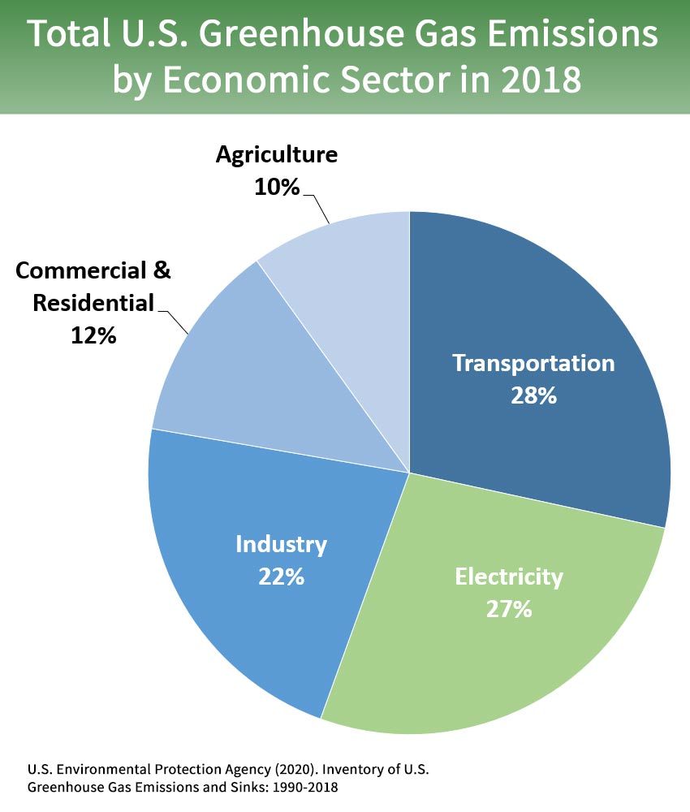
Introduction
Transportation is a major contributor of greenhouse gas (GHG) and pollutant emissions.
  On-road motor vehicles account for >80% of GHG emissions from transportation sources.
Vehicle emission modeling is essential for informing sustainable transportation and climate change programs and policies.
Notes:
Transportation is a major contributor of greenhouse gas (GHG) and pollutant emissions. Among the various transportation modes, on-road motor vehicles are the most significant sources of transportation-related emissions. For example, on-road motor vehicles account for more than 80% of GHG emissions from transportation sources.
Ability to model emissions from these sources is essential in making informed decisions on transportation programs and investments as well as in forming sustainable transportation and climate change policies.

Slide 4
Needs for Emission Modeling
Construct emission inventories
  Understand contributions of different emission sources
  Assess emission trends and track progress of emission reduction strategies
Evaluate emission and air quality impacts of transportation plans, programs, or projects
  Environmental assessment and environmental impact statement
  State implementation plan (SIP) and transportation conformity analyses for agencies in nonattainment areas
Support analyses of other related policies (e.g., land use, public health)
  Estimate emission reduction co-benefits of land use strategies
  Provide data inputs for air quality and health impact assessment
Notes:
There are several needs for the modeling of transportation-related emissions in planning and policy analysis. In a broad sense, emission modeling is conducted to construct emission inventories. Historical and current emission inventories are used by policy makers to assess emission trends, understand the contribution of each emission source, develop strategies to reduce emissions, and track progress over time. Future emission inventory estimates are used to inform the selection of emission reduction strategies and establish emission reduction goals.
In the context of planning, emission modeling is performed by transportation agencies to evaluate the potential impacts of transportation plans, programs, or projects on emissions and air quality in their areas. For example, in the U.S. this is required of agencies in nonattainment areas, which do not meet one or more of the national ambient air quality standards. The requirement, referred to as transportation conformity, aims to ensure that federal funding and approval are given to highway and transit projects that will not lead to new air quality violations, worsen existing violations, or delay the ability of an area to attain the standards. Also, some transportation programs are partly driven by the desire to reduce emissions from on-road motor vehicles. For example, a U.S. federal programs encourage construction of high-occupancy vehicle lanes instead of general-purposed lanes in nonattainment areas. Many programs that are aimed at reducing traffic congestion also have a co-benefit of reducing traffic emissions. Examples include congestion pricing, carsharing, transit improvement, etc. Emission modeling can be performed to analyze the emissions reduction benefits of these programs.
In addition, emissions modeling can play a role in the analysis of policies related to other issues beyond transportation. For example, emissions modeling is one of the key modeling steps required to determine the level of transportation-related air pollution near roadways. The modeling results can have implication on public health and land use policies. For example, facilities with a high fraction of sensitive population such as schools and nursing homes should be located far enough from major highways.

Slide 5
Emission Modeling Basics
Vehicle Emission (g) = Vehicle Activity (mi) x Emission Rate (g/mi)
Notes:
The basic form of emission modeling is the multiplication of vehicle activity with emission rate. Here, vehicle activity is in the unit of miles (mi) and emission rate in the unit of grams per mile (g/mi). However, they can be in other units as long as the units are consistent, for example, hours & kg/hour, days & tons/day. For emissions associated with the start of the engine (called start emissions), the units can be the number of engine starts & g/start.
In addition, vehicle activity and emission rate should be for the same vehicle, road, operating, and environmental characteristics. For example, the right figure shows that emission rates of fine particles (PM2.5) vary by average speed of the vehicle. Thus, vehicle activity should be disaggregated by average vehicle speed, as shown in the left figure. Then, the number of vehicle miles traveled (VMT) occurred at each average speed can be multiplied by PM2.5 emission rate for the corresponding average speed. After that, the calculated emissions for different average speeds can be summed to result in the total emission.

Slide 6
Factors Affecting Vehicle Emission Rates
Vehicle characteristics
  Vehicle type, vehicle weight
  Age or engine model year
  Fuel type and properties
  Etc.
Roadway characteristics
  Road type
  Road grade
  Traffic control device
  Etc.
Operating characteristics
  Speed
  Acceleration
  Loaded weight
  Etc.
Environmental characteristics
  Ambient temperature
  Relative humidity
  Etc.
Notes:
There are a number of factors that can affect vehicle emission rates. Some of them are listed on this slide.
Vehicle characteristics
Vehicle type – E.g., heavy-duty trucks generally have higher emission rates than passenger cars.
Age or engine model year – Older vehicles typically have higher emission rates than newer ones, which meet later, more stringent emission standards.
Road characteristics
Road grade – Emission rates when traveling up steep road grade are higher than when traveling on flat road.
Traffic control device – Stop signs and traffic signals induce deceleration, idling, and acceleration, which result in more emissions.
Operating characteristics
Speed – As seen in the previous slide, emission rates vary by travel speed and not in a linear fashion.
Loaded weight – Carrying heavy load results in higher emission rates.
Environmental characteristics
Cold ambient temperature could slow the warm up of the catalyst in the emission control system, resulting in higher emission rates.
As such, vehicle activity should be disaggregated based on these factors as much as possible.

Slide 7
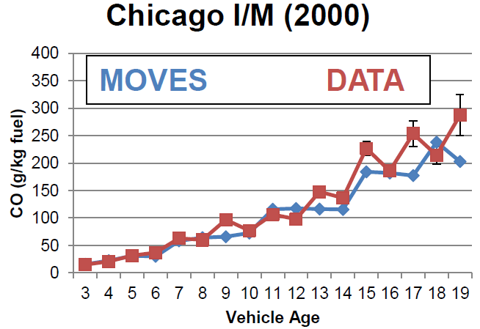
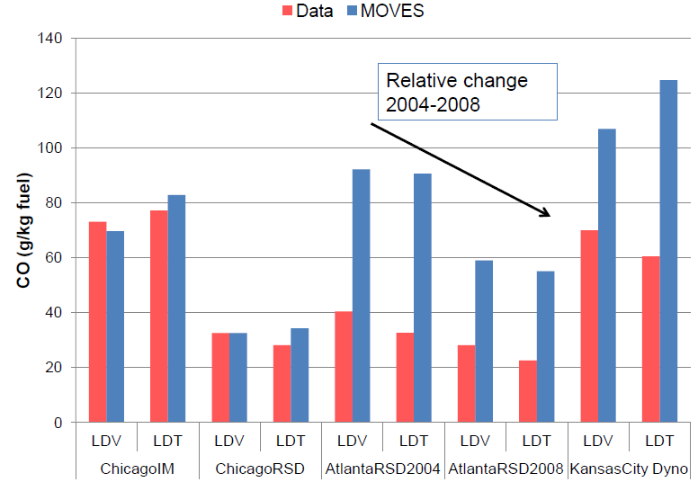
Emission Model Validation
Compare model predictions to independent measurements
  Evaluation of absolute emissions
  Evaluation of relative trends
Source: Choi and Koupal (2012)
Source: Choi and Koupal (2012)
Notes:
Validation of emission models is challenging. Emission measurements are expensive and so measurement data are limited. Also, as there are many factors that can affect vehicle emissions, a proper validation will require matching model data inputs for these factors as close as possible to the conditions in real world.
When the estimated emission values are in line with the measured values, it gives a lot of confidence in the model estimates. But when the estimated values are quite different from the measured values, the relative trends between the two should be evaluated. There could be systematic errors in the measurement, the model, or both.

Slide 8
Modeling Scales
Scale | Transportation Models | Vehicle Activity | Emission Models | Emission Rate
Macroscopic | Travel demand models | Average overall traffic speed | EMFAC | Per mile
Mesoscopic | Travel demand or transportation network models | Average traffic speed by road type | MOVES (County Domain) | Per hour
Microscopic | Traffic microsimulation models | Second-by-second vehicle speed profile | MOVES (Project Domain) | Per second
Notes:
Modeling vehicle emissions can range from a simple exercise to a complicated task. The choice of the modeling approach depends on the purpose of the analysis, the available data and tools, and the level of accuracy expected. Different modeling approaches have their own strengths and limitations, and are suitable for answering different types of policy questions.
For modeling at the macroscopic or mesoscopic scale, data input requirements are minimal and the modeling approach is not sophisticated. On the other hand, modeling results are sensitive to only a limited set of variables, which limits the range of policy questions that can be addressed. The macroscopic and mesoscopic approaches have traditionally been used by transportation agencies and metropolitan planning organizations to analyze the emission impacts of transportation plans and programs. Travel demand models are often used to generate vehicle activity data inputs in terms of vehicle miles traveled or vehicle hours traveled. Vehicle emission rates are usually obtained from the U.S. Environmental Protection Agency’s MOVES model, or in the case of California, the California Air Resources Board’s EMFAC model. Then, emissions can be calculated for roadway links, specific areas, or the entire region.
For analyses of the emission impacts of some transportation projects and technologies, a highly detailed modeling approach that can capture the effects of driving behavior on vehicle emissions is needed. This microscopic approach calculates emissions at high time resolution, typically on a second-by-second basis, as it accounts for the modal operations of vehicle such as acceleration, deceleration, and idling. Although the microscopic approach provides more accurate emission results than the other two approaches, it is more computationally demanding and requires more detailed data inputs. Thus, it is used more frequently in project-level analyses (e.g., modeling emission hotspots) than in areawide analyses (e.g., regional emissions inventory development). This modeling approach requires traffic microsimulation models to produce modal vehicle activity data inputs in the form of vehicle trajectories (i.e., second-by-second position and speed profiles). These vehicle trajectories are used in conjunction with microscopic vehicle emissions models such as MOVES and CMEM to calculate the corresponding emissions. These emission results can then be aggregated for specific roadways or locations as well as for specific time periods in the modeling domain.

Slide 9
Emission Modeling Tools/Software
MOVES
  Regulatory emission model for U.S. except in California
  Available at https://www.epa.gov/moves
EMFAC
    Regulatory emission model for California
  Available at https://arb.ca.gov/emfac/
Others
  COPERT
    Standard emission model for countries in the European Union
    Available at https://www.emisia.com/utilities/copert/
  CMEM
    Research-grade microscopic emission model (Barth et al., 2000)
    Available at https://www.cert.ucr.edu/cmem
Notes:
These are widely used and publically available vehicle emission models. Regulatory models are approved for use in regulatory analyses such as SIP and transportation conformity analyses. All of these models are empirical models, except for CMEM, which is an analytical model.
The empirical models such as MOVES have embedded emission rates and defaults for a variety of vehicle, road, operating, and environmental characteristics. Users can also input local/customized data regarding these characteristics. Then, the models calculate and output emissions for each second, each road way link, or the entire modeling area, depending on the models’ modeling scale. The emission outputs can be disaggregated by vehicle type, age, etc. Most models also provide an option for users to obtain the emission rates for use outside of model runs.

Slide 10
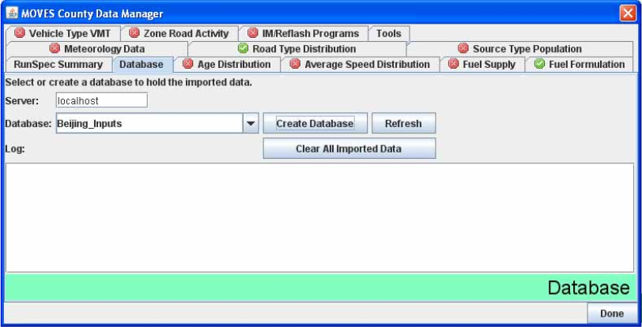
MOVES Overview
Motor Vehicle Emission Simulator
  Developed by U.S. Environmental Protection Agency
  Use relational database structure, allowing easy update of individual data tables
  Modal model, sensitive to different vehicle operating modes (e.g., accelerating, cruising, decelerating, idling)
Generate emissions estimates at multiple spatial scales
  National
  County
  Project
And multiple temporal scales
  By hour, day (weekday or weekend), month, or year
Notes:
MOVES is the most widely used emission model in the U.S., and have also been adapted for use in other countries. So, in this lecture we will discuss about MOVES in more details and use it as an example for understanding emission modeling approach and data inputs.
MOVES consists of a large number of data tables stored in a relational database structure, which allows easy update of individual data tables.
MOVES is a modal model, which means it can estimate emissions associated with different modes of vehicle operations such as accelerating, cruising, idling.
MOVES is a multi-scale model with three scales.
National ~ macro
County ~ meso
Project ~ micro

Slide 11
Emission Processes Accounted for by MOVES
Emission Process | Activity Basis | Operating Modes
Running exhaust | Source hours operating | Vehicle specific power and speed bins
Start exhaust | Engine starts | Soak time bins
Extended idle exhaust | Source hours extended idle | Single mode
Crankcase | N/A (chained to start, running, & idling emissions) | N/A
Brake wear | Source hours operating | Vehicle specific power and speed bins
Tire wear | Source hours operating | Speed bins
Evaporative – permeation | Source hours | Running, hot soak, cold soak
Evaporative – fuel vapor venting | Source hours | Running, hot soak, cold soak
Evaporative – fuel leaks | Source hours | Running, hot soak, cold soak
Evaporative – refueling losses | N/A (chained to fuel consumption) | N/A
Source: Adapted from Beardsley (2011)
Notes:
Vehicles produce emissions in more ways than through their tailpipes when they are running. MOVES also estimates emissions from these various processes. For example, start exhaust emissions are additional emissions released during a period after engine starts when the emission control system has not reached the required temperature. Brake wear and tire wear emissions are particles that come off brake pads and tires when the vehicle is running.
The basis of activity for the different emission processes depend on the processes. For example, MOVES characterizes running exhaust emissions per unit time, and thus the activity basis is the number of hours that the vehicle operates (i.e., source hours operating). On the other hand, evaporative emissions can be released when the vehicle is not in use, so the activity basis is simply source hours (rather than source hours operating).
[In MOVES, vehicle is referred to “source” as it is an emission source.]
In addition, MOVES defines operating modes for each emission process by which activity is disaggregated. For example, brake wear emissions depend on the number of hours the vehicle operates in different vehicle specific power and speed bins where as tire wear emissions depend on the number of hours the vehicle operates in different speed bins.

Slide 12
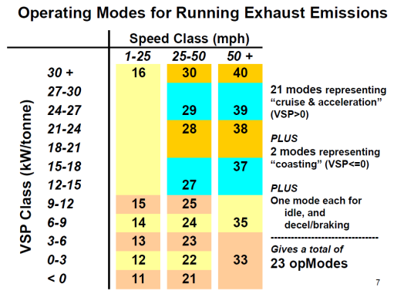
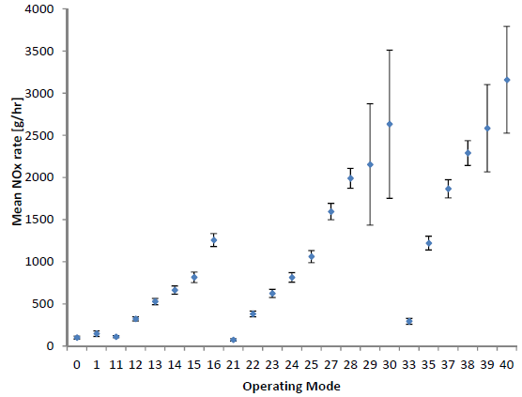
Operating Modes for Running Exhaust Emissions
Defined by vehicle specific power (VSP) and speed bins.
There is an emission rate associated with each operating mode.
Source: Warila et al. (2011)
Source: U.S. Environmental Protection Agency (2015)
Notes:
Vehicle specific power (VSP) is the amount of power per unit mass of vehicle that the engine exerts to propel the vehicle forward. It is calculated on a second-by-second basis as a function of vehicle speed, vehicle acceleration, vehicle mass, road grade, as well as coefficients associated with air drag, rolling resistance, and rotating friction forces. It has been found that running exhaust emissions are strongly correlated with VSP. So, MOVES defines operating modes for these emissions by a combination of VSP and speed bins, as shown in the left figure. In total, there are 23 operating modes that have different emission rates associated with them, as shown in the right figure. Notice that the emission rate has a similarly increasing trend in three regimes, which correspond to the three speed bins. In each speed bin, the emission rate increases as VSP is higher.

Slide 13
County-Level: Fleet Data
ID | Vehicle Type in MOVES
11 | Motorcycle
21 | Passenger Car
31 | Passenger Truck
32 | Light Commercial Truck
41 | Intercity Bus
42 | Transit Bus
43 | School Bus
51 | Refuse Truck
52 | Single Unit Short-haul Truck
53 | Single Unit Long-haul Truck
54 | Motor Home
61 | Combination Short-haul Truck
62 | Combination Long-haul Truck
Key MOVES inputs
  Vehicle population by vehicle type
  Age distribution of each vehicle type
Potential data sources
  State vehicle registration databases
  Inspection and maintenance (I/M) program records
  Fleet databases, e.g.,
    Polk registration databases
    Vehicle Inventory and Use Survey
    National Transit Database
    School Bus Fleet Fact Book
Notes:
In the next several slides, we will look at some data inputs required by MOVES and potential sources for these data. We will focus on the modeling at the county level and project level, which MOVES is commonly used for. For all of these data inputs, MOVES has embedded default values that represent the national level. Local-specific data should be used as much as possible, but the national default values can be used as a fallback option if local-specific data are not available.
For fleet data at the county level, the key inputs for MOVES are vehicle population by vehicle type and age distribution of each vehicle type. MOVES defines 13 vehicle types as shown in the table.
Vehicle population is not simply the number of vehicles traveling on roadways (which can be obtained from traffic counts), but rather the number of the vehicles domiciled in the county so that evaporative emissions can be estimated. The most common source for this data is vehicle registration databases.
Data regarding age distribution can be obtained from state vehicle registration databases and specialized databases such as National Transit Database for transit buses. In states that have inspection and maintenance (I/M) programs, it may be possible to get age distribution data from I/M records as well.

Slide 14
County-Level: Vehicle Activity Data
Key MOVES inputs
  Vehicle miles traveled (VMT) by vehicle type
  Temporal adjustments – Fraction of VMT by month, weekday vs. weekend, hour
  Road type distribution – Fraction of VMT occurring on 5 road types
  Average speed distribution – Fraction of VMT by 16 speed bins
  Ramp fraction – Fraction of vehicle hours traveled (VHT) occurring on freeway ramps
Potential data sources
  Highway Performance Monitoring System
  Automated traffic recorders
  Travel demand model
  Trend extrapolation
  Traffic speed sensors and probe vehicles
Notes:
Vehicle activity data inputs in MOVES are mostly about VMT, but the VMT need to characterized by several factors including vehicle type, road type, speed bin, and time scale (month, weekday vs. weekend, hour).
A common source for this data is the Highway Performance Monitoring System (HPMS), which has traffic count and vehicle classification data collected by states from sample road sections, and then projected to represent all VMT by the state. By design, MOVES requires VMT data for each of the 6 vehicle types in HPMS so that it is easy to obtain. Then, MOVES allocates the VMT data from 6 HPMS vehicle types to 13 MOVES vehicle types internally. If additional automated traffic recorders or count stations are available in the county, data from these sources can be used to supplement HPMS data.
In areas or regions with travel demand model, the model outputs can be used to generate the required VMT data inputs for MOVES for both base year and forecast years. In areas or regions without travel demand model, VMT data inputs for forecast years can be obtained by extrapolating the trend of historical VMT data.
Note that HPMS does not provide vehicle speed data. So, travel demand model is usually relied on for that data. In addition, traffic speed sensors and probe vehicles are emerging sources of average speed distribution data.

Slide 15
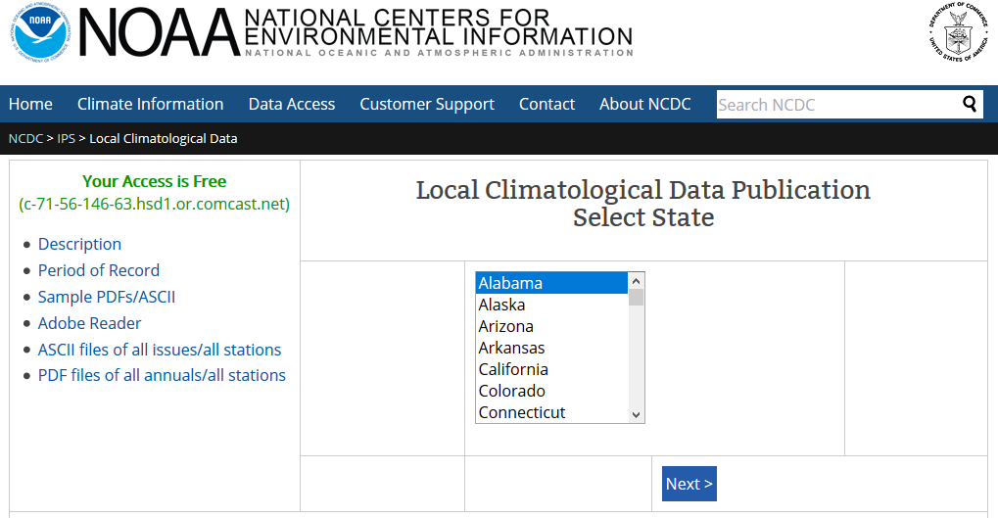
County-Level: Other Data
Key MOVES inputs
  Ambient temperature by hour in each month
  Relative humidity by hour in each month
  Fuel formulation – Fuel type and its contents
  Fuel supply – Market share of each fuel formulation by month
  I/M programs
Potential data sources
  National Centers for
  Environmental Information
  Fuel surveys
  I/M program-specific data
The same inputs and data sources are also applied to project-level.
Notes:
Other data inputs required to run MOVES include ambient temperature and relative humidity, fuel formulation and supply, and details about any I/M programs in the county.
For ambient temperature and relative humidity, the most common and readily available source is the National Centers for Environmental Information (formerly the National Climatic Data Center) website.
For fuel and I/M data, local surveys and I/M program-specific data are the key sources.
These other data inputs are the same for both county-level and project-level model runs.

Slide 16
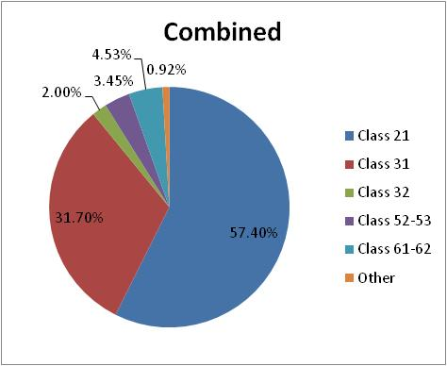
Project-Level: Fleet Data
Key MOVES inputs
  Vehicle population by vehicle type
  Age distribution of each vehicle type
Potential data sources
  State vehicle registration databases
  I/M program records
  Vehicle classification counts
  License plate surveys
    Used in conjunction with
    vehicle registration databases
    Provide site-specific fleet data
Source: Boriboonsomsin et al. (2011)
Source: Boriboonsomsin et al. (2011)
Notes:
In the next few slides, we will go over data inputs for project-level model runs. For fleet data, MOVES requires vehicle population by vehicle type and age distribution for each vehicle type. As in the case for county-level model runs, state vehicle registration databases and I/M program records are the primary data sources. However, the data may not be representative of the project areas.
To obtain project-specific data, temporary traffic count stations can be set up in the project area. In addition, license plate surveys can be conducted after which the license plate numbers can be matched with vehicle registration databases to obtain vehicle model year information, which can then be used to develop age distribution data input. In addition, license plate surveys can provide vehicle classification counts as a byproduct, which can be used to develop vehicle population data input as well.

Slide 17
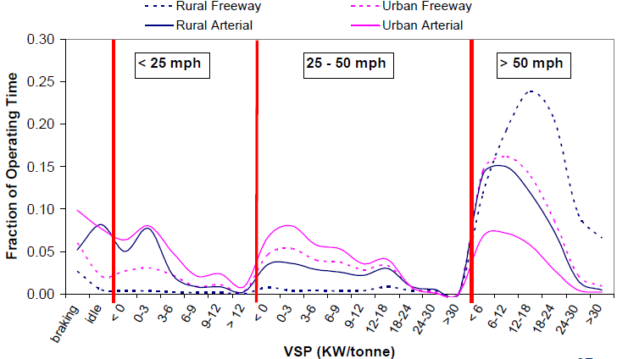
Project-Level: Road Link Data
Key MOVES inputs
  Traffic volume
  Average speed or drive schedule or operating mode distribution
  Link length and vertical grade
Potential data sources
  Traffic counts
  Travel demand models
  Probe vehicle studies
  Traffic microsimulation models
  Project as-built plans
  Field or aerial surveys
Source: Dresser and Laurita (2012)
Notes:
At the project level, MOVES requires VMT and speed data on specific road links in the project area rather than for the project area as a whole. The data inputs include traffic volume and average speed on the link as well as link length and vertical grade. Traffic volume and link length are multiplied to result in VMT. Average speed and vertical grade are used to calculate VSP and subsequently operating mode. In the calculation, MOVES uses a set of default drive schedules for different average speed values.
In lieu of average speed, MOVES allows modelers to input drive schedule or operating mode distribution. Drive schedule is a representative second-by-second vehicle speed profile on the road link, which can be obtained from probe vehicle data. MOVES uses drive schedule in conjunction with vertical grade to calculate VSP and subsequently operating mode. Alternatively, modelers can do this calculation outside of MOVES and input the resulting operating mode distribution (such as the ones in the figure) directly into MOVES.
Common sources for traffic volume data at project sites are traffic counts and travel demand models. Travel demand models can also provide average speed. However, if modelers would like to input project-specific or customized drive schedules or operating mode distributions, they could obtain second-by-second vehicle speed profile data from probe vehicles or traffic microsimulation models.
Link length and vertical grade data are typically available from the project as-built plans. If not, field or aerial surveys can be conducted to obtain these data.

Slide 18
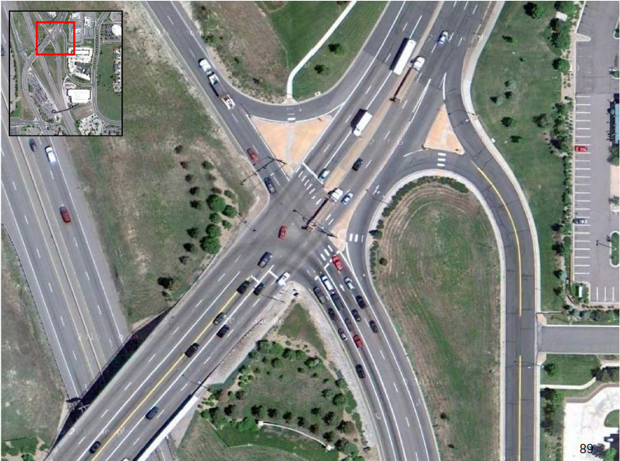
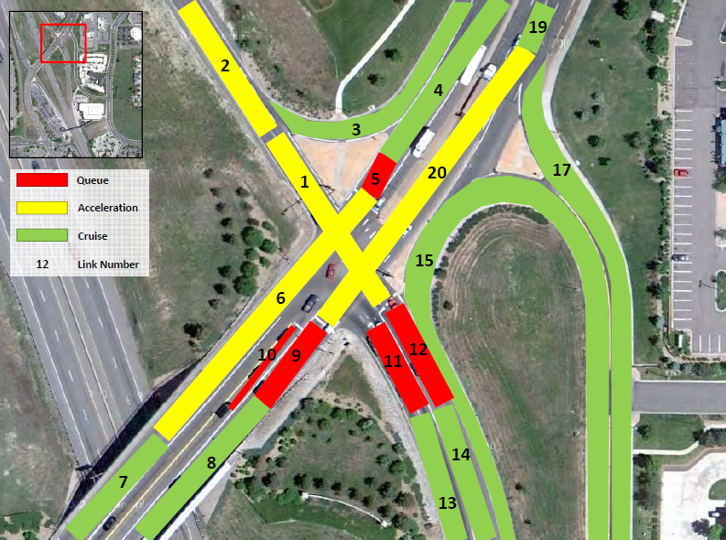
Defining Road Links
A road should be divided into links if they have different fleet, vehicle activity, or other characteristics that could impact vehicle emissions.
Source: Dresser and Laurita (2012)
Source: Dresser and Laurita (2012)
Notes:
Road links in MOVES may sometime be defined differently from road links in other contexts. A typical road block may need to be divided into multiple links if they have different fleet, vehicle activity, or other characteristics that could impact vehicle emissions. Taking the right figure as an example, links #11 and #12 are separated from links #13 and #14, respectively, as those are the areas where vehicles queue up at the intersection as opposed to cruising and so the average speeds on links #11 and #12 are usually lower. In another example, although both links #1 and #2 are areas where vehicles accelerate from the intersection, link #2 is separated from link #1 because the merging traffic from link #3 could induce more speed fluctuation, resulting in a different drive schedule or operating mode distribution.

Slide 19
Project-Level: Off-Network Data
Off-network refers to non-roadway facilities that produce vehicle emissions such as parking lots, truck stops, and bus terminals.
Key MOVES inputs
  Source type fraction – Vehicle population by vehicle type
  Start fraction – Fraction of vehicles that start engines in each hour of the day
  Extended idle fraction – Fraction of time long-haul combination trucks spend in extended idle mode
  Parked fraction – Fraction of time vehicles parked in each hour of the day
Potential data sources
  Facility-specific entrance/exit data or field observations
  Vehicle data logging or fleet telematics
  Parking studies
Notes:
As pointed out earlier, MOVES estimates emissions from multiple processes beyond just tailpipe emissions when vehicles are running on the roads. Some of the other emission processes occur in non-roadway facilities such as parking lots, truck stops, bus terminals, etc. referred to in MOVES as “off-network”.
The emission processes occurring off-network include start exhaust, extended idle exhaust, and evaporative. Thus, the required data inputs are directly associated with these emission processes.
Because these data inputs vary from facility type to facility type and from site to site, there is no common data source and facility-specific field observation or studies are often required. In some cases such as bus terminals, telematics data from the vehicle fleet may be used, if available.

Slide 20
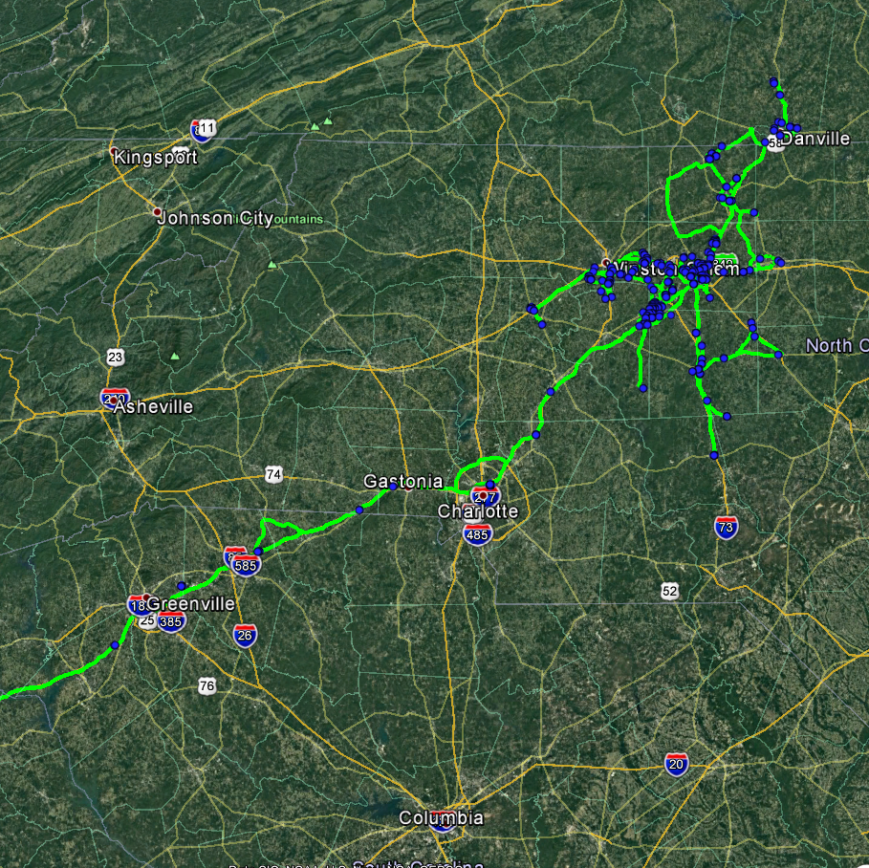
Discussion
Significant advancements in the field of emission modeling have been made over the last few decades.
There are many new data sources that can be used for emission modeling:
  Traffic sensor network
  Weigh-in-motion stations
  Probe vehicle (GPS) data
  Fleet telematics
  Location-based (cell phone) data
  Etc.
Notes:
Emission models have come a long way over the last several decades. Starting with macroscopic models in the 70’s, which were driven by the Clean Air Act. Then, the creation of microscopic models (e.g., CMEM) in the 90’s to better estimate modal vehicle emissions for transportation projects. The development of MOVES since the 2000’s has filled the needs for multi-scale emission model. Since then, the focus has been on improving the fidelity and usability of MOVES through various version releases.
In the last decade, several data sources have emerged as potential new data sources for emission modeling. Some of them (e.g., traffic sensor network and probe vehicle data) are not necessarily new, but their accuracy, coverage, or both have improved to the point that they can be used for emission modeling purposes. Studies have been conducted to demonstrate the use of these new data sources in developing data inputs for emission modeling.

Slide 21
Research Gaps and Future Directions
Emissions from advanced vehicle, fuel, and emission control technologies
  Hybrid, plug-in hybrid, and battery electric vehicles
  Compressed natural gas, biofuel, etc.
  Gasoline direct injection, selective catalytic reduction, etc.
Life-cycle emissions
  Emissions associated with fuel production and distribution
Big vehicle activity and emission data
  Collection and acquisition, processing and QA/QC, analysis and interpretation
Emission impacts of transformative transportation technologies
  Connected and automated vehicles
  Shared mobility, mobility on demand
Notes:
Although emission models have improved significantly over the last several decades, they are yet to fully catch up with the advancements in vehicle, fuel, and emission control technologies during the same period. Emissions from these advanced technologies are still not well understood, and more work is needed in that area.
Also, as the vehicle and fuel technologies evolve, it is increasingly important to understand their life-cycle emissions, especially during fuel production and distribution, e.g.,
Electricity generation and distribution (electric fuel)
Feedstock production and transportation (biofuel)
As discussed in the previous slide, there are several new data sources for emission modeling. Some of these data sources produce big data, which requires research on how to collect, process, and analyze them for emission modeling purposes.
Lastly, there have been a few transformative transportation technologies emerging in the last few years including connected and automated vehicles, shared mobility, mobility on demand, etc. The emission impacts of these technologies are uncertain and need more research.

Slide 22
Take-Home Messages
Emission modeling is crucial for understanding emission impacts of transportation systems
A basic form of emission modeling is the multiplication of vehicle activity with emission rate for the same vehicle, roadway, operating, and environmental characteristics.
The three modeling scales—macro, meso, and micro—have different advantages and limitations, and are appropriate for different use cases.
For many model inputs, there are multiple potential data sources. Modelers can evaluate and choose one or more that best fit their needs and resources.

Slide 23
List of Abbreviations
GHG – Greenhouse gas
I/M – Inspection and maintenance
SIP – State implementation plan
VHT – Vehicle hours traveled
VMT – Vehicle miles traveled
VSP – Vehicle specific power

Slide 24
References
Barth, M., An, F., Younglove, T., Scora, G., Levine, C., Ross, M., and Wenzel, T., 2000. Development of a comprehensive modal emission model. Web-Only Document 122, National Cooperative Highway Research Program.
Beardley, M., 2011. Fleet & activity data in MOVES2010. Presented at MOVES Workshop, Ann Arbor, MI, June 14.
Boriboonsomsin, K., Scora, G., Wu, G., and M. Barth, 2011. Improving vehicle fleet, activity, and emissions data for on-road mobile sources emissions inventories. University of California at Riverside, final report prepared for Federal Highway Administration.
Choi, D. and Koupal, J., 2012. MOVES validation efforts to date. Presented at FACA MOVES Review Workgroup Meeting. July 31.
Dresser, C. and Laurita, M., 2012. Introduction to MOVES for non-modelers. Presented at Northern Transportation & Air Quality Summer, August.
U.S. Environmental Protection Agency, 2015. Exhaust emission rates for heavy-duty on-road vehicles in MOVES2014. Report No. EPA-420-R-15-015, September.
Warila, J., Nam, E., Landman, L., and Kahan, A., 2011. Light-duty exhaust emission rates in MOVES2010. Presented at MOVES Workshop, Ann Arbor, MI, June 14.

Slide 25
Reading List
National Academies of Sciences, Engineering, and Medicine, 2019. Guide to truck activity data for emissions modeling. The National Academies Press, Washington, DC, https://doi.org/10.17226/25484.
National Academies of Sciences, Engineering, and Medicine, 2015. Input guidelines for motor vehicle emissions simulator model, volume 1: practitioners’ handbook: regional level inputs. The National Academies Press, Washington, DC, https://doi.org/10.17226/22214.
National Academies of Sciences, Engineering, and Medicine, 2015. Input guidelines for motor vehicle emissions simulator model, volume 2: practitioners’ handbook: project level inputs. The National Academies Press, Washington, DC, https://doi.org/10.17226/22213.
U.S. Environmental Protection Agency, 2018. MOVES2014, MOVES2014a, and MOVES2014b technical guidance: Using MOVES to prepare emission inventories for state implementation plans and transportation conformity. Report No. EPA-420-B-18-039, August.

